Slide 1
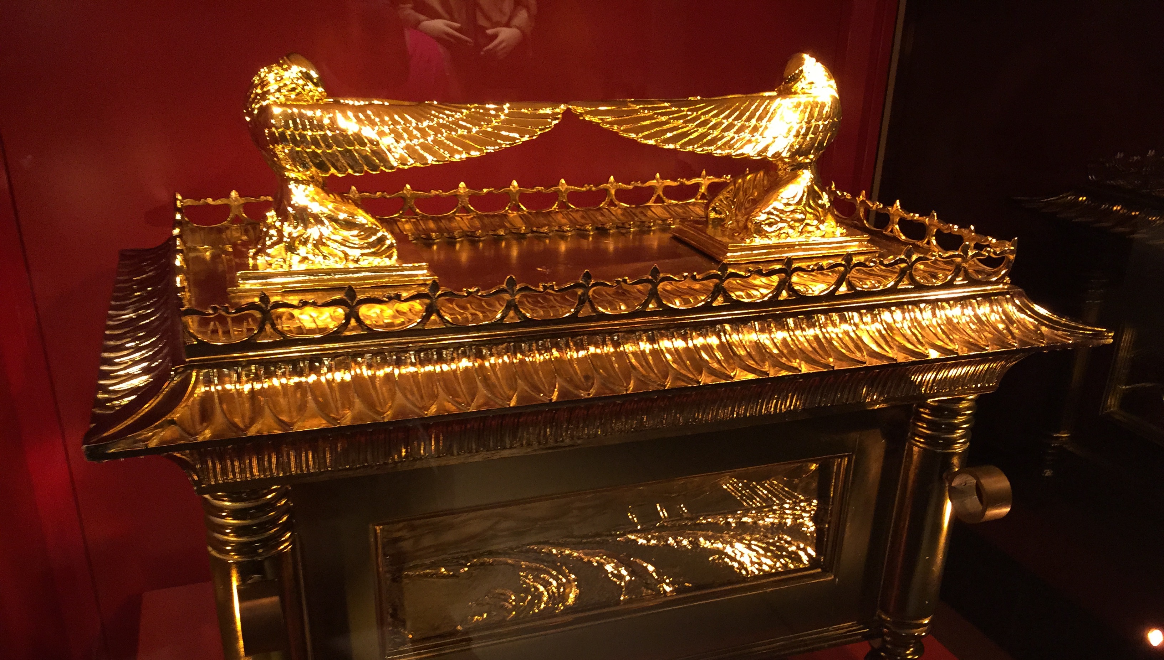
Most Holy Present Truth
Christian Hjortland
Blake Patterson

Slide 2
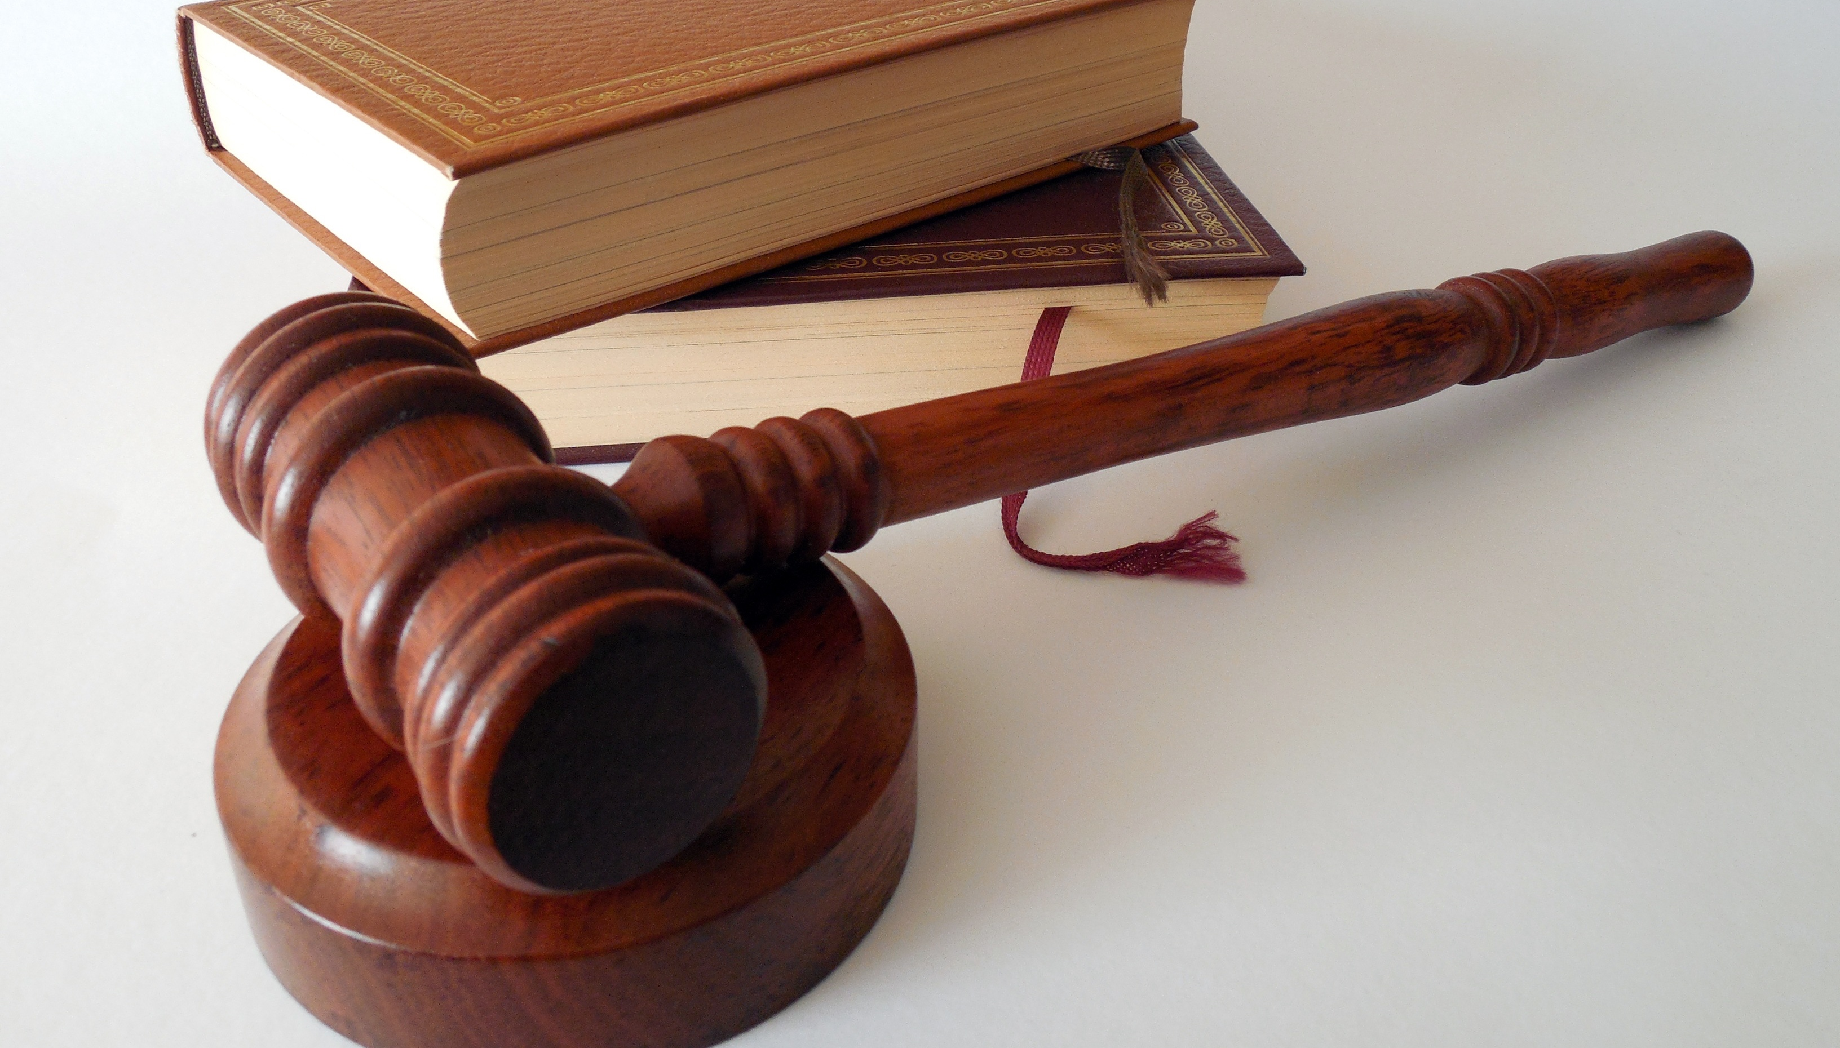

“And I saw another angel fly in the midst of heaven, having the everlasting gospel to preach unto them that dwell on the earth, and to every nation, and kindred, and tongue, and people,
Saying with a loud voice, Fear God, and give glory to him; for the hour of his judgment is come: and worship him that made heaven, and earth, and the sea, and the fountains of waters.
- Revelation 14:6-7
Daniel 7:9-10
1 Thessalonians 4:16-17
Revelation 22:11-12

Slide 3
Study about Truth
74% of Americans believe that “there is only one God, holy and perfect, who created the world.”
65% believe that “there is no such thing as absolute truth.”
Christianity Today, Sept 16, 1991, p. 48

Slide 4
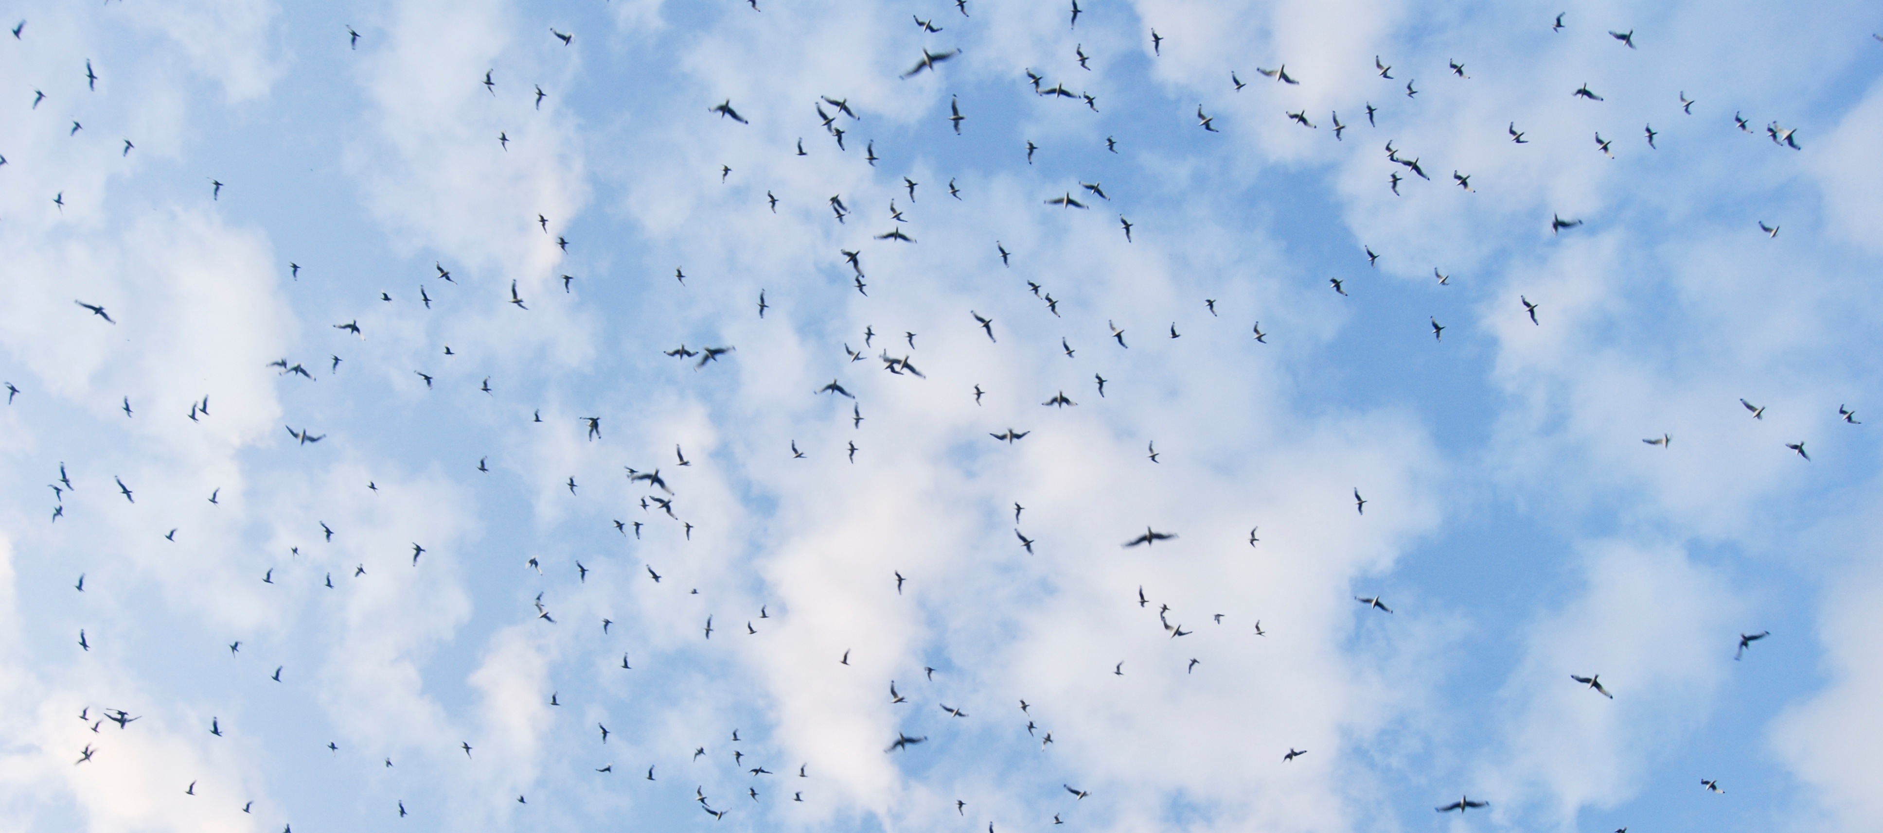
Before the Fall

Slide 5
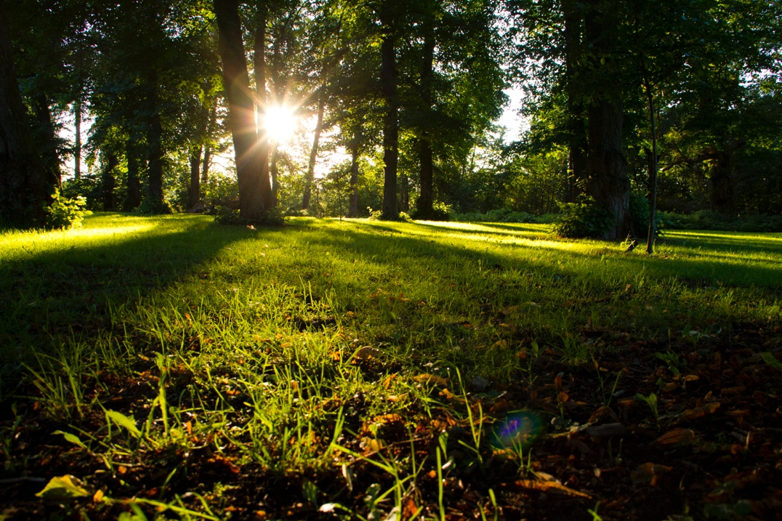
Before the Fall
”And the LORD God commanded the man, saying, Of every tree of the garden thou mayest freely eat: But of the tree of the knowledge of good and evil, thou shalt not eat of it: for in the day that thou eatest thereof thou shalt surely die.”
- Genesis 2:16

Slide 6
Before the Fall
Truth for this time:
- Free will.
- Great Controversy between good and evil.

Slide 7
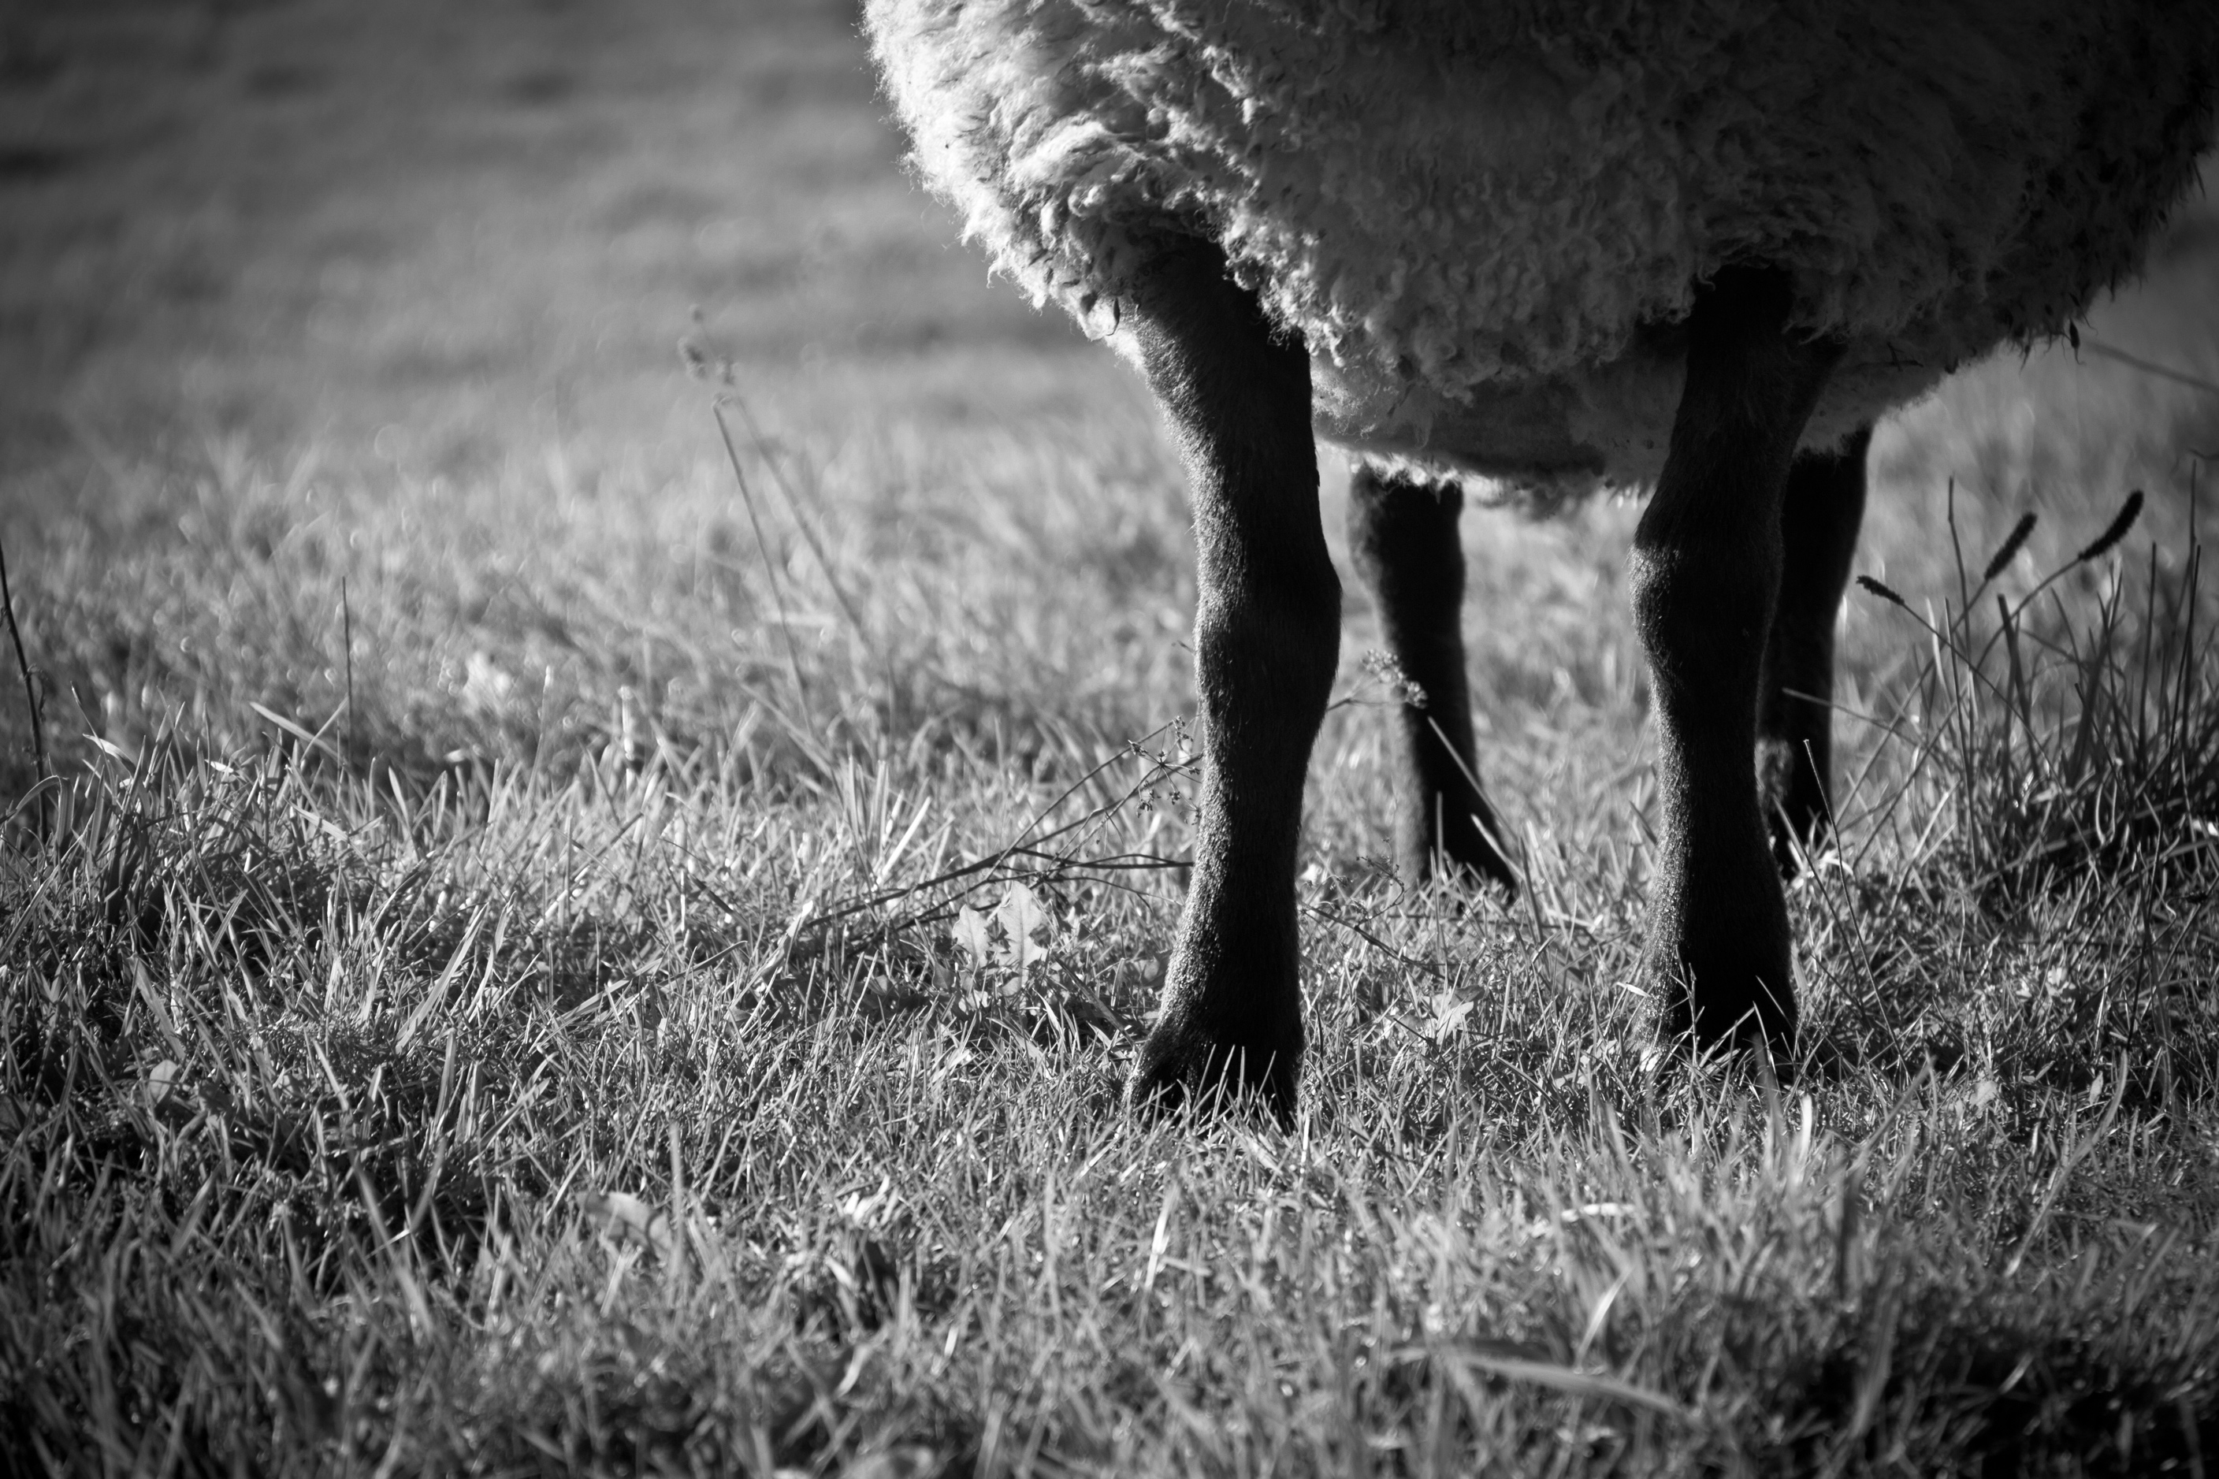
After the Fall
Sacrificial system
Cain vs. Abel
Genesis 4:3-5
Repentance

Slide 8
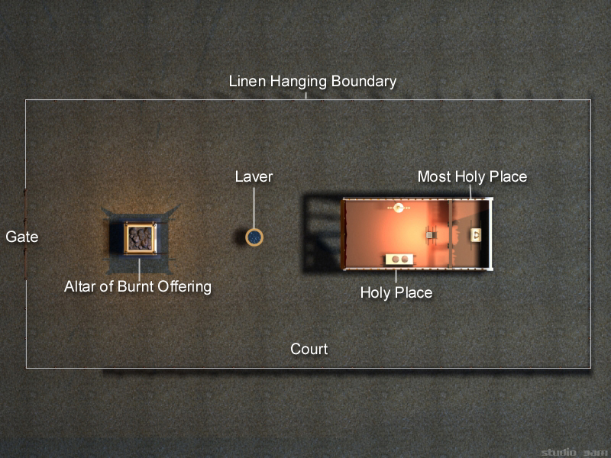

Slide 9
The Time after the Birth of Jesus
“I am the door: by me if any man enter in, he shall be saved, and shall go in and out, and find pasture. The thief cometh not, but for to steal, and to kill, and to destroy: I am come that they might have life, and that they might have it more abundantly. I am the good shepherd: the good shepherd giveth his life for the sheep.”
- John 10:9-11

Slide 10
The Time after the Birth of Jesus
1. The door 2. The altar of sacrifice 3. Laver Did God's people receive this message?
Who entered the court?

Slide 11
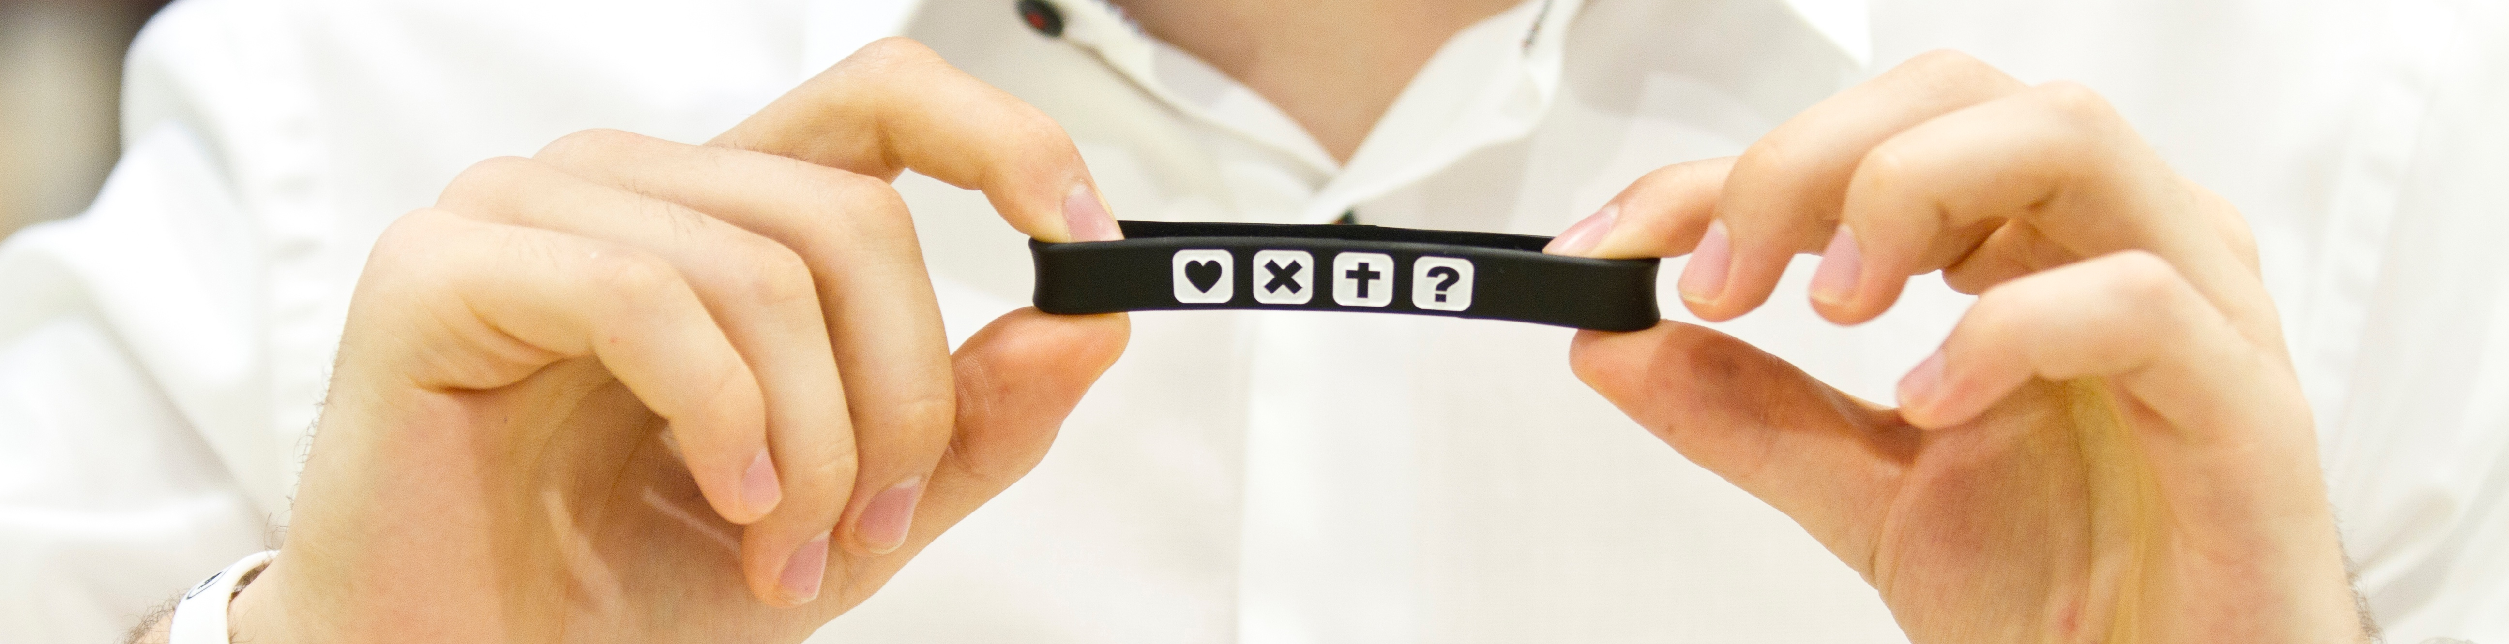
The Time after Jesus Left the Earth
Why so many different truths?

Slide 12
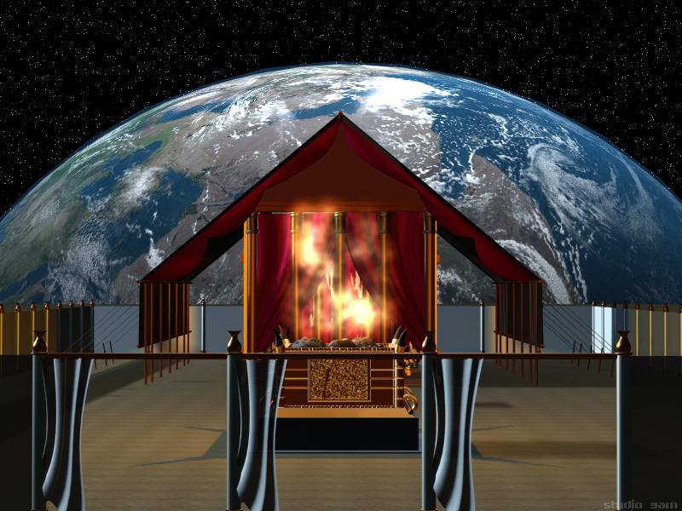
The Time after Jesus Left the Earth
”Thy way, O God, is in the sanctuary: who is so great a God as our God?”
- Psalms 77:14

Slide 13
The Time after Jesus Left the Earth
1. God's people is no longer limited to Israel as a nation
Matthew 10:5-7
Acts 1:8: ”But ye shall receive power, after that the Holy Ghost is come upon you: and ye shall be witnesses unto me both in Jerusalem, and in all Judæa, and in Samaria, and unto the uttermost part of the earth.”
Galatians 3:28: There is neither Jew nor Greek, there is neither bond nor free, there is neither male nor female: for ye are all one in Christ Jesus.
Acts 10, 13:46 – God reveals this for Peter and the disciples.
70 Weeks

Slide 14
The Time after Jesus Left the Earth
”The Jews who rejected the light given at Christ's first advent, and refused to believe on Him as the Saviour of the world, could not receive pardon through Him. When Jesus at His ascension entered by His own blood into the heavenly sanctuary to shed upon His disciples the blessings of His mediation, the Jews were left in total darkness to continue their useless sacrifices and offerings. The ministration of types and shadows had ceased. That door by which men had formerly found access to God was no longer open. The Jews had refused to seek Him in the only way whereby He could then be found, through the ministration in the sanctuary in heaven. Therefore they found no communion with God. To them the door was shut. They had no knowledge of Christ as the true sacrifice and the only mediator before God; hence they could not receive the benefits of His mediation.” {GC 430.2}

Slide 15
The Time after Jesus Left the Earth
2. The truth in the court was accepted – Jesus went into the Holy Place
“Neither by the blood of goats and calves, but by his own blood he entered in once into the holy place, having obtained eternal redemption for us.”
- Hebrews 9:12

Slide 16
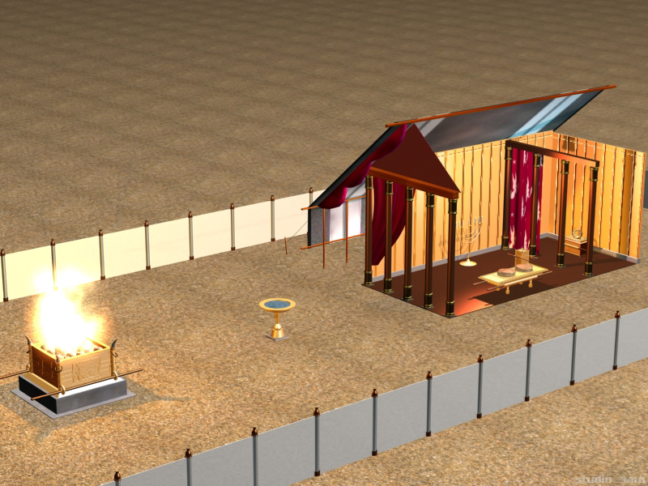
The Time after Jesus Left the Earth
1. God's people are those who have received Jesus.
2. The truth in the court was accepted by God's people, and they followed Jesus into the Holy place, by faith.
3. A sanctified life.

Slide 17
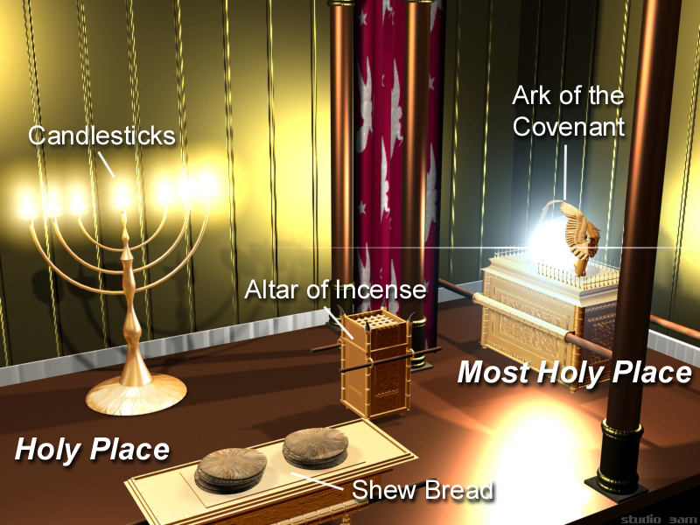

Slide 18
The Time of Today

Slide 19
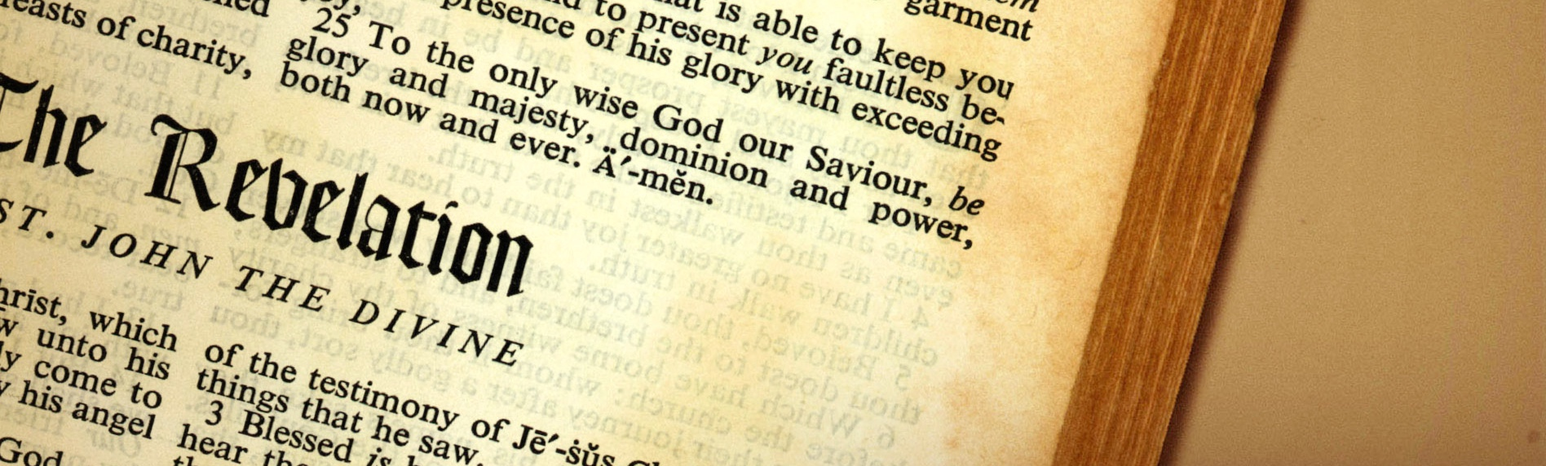
The Time of Today
Revelation 3:7-13

Slide 20
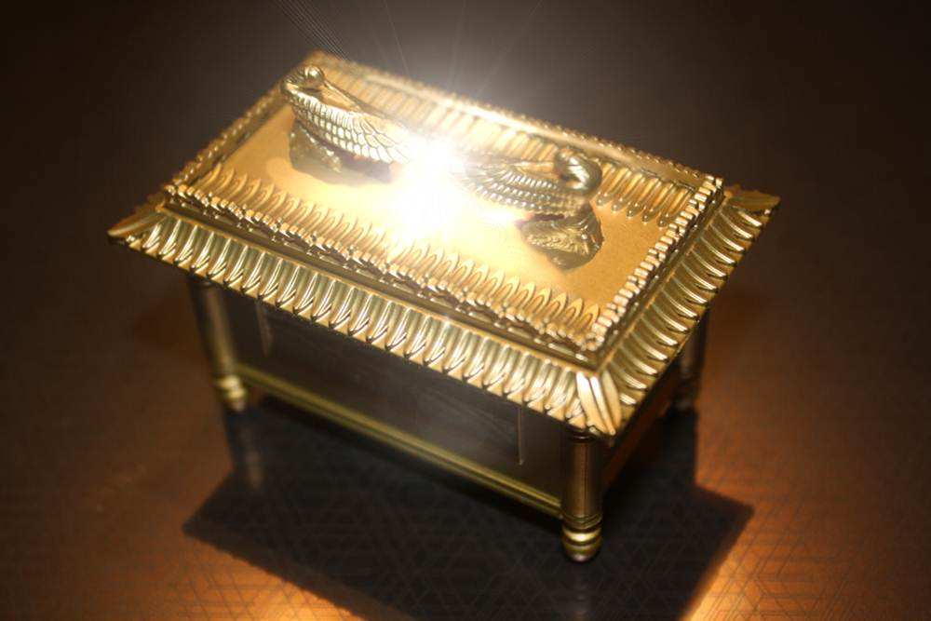
Present Truth
“And he said unto me, Unto two thousand and three hundred days; then shall the sanctuary be cleansed.”
- Daniel 8:14

Slide 21
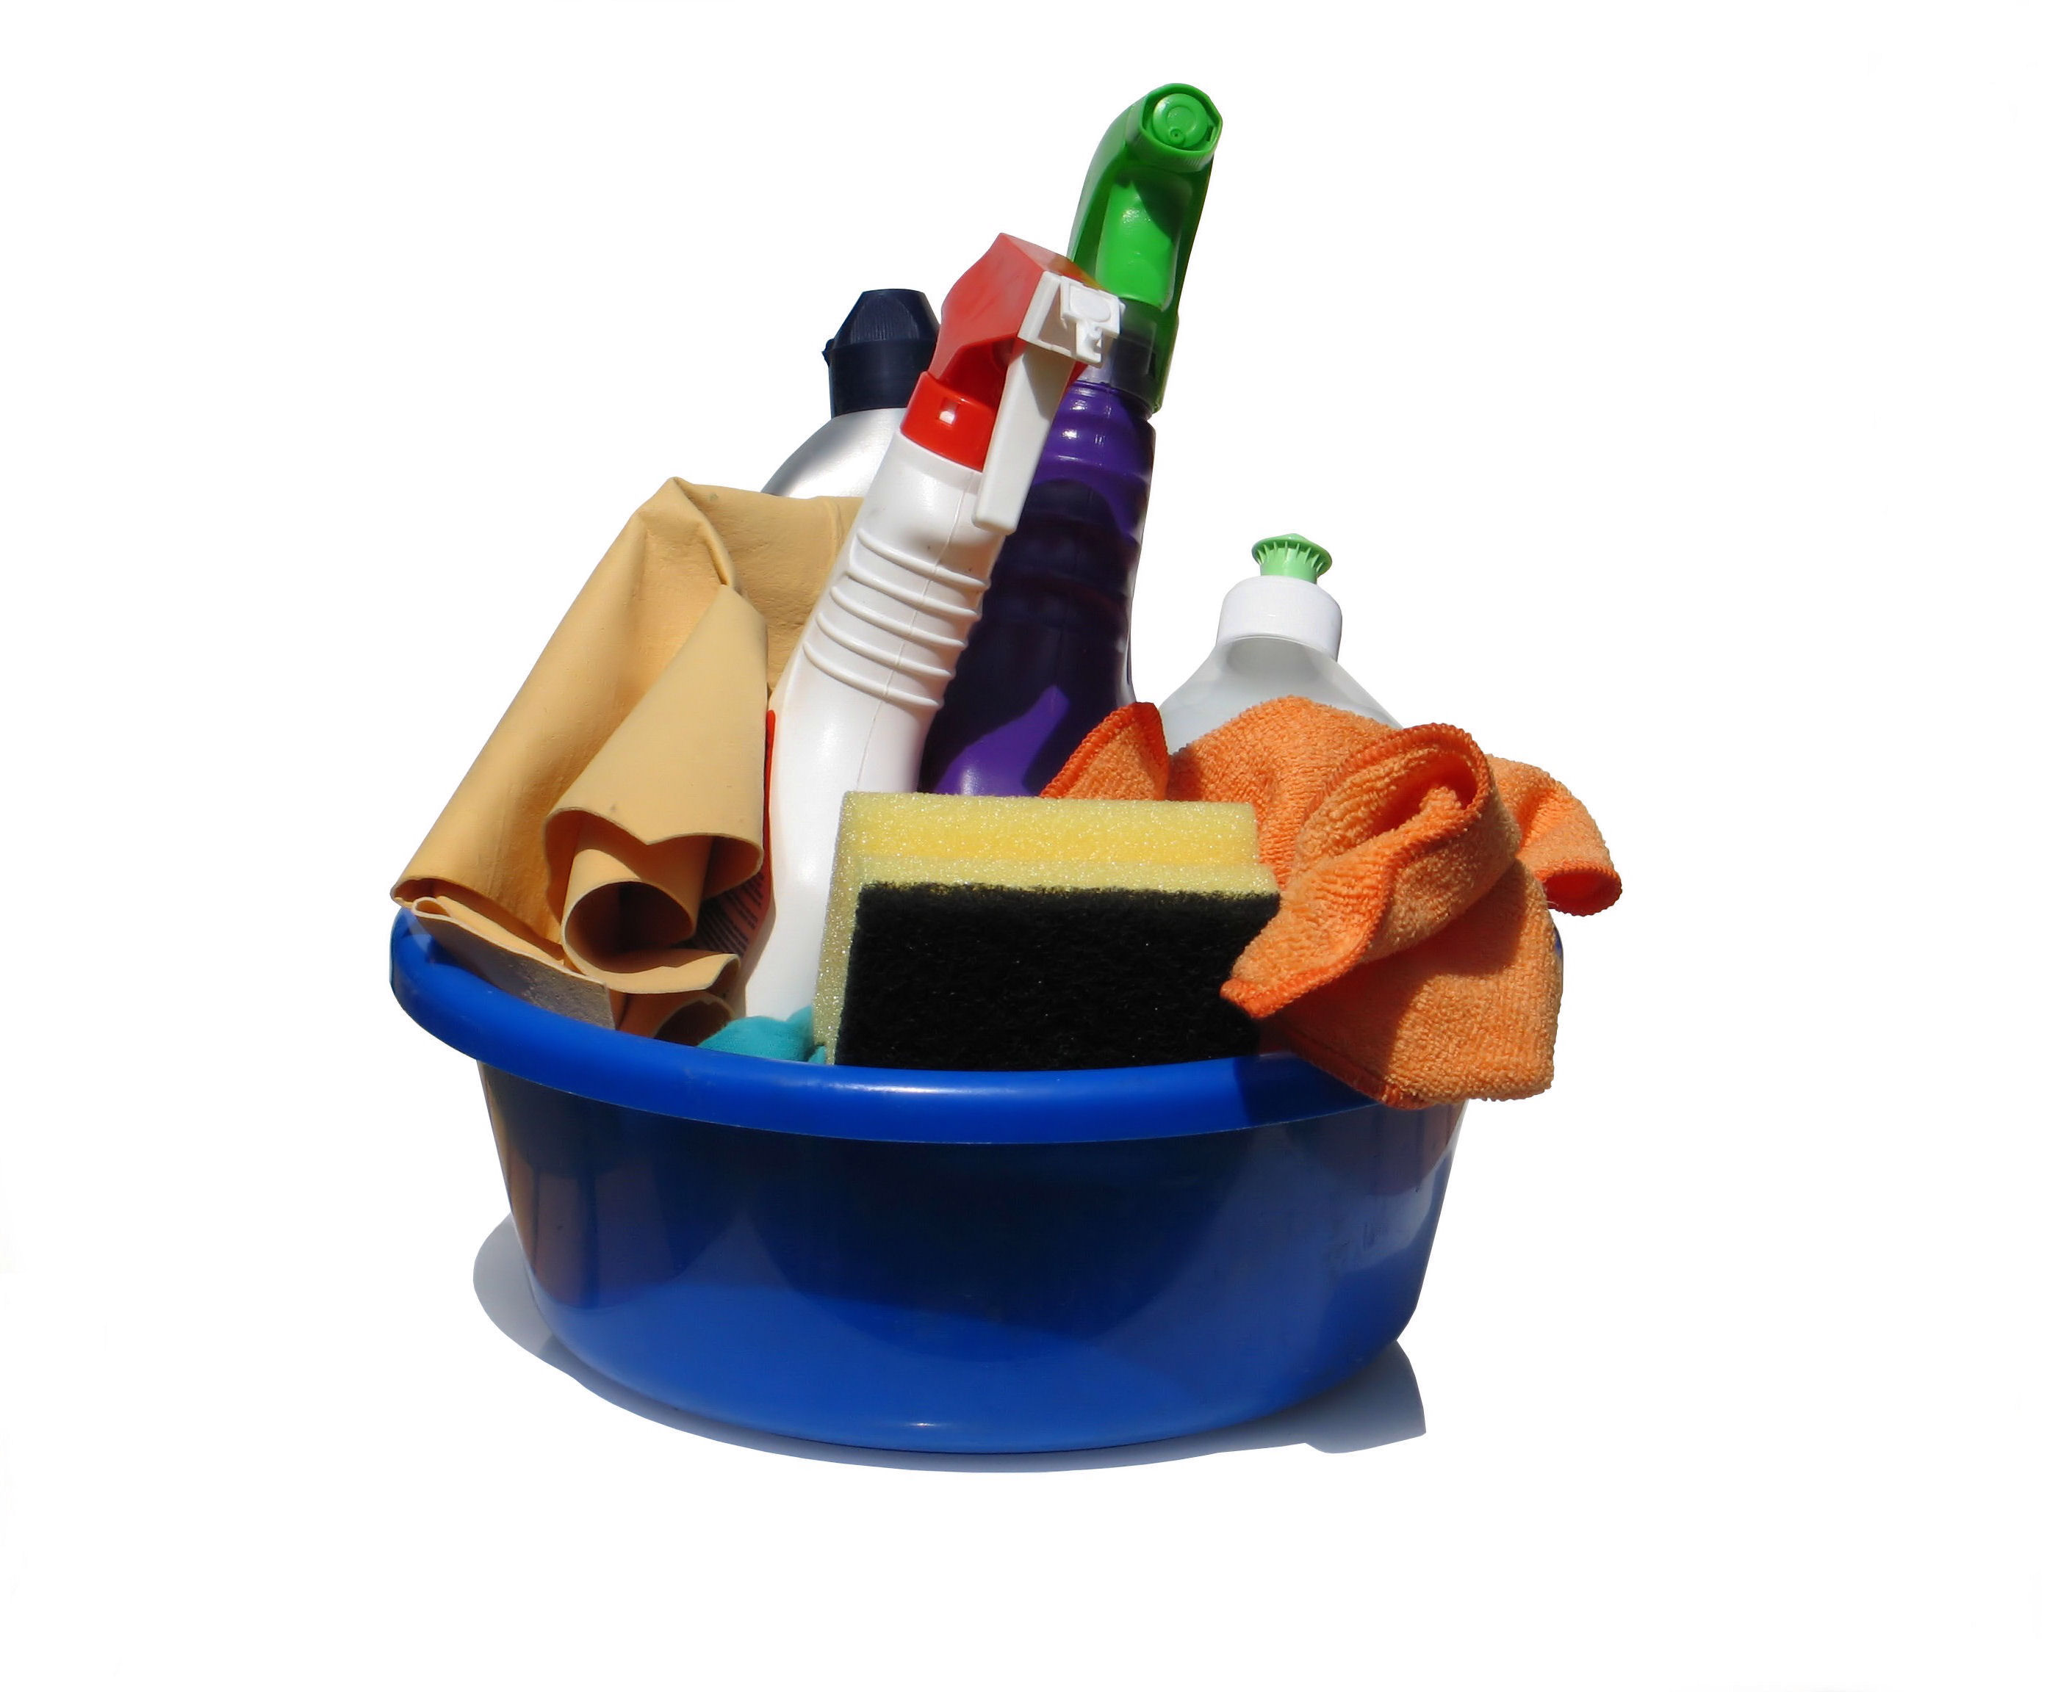
Present Truth
Photo: Sanja Gjenero

Slide 22
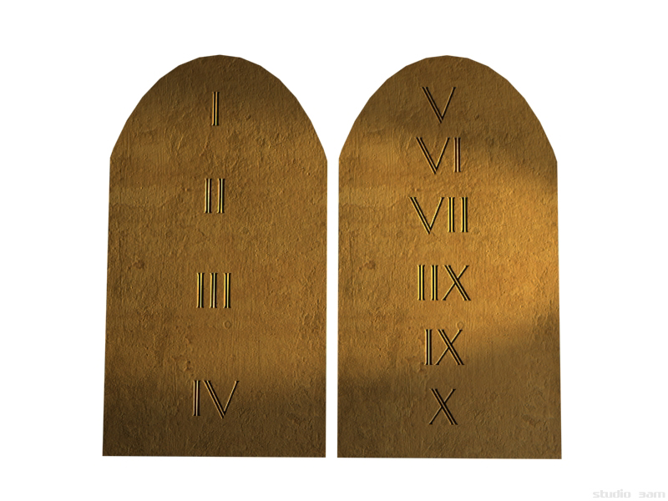
Present Truth: Ten Commandments
2. The ten commandments
Revelation 14:12

Slide 23
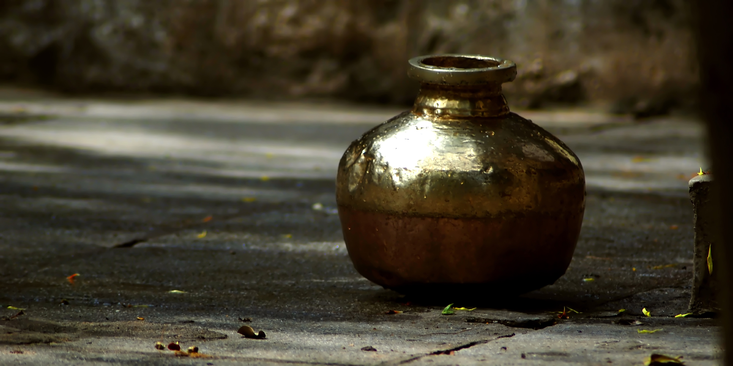
Present Truth
Manna – Exodus 16:4-5, 20-23
Vivek Chugh

Slide 24
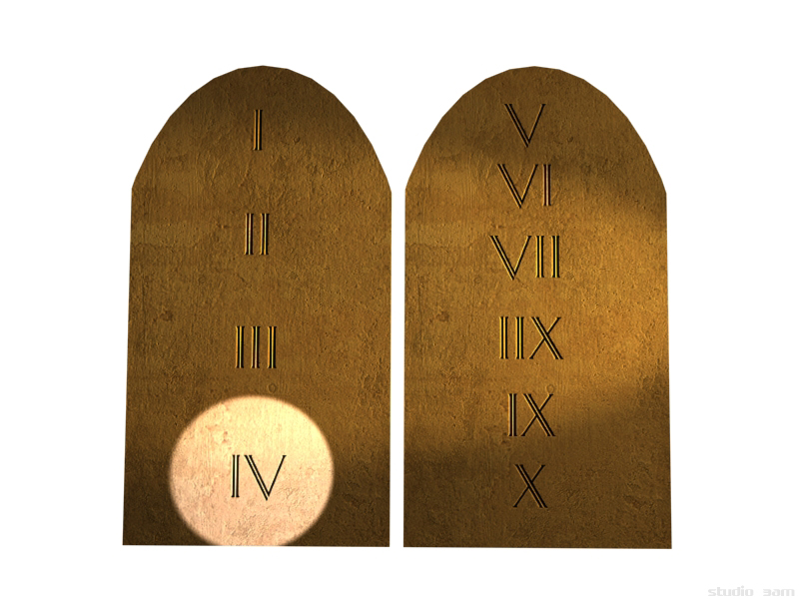
Present Truth: The Sabbath
3. The Sabbath Ezekiel 20:12: Moreover also I gave them my sabbaths, to be a sign between me and them, that they might know that I am the Lord that sanctify them.

Slide 25
Present Truth
Manna
Vivek Chugh

Slide 26
Present Truth
4. The Health Message ”I must now give to my brethren the instruction that the Lord has given me in regard to the health food question. By many the health foods are looked upon as of man's devising, but they are of God's originating, as a blessing to His people. The health food work is the property of God, and is not to be made a financial speculation for personal gain. The light that God has given and will continue to give on the food question is to be to His people today what the manna was to the children of Israel. The manna fell from heaven, and the people were told to gather it, and prepare it to be eaten. So in the different countries of the world, light will be given to the Lord's people, and health foods suited to these countries will be prepared.» {CD 269.1}

Slide 27
Present Truth
Aarons rod
Numbers 17:1-5, 8, 10
Psalms 2:9: ”Thou shalt break them with a rod of iron; thou shalt dash them in pieces like a potter's vessel.”
Isaiah 11:4: ”But with righteousness shall he judge the poor, and reprove with equity for the meek of the earth: and he shall smite the earth with the rod of his mouth, and with the breath of his lips shall he slay the wicked.”
Almonds

Slide 28

Present Truth
5. Judgment (Gods Authority)
Daniel 8:14 Yom Kippur

Slide 29
Present Truth
1. Overcoming Sin
2. The 10 Commandments
3. The Sabbath
4. The Health Message
5. Judgment (God's Authority)
6. The State of the Dead

Slide 30
Present Truth
1. Overcoming Sin
2. The 10 Commandments
3. The Sabbath
Do we find these truths in Revelation 14?
1. Fear God...
Give Him glory
Worship him
2. Babylon is fallen (Did not enter the Most Holy Place)
3. Keep the commandments of God
4. The Health Message
5. Judgment (God's Authority)
6. The State of the Dead

Slide 31
Present Truth
”The enemies of the present truth have been trying to open the door of the holy place, that Jesus has shut, and to close the door of the most holy place, which He opened in 1844, where the ark is, containing the two tables of stone on which are written the ten commandments by the finger of Jehovah... Satan is now using every device in this sealing time to keep the minds of God's people from the present truth and to cause them to waver. I saw a covering that God was drawing over His people to protect them in the time of trouble; and every soul that was decided on the truth and was pure in heart was to be covered with the covering of the Almighty.” {EW 43}

Slide 32
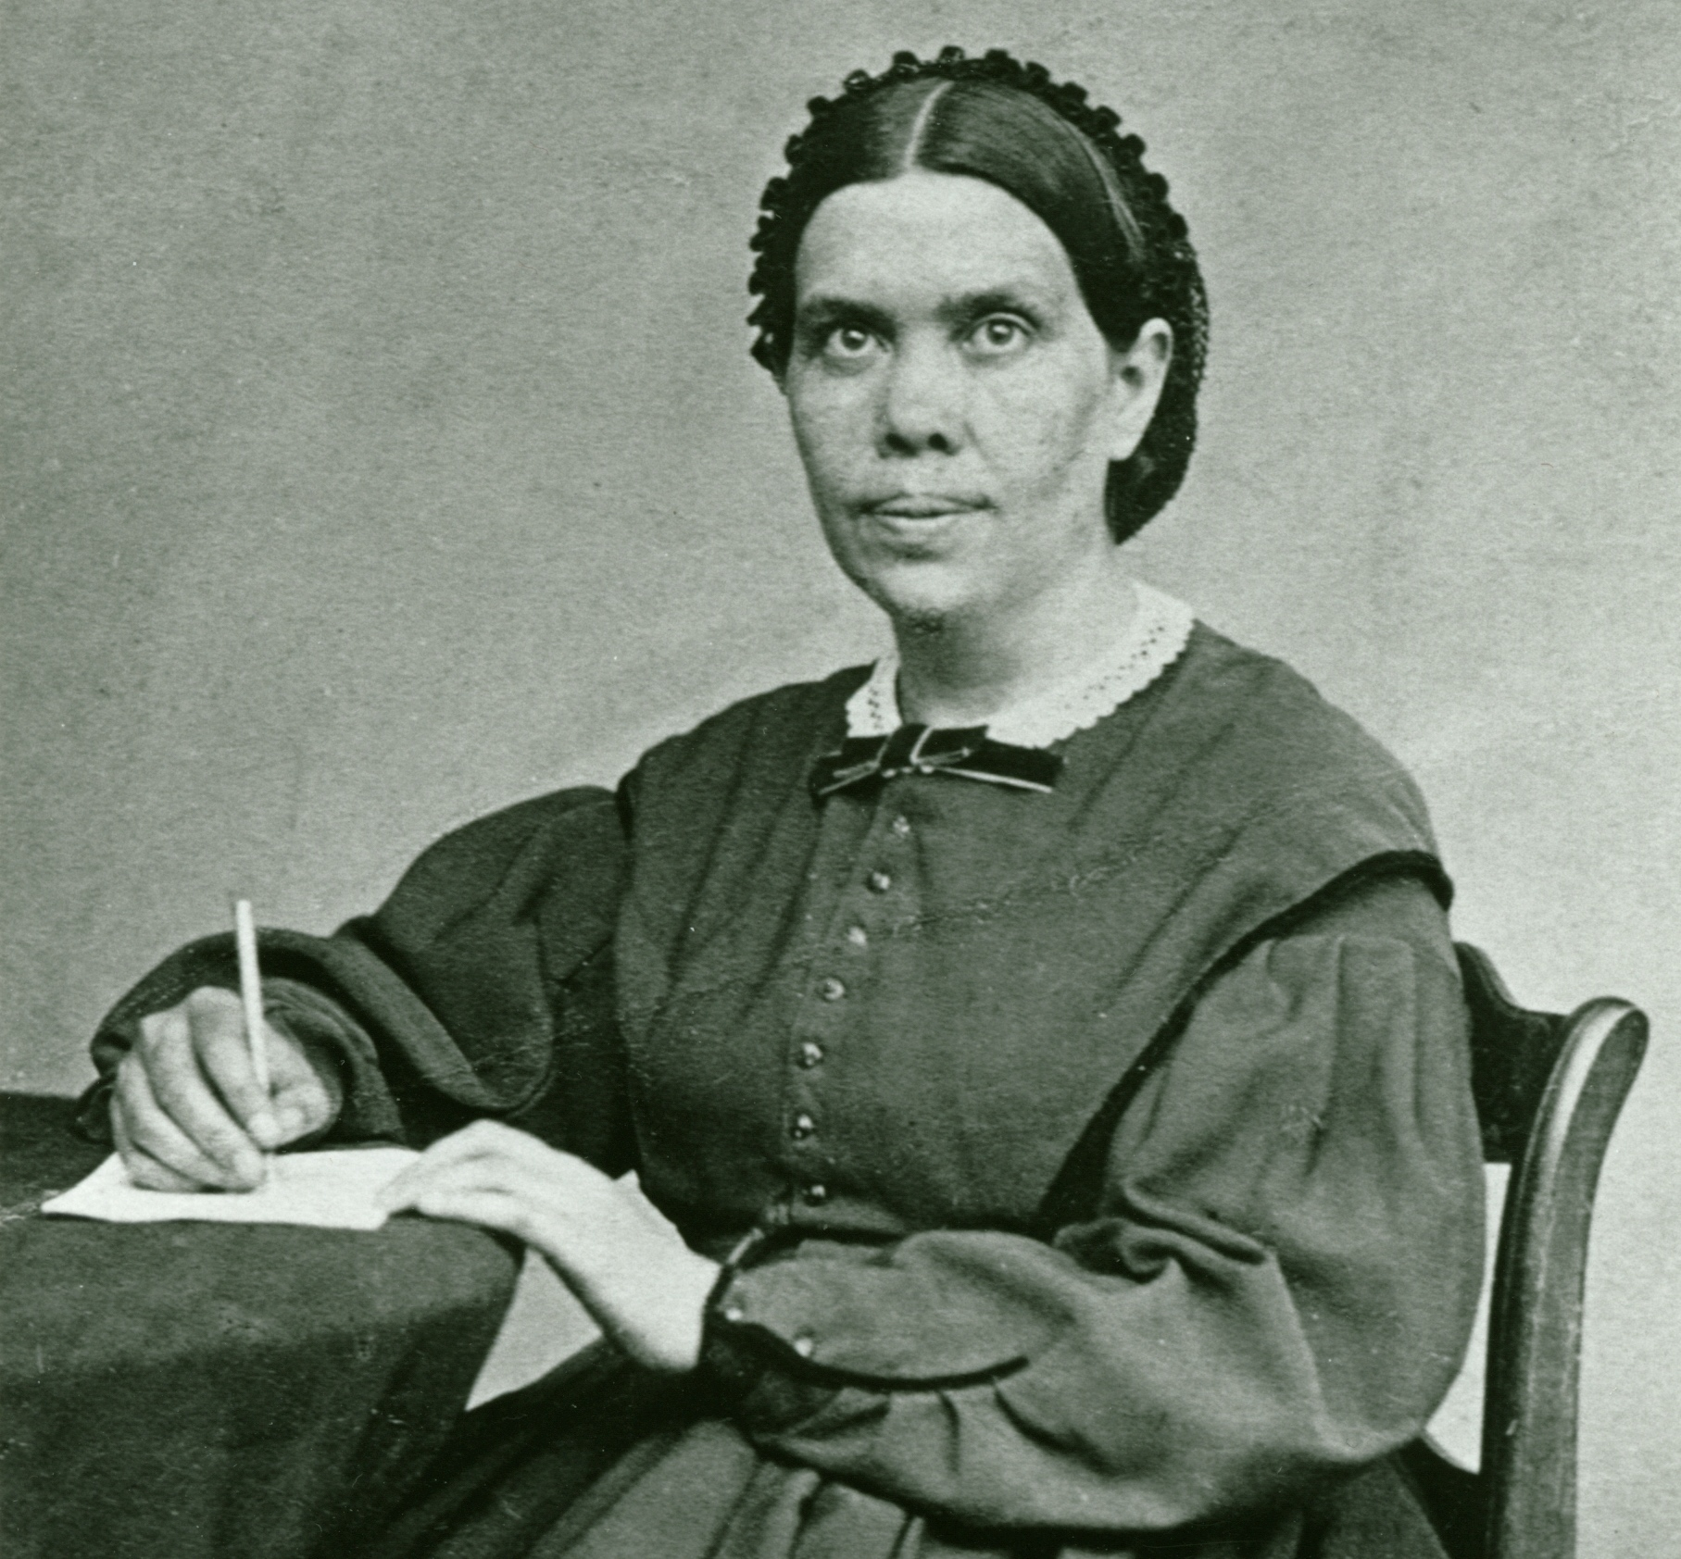
Present Truth

Slide 33
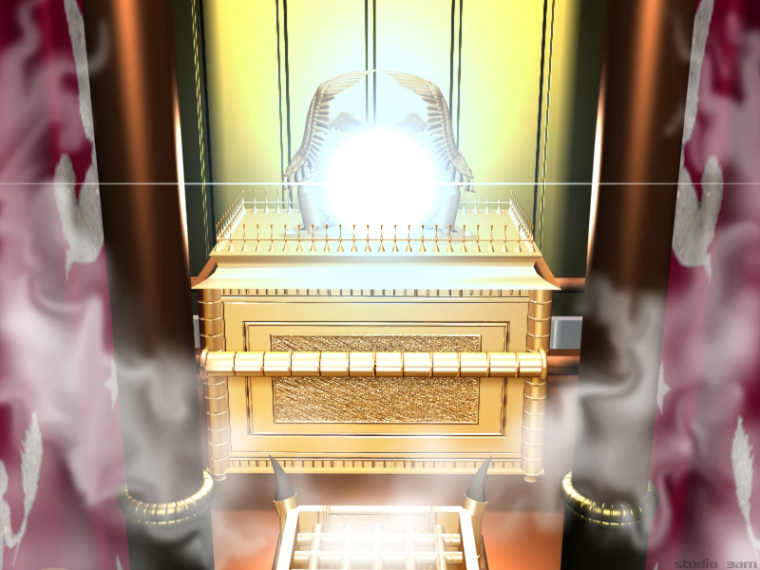

Slide 34
Questions for Reflection
What was God’s mission for Israel?
Why did Israel fail to fulfill God’s ideal plan for them?
What does it mean to be a spiritual Israelite?
According to the pattern of the sanctuary, where is God ultimately trying to lead us back to?
Why is it important to understand the sanctuary blueprint?
What was the purpose of the Reformation? How did Satan seek to stop the Reformation?

