Slide 1

Truth Cast Down, but Restored! Christian Hjortland
Moonchilde-Stock

Slide 2

Introduction
Daniel 7
Daniel 8 – The Little horn
“And let them make me a sanctuary; that I may dwell among them.”
- Exodus 25:8 “Thy way, O God, is in the sanctuary: who is so great a God as our God?”
Psalms 77:13
Two services in the Sanctuary

Slide 3
Truth Cast Down
“Yea, he magnified himself even to the prince of the host, and by him the daily sacrifice was taken away, and the place of his sanctuary was cast down.”
- Daniel 8:11
The word continual
Bread - Numbers 4:7
Lamp - Exodus 27:20
Fire – Leviticus 6:13
Incense – Exodus 30:7,8
What was the priests job?

Slide 4
What did the Little Horn Remove?
Christ as our only mediator
“The pope takes the place of Jesus Christ on earth. ... By divine right the pope has supreme and full power in faith, in morals over each and every pastor and his flock. He is the true vicar, the head of the entire church, the father and teacher of all Christians. He is the infallible ruler, the founder of dogmas, the author of and the judge of councils; the universal ruler of truth, the arbiter of the world, the supreme judge of heaven and earth, the judge of all, being judged by no one, God himself on earth.” - The New York Catechism

Slide 5
1. Christ the Only Mediator Cast Down
“Have no fear when people call me the "Vicar of Christ," when they say to me "Holy Father," or "Your Holiness," or use titles similar to these, which seem even inimical [cause harm] to the Gospel”- Pope John Paul II (1995) Cardinal Sarto, who became Pope Pius X: “The Pope is not only the representative of Jesus Christ, but he is Jesus Christ Himself hidden under the veil of the flesh. Does the Pope speak? It is Jesus Christ who speaks.”

Slide 6
1. Christ the Only Mediator Cast Down
The Bible says: “For there is one God, and one mediator between God and men, the man Christ Jesus.”
- 1 Timothy 2:5

Slide 7
2. The Altar of Sacrifice Cast Down
Sacraments/Penances
Paying indulgences
Ceremonies
Martin Luther
Pilgrim Routes
The Bible says: Mark 2:7: Why doth this man thus speak blasphemies? who can forgive sins but God only?

Slide 8
2. The Altar of Sacrifice Cast Down
“The priest has the power of the keys, or power of delivering sinners from hell, of making them worthy of paradise. And God himself is obliged to abide by the judgment of his priests.”
- Dignities and Duties of a Priest, by Liguori, p. 27 The Bible says: Revelation 1:18: I am he that liveth, and was dead; and, behold, I am alive for evermore, Amen; and have the keys of hell and of death. John 5:22: “For the father judges no one, but has committed all judgment to the Son.”

Slide 9
3. The Laver Cast Down
Child baptism - sprinkling
“And John also was baptizing in Aenon near to Salim, because there was much water there: and they came, and were baptized.”
- John 3:23 “Therefore we are buried with him by baptism into death: that like as Christ was raised up from the dead by the glory of the Father, even so we also should walk in newness of life.
Knowing this, that our old man is crucified with him, that the body of sin might be destroyed, that henceforth we should not serve sin.
- Romans 6:4, 6

Slide 10
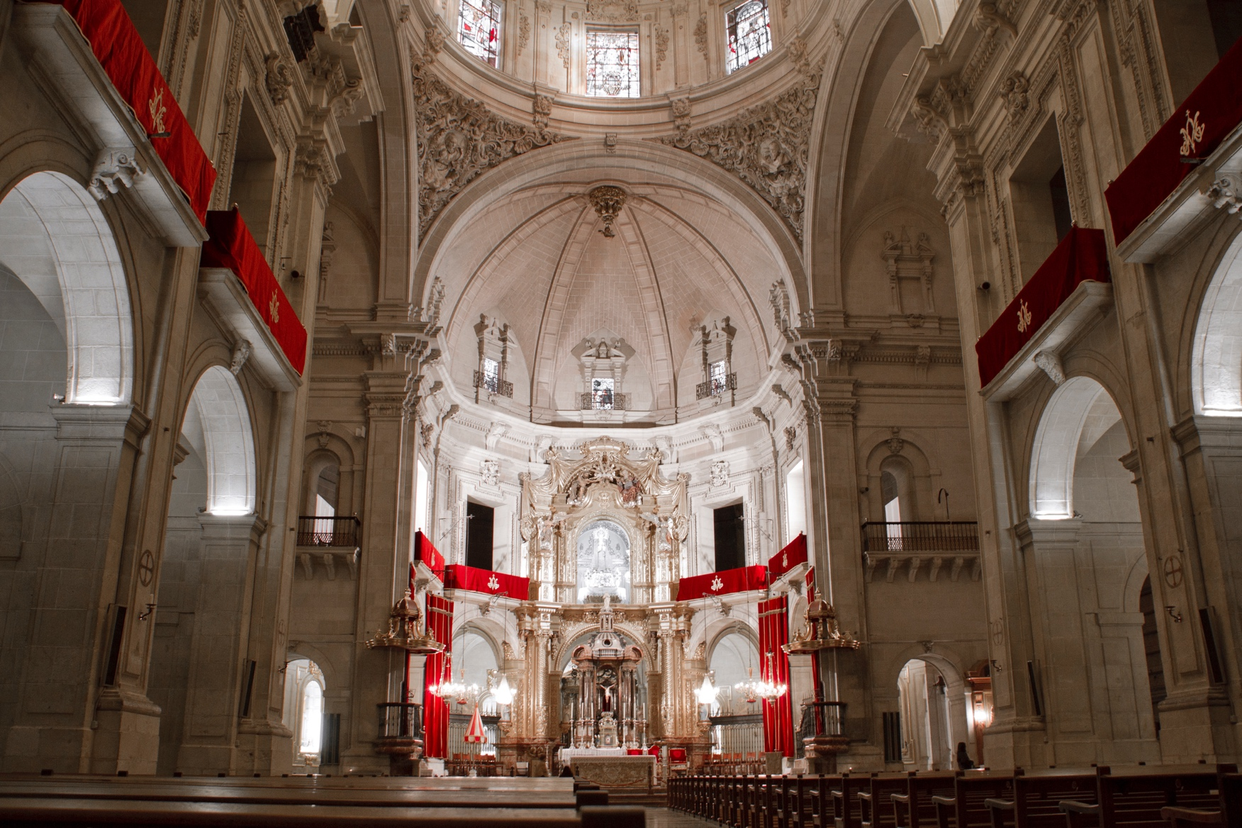
4. The Table of Showbread Cast Down
1229 – The Bible Forbidden
1546 – A confirmation and punishment
1713 – Another prohibition
Result: Trust in the priest/Church.

Slide 11
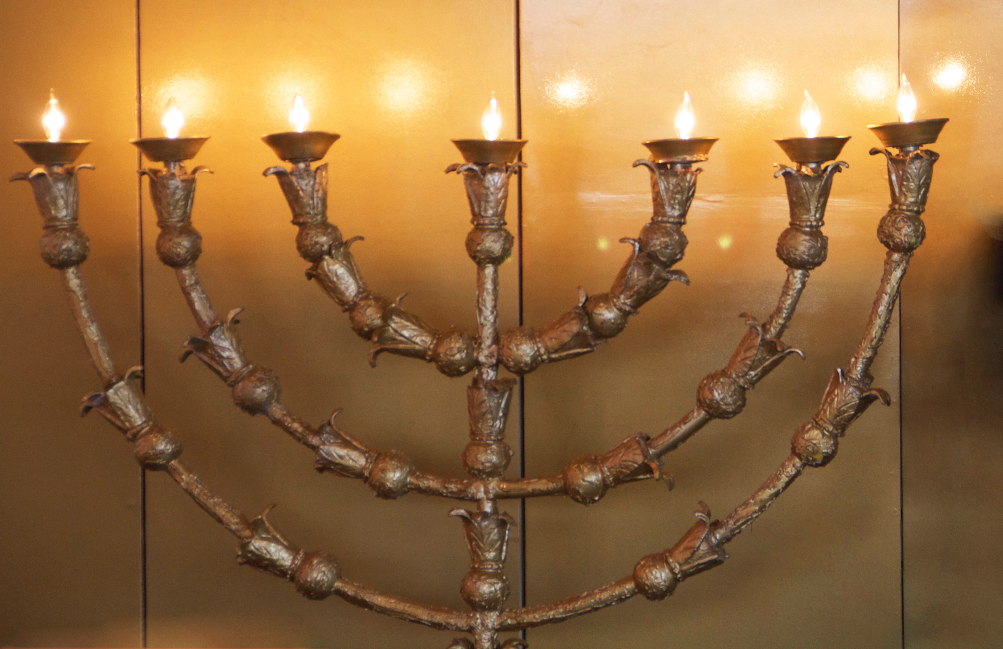
5. The Candlestick Cast Down

Slide 12
6. The Altar of Incense Cast Down
“The poor sinner kneels at his confessor’s feet. He knows he is not speaking to an ordinary man but to another christ. He hears the words, ‘I absolve thy sins’ and the hideous load of sins drops from his soul forever”
- William Doyle, Shall I Be a Priest, pp. 14, 15
The Bible says: John 16:23:...Verily, verily, I say unto you, Whatsoever ye shall ask the Father in my name, he will give it you.

Slide 13
What else was Cast Down?
Daniel 8:11,12 – The place of his sanctuary + truth
John 17:17 – God’s Word is truth
John 14:6 – Jesus is the truth
“And he opened his mouth in blasphemy against God, to blaspheme his name, and his tabernacle, and them that dwell in heaven.”
- Revelation 13:6

Slide 14
The Ten Commandments Cast Down
Psalms 119:142 – Your law is the truth
“And he shall speak great words against the most High, and shall wear out the saints of the most High, and think to change times and laws: and they shall be given into his hand until a time and times and the dividing of time.”
- Daniel 7:25

Slide 15
The Ten Commandments Cast Down
“The pope has power to change times, to abrogate laws, and to dispense with all things, even the precepts of Christ” - Decretal, de Tranlatic Episcop
“The Church changed the observance of the Sabbath to Sunday by right of the divine, infallible authority given to her by her founder, Jesus Christ. The Protestant claiming the Bible to be the only guide of faith has no warrant for observing Sunday”
- The Catholic Universe Bulletin, August 14, 1942, p. 4

Slide 16
The Ten Commandments Cast Down
Exodus 20:4,5: “Thou shalt not make unto thee any graven image, or any likeness of any thing that is in heaven above, or that is in the earth beneath, or that is in the water under the earth: Thou shalt not bow down thyself to them, nor serve them: for I the Lord thy God am a jealous God…” Exodus 20:8,10: “Remember the sabbath day, to keep it holy…the Seventh Day is the sabbath of the Lord thy God…”
Matthew 12:8: “For the Son of man is Lord even of the sabbath day.”

Slide 17
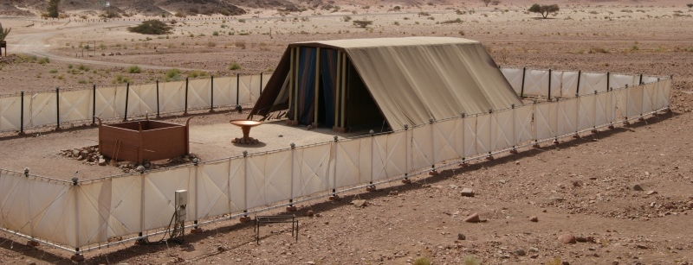
The Truth Restored!
1300’s – John Wycliffe – The Bible
1500’s – Martin Luther – Jesus’ Sacrifice
1500’s – John Calvin – Prayer / Direct Access
1600’s – John Smyth – Baptism
1700’s – John Wesley – Witnessing
Photo: Ruk7

Slide 18
How Long was the Sanctuary to be Cast Down?
“Then I heard one saint speaking, and another saint said unto that certain saint which spake, How long shall be the vision concerning the daily sacrifice, and the transgression of desolation, to give both the sanctuary and the host to be trodden under foot?
And he said unto me, Unto two thousand and three hundred days; then shall the sanctuary be cleansed.”
- Daniel 8:13-14

Slide 19

The Last Truths Restored!
1800’s – Seventh-Day Adventist Church
The Law and the Sabbath was restored

