Slide 1
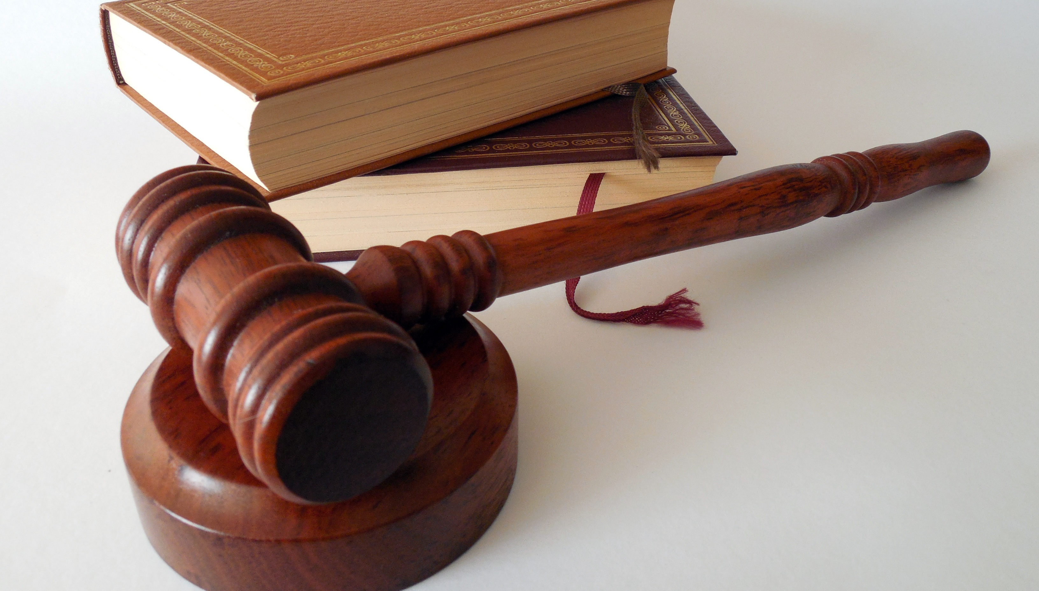
The Good News about the Judgment
Christian Hjortland

Slide 2

When does the Judgment start?
“And I saw another angel fly in the midst of heaven, having the everlasting gospel to preach unto them that dwell on the earth, and to every nation, and kindred, and tongue, and people,
Saying with a loud voice, Fear God, and give glory to him; for the hour of his judgment is come: and worship him that made heaven, and earth, and the sea, and the fountains of waters.
- Revelation 14:6-7
Daniel 7:9-10
1 Thessalonians 4:16-17
Revelation 22:11-12

Slide 3
Who is judged, and who is involved?
Leader of the court: God, the Father (Dan 7:9-10)
Accuser: Satan: (Rev 12:9-10)
Lawyer: Jesus (1 John 2:1)
Judge: Jesus (John 5:22)
Witness: Jesus and the Holy Spirit (Rev 3:14, Romans 8:16)

Slide 4
The Investigative and Executive Judgment
“For the time is come that judgment must begin at the house of God: and if it first begin at us, what shall the end be of them that obey not the gospel of God?”
- 1 Peter 4:17
“For I think that God hath set forth us the apostles last, as it were appointed to death: for we are made a spectacle unto the world, and to angels, and to men.”
- 1 Corinthians 4:9
Revelation 20:7,9

Slide 5
How will the Sanctuary Get cleansed?
Leviticucs 16:29-34
“The first ten days of Tishri grew to be the ten penitential days of the year, intended to bring about a perfect change of heart, and to make Israel like newborn creatures. . . . the culmination being reached on the Day of Atonement when religion's greatest gift, God's condoning mercy, was to be offered to man.”
- Jewish Encyclopedia, article “Atonement, Volume 2, page 281.

Slide 6
How will the Sanctuary Get cleansed?
“God, seated on His throne to judge the world, at the same time judge, Pleader, Expert, and Witness, opens the Book of Records; it is read, every man's signature being found therein. The great trumpet is sounded; a still, small voice is heard; the angels shudder, saying, this is the day of judgment: for His very ministers are not pure before God. As a shepherd musters his flock, causing them to pass under his rod, so does God cause every living soul to pass before Him to fix the limit of every creature's life and to foreordain its destiny. On New Year's Day the decree is written; on the Day of Atonement it is sealed who shall live and who are to die, etc. But penitence, prayer, and charity may avert the evil decree.”
- Jewish Encyclopedia, article “Atonement, Volume 2, Page 286
.

Slide 7
How will the Sanctuary Get cleansed?
“And I saw the dead, small and great, stand before God; and the books were opened: and another book was opened, which is the book of life: and the dead were judged out of those things which were written in the books, according to their works.”
- Revelation 20:12

Slide 8
The Sacrifice on the Day of Atonement
Leviticus 16:5 – Two goats
Leviticus 16:12-14 – The priest’s sin offering
What is the difference between the scape goat and the Lord’s goat?
Leviticus 16:15-16
– A cleansing of things + a cleansing of people.
Leviticus 23:29 – A cutting off…

Slide 9
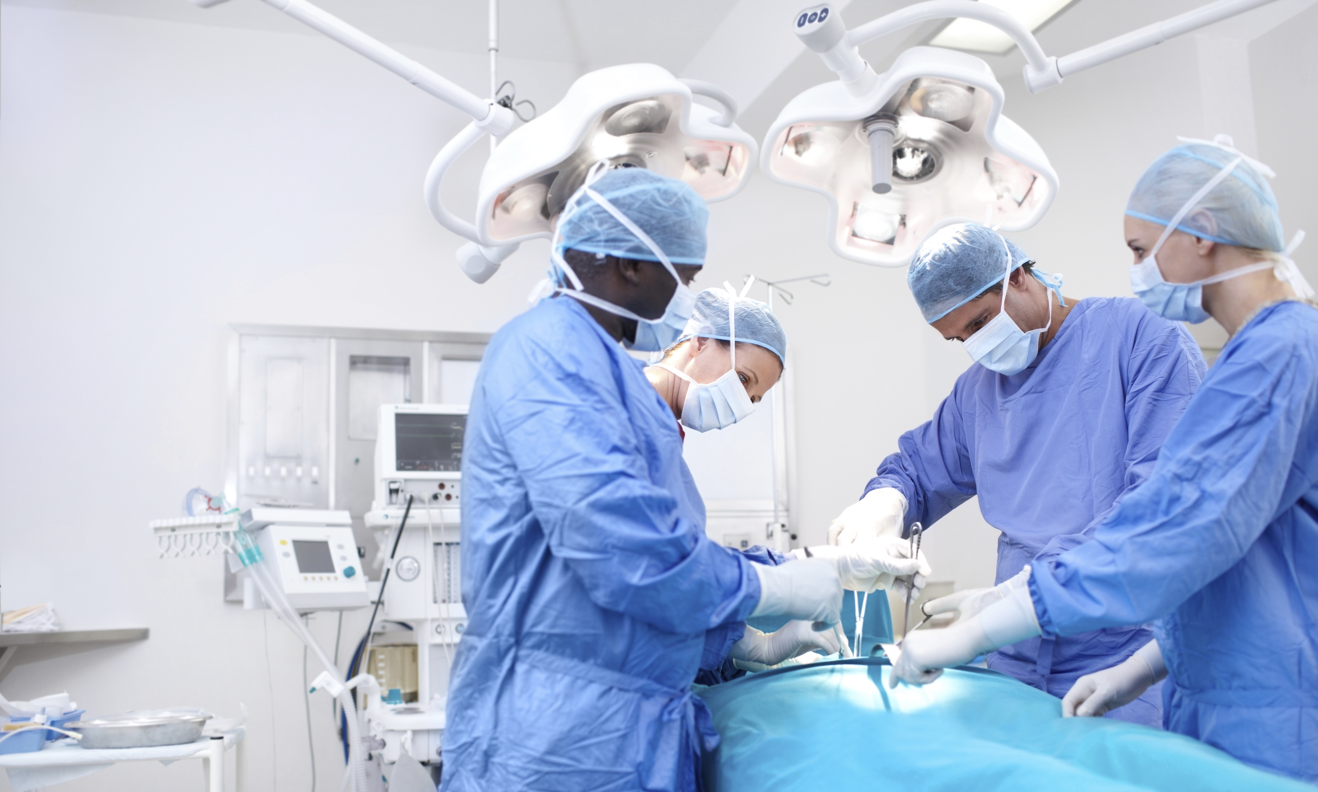

Slide 10
The Heavenly Sanctuary
2300 days
Hebrews 9:11-12 – Christ entered into the Holy Place.
Heb 8:1-5 – The Main thing
“It was therefore necessary that the patterns of things in the heavens should be purified with these; but the heavenly things themselves with better sacrifices than these.”
- Hebrews 9:23
“And he said unto me, Unto two thousand and three hundred days; then shall the sanctuary be cleansed.”
- Daniel 8:14

Slide 11
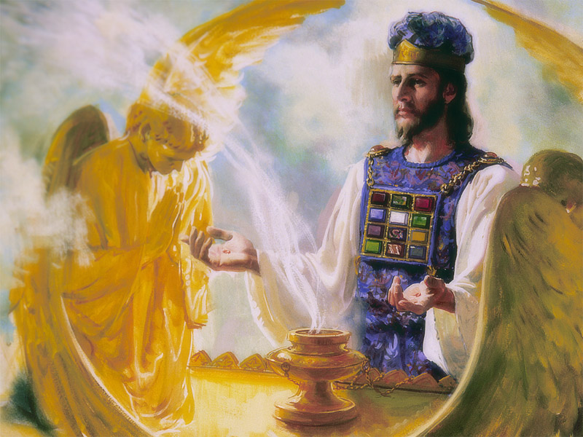
The Heavenly Sanctuary
“The intercession of Christ in man's behalf in the sanctuary above is as essential to the plan of salvation as was His death upon the cross. By His death He began that work which after His resurrection He ascended to complete in heaven.” {GC 489.1}

Slide 12
