Slide 1
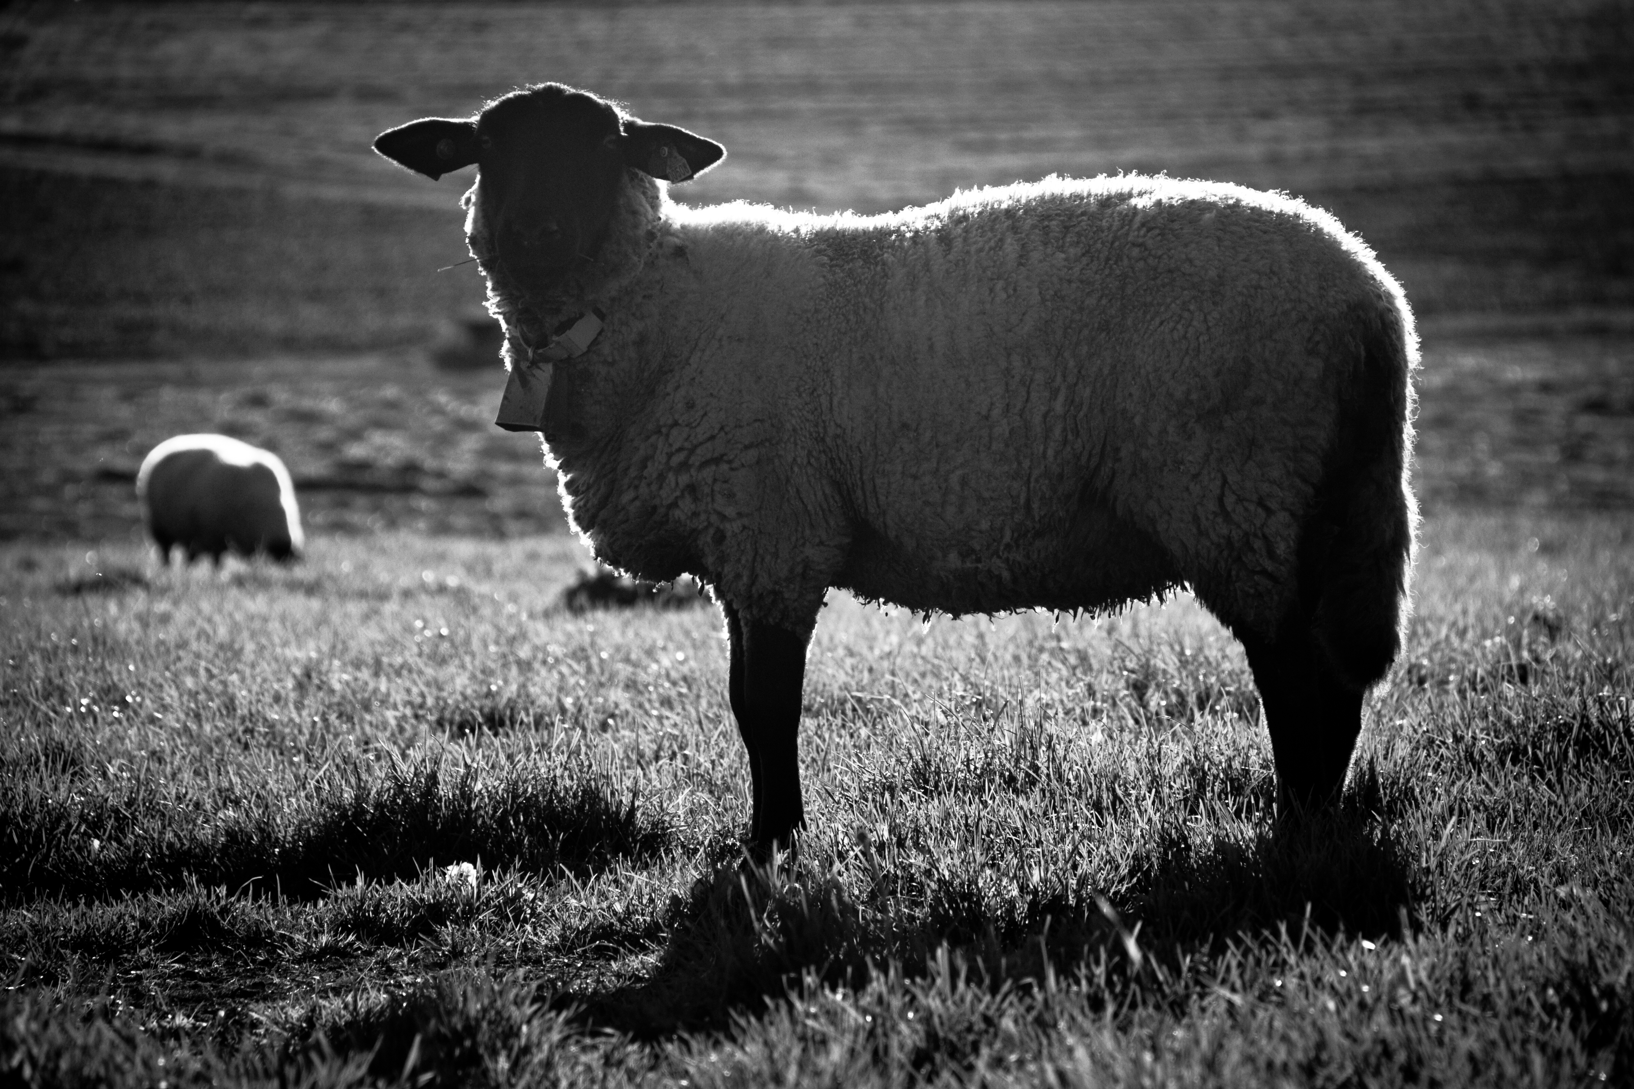
The Sanctuary – Offerings and Symbolism
Christian Hjortland

Slide 2
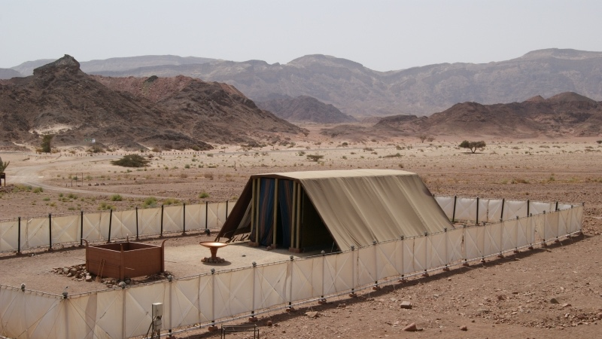

Slide 3

The 8 Health Keys in the Sanctuary
“And what agreement hath the temple of God with idols? for ye are the temple of the living God; as God hath said, I will dwell in them, and walk in them; and I will be their God, and they shall be my people.”
- 2 Corinthians 6:16

Slide 4
The 8 Health Keys in the Sanctuary
The Altar of Sacrifice (Self Sacrifice)
The Laver (Water)
The Table of Showbread (Nutrition + Temperance)
- Gen 1:29
- Ex 25:29
The Candlestick (Exercise, Air and Sunlight)
The Altar of Incense and the Ark of the Covenant (Trust)

Slide 5
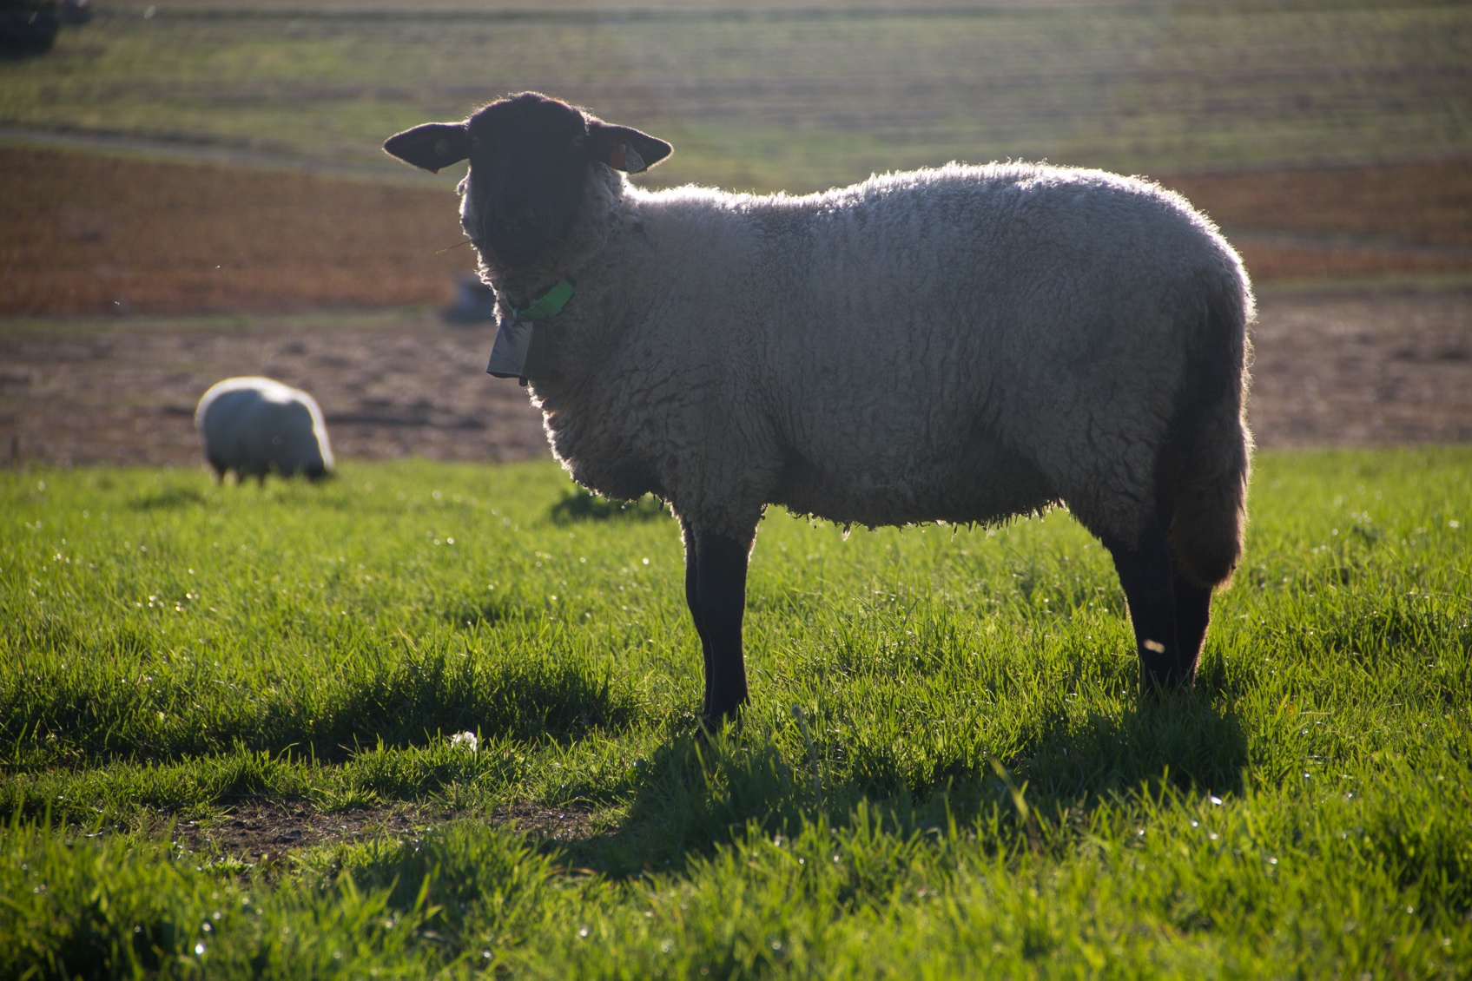
Sanctuary Offerings
Burnt offerings (Lev 1)
Daily burnt offering
Consecration of priest
Cleansing of a leper
Feasts
Confirmation and dedication
Romans 12:1
When did the fire burn on the altar? (Lev 6:13, Lev 9:24)
3 Elements of purification
Blood – Lev 17:11, 1 John 5:6

Slide 6
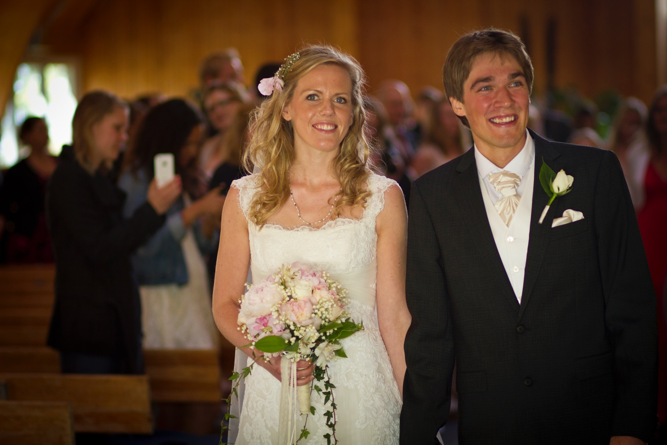
2. Meal Offering (Lev 2)
Cain and Abel
Jabob
Joseph’s Brothers
Mark 9:49 – Fire and salt
Submission and dependence
Firstfruits (Wave offering) - Ex 23:19, Neh 10:35
Drink offering – Num 28:7, Ex 30:9
Consecration of life first, then means.

Slide 7
3. Peace Offering (Lev 22)
Thankfulness and Joy
Thank offerings, vows, voluntary offerings
Divided
“And offer a sacrifice of thanksgiving with leaven, and proclaim and publish the free offerings: for this liketh you, O ye children of Israel, saith the Lord God.” - Amos 4:5
Leavened and unleavened bread
Eph 2:14, Rom 5:2,11

Slide 8
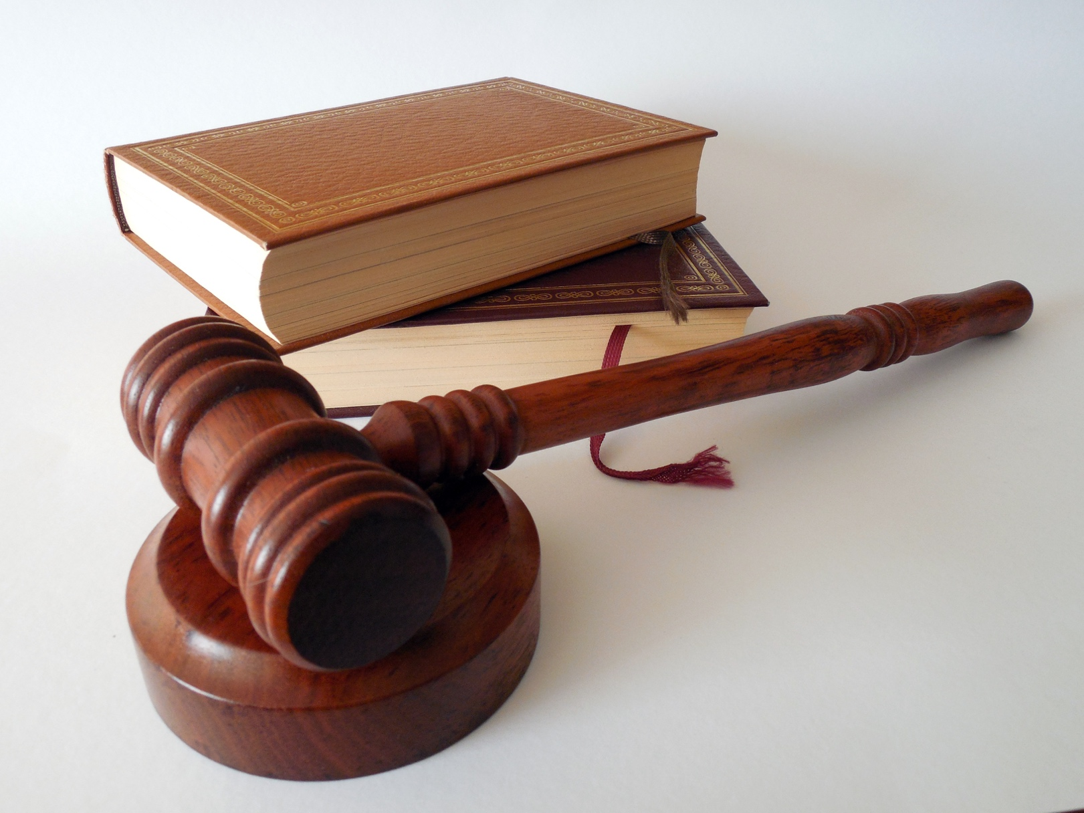
4. Sin Offering (Lev 4)
Through ignorance
Leviticus 5:7, 11
Atonement without blood? (Heb 9:22)
Sin by the priest or the congregation
Leviticus 10:16-18 – eating the meat
Leviticus 16:21 – Transfer of sin

Slide 9
5. Trespass Offering
(Lev 5:14-19, 6:1-7, Num 5:6-7)
Leviticus 5:15, 17
Serious sins (known and unknown)
Confession
Restution
Sacrifice
Forgiveness

Slide 10
5. Trespass Offering
“Let the members of every family begin to work over against their own houses. Let them humble themselves before God. It would be well to have a trespass-offering box in sight, and have all the household agreed that whosoever speaks unkindly of another or utters angry words, shall drop into the trespass-offering box a certain sum of money. This would put them upon their guard against the wicked words which work injury, not only to their brethren, but to themselves. No man of himself can tame the unruly member, the tongue; but God will do the work for him who comes unto him with contrite heart in faith and with humble supplication. By the help of God, bridle your tongues; talk less, and pray more. {RH, March 12, 1895 par. 12}

Slide 11
The High Priest
Clothing: Exodus 28:4, 6, 21, 29-30
Gold = Pure character (Is 13:12)
Blue = The law (Numbers 15:38-39)
Purple = Royalty (Mark 15:17, Judges 8:26)
Scarlet = Sin/corruption (Isaiah 1:18, Nahum 2:3, Revelation 17:1-4)
White = Purity (Revelation 3:4,5; 7:14; 19:14)

Slide 12
The High Priest
Mediator
Representing
“Therefore as by the offence of one judgment came upon all men to condemnation; even so by the righteousness of one the free gift came upon all men unto justification of life.”
- Romans 5:18

Slide 13
Questions
Why do you think God provided a plan of salvation for mankind?
Why is it a dangerous thing for people to try working out their own path to salvation?
2B. How can we avoid making the same mistakes as the Israelites?
3. In what ways do you think Satan attempts to stop us from advancing to each step in the plan of salvation? (As seen in the Sanctuary)
4. How can you see Christ symbolized in the Sanctuary? (Give references)
5. What can you practically apply to your daily spiritual life from each furniture?

