Slide 1
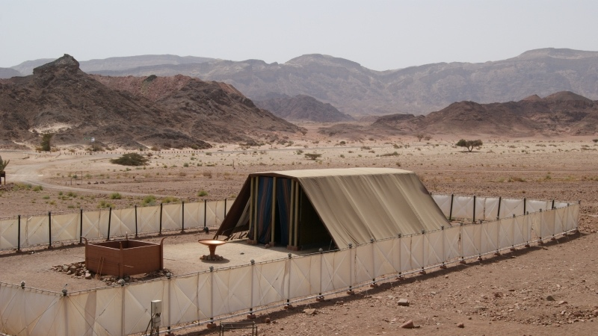

God’s GPS – The Sanctuary
Christian Hjortland, Denmark 2015

Slide 2


By Saad Faruque

Slide 3
God’s Way
Genesis 3:15
“Thy way, O God, is in the sanctuary...”
- Psalms 77:13
“And let them make me a sanctuary; that I may dwell among them. According to all that I shew thee, after the pattern of the tabernacle, and the pattern of all the instruments thereof, even so shall ye make it.”
- Exodus 25:8-9

Slide 4
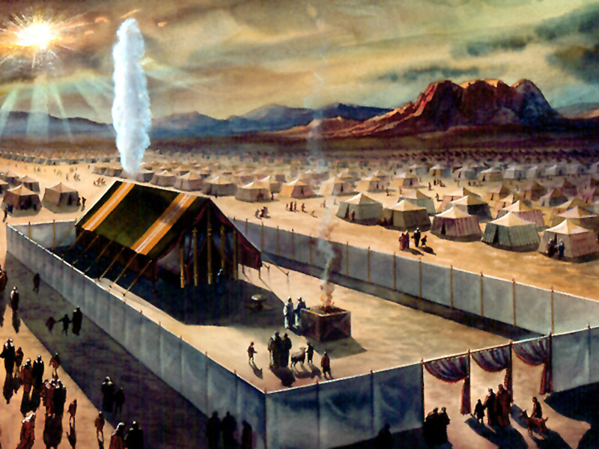
The Sanctuary
5x15m
3 apartments
Walls: Boards of Acacia Wood
Roof: Linen, goat hair, ram skin, badger skin
Court: 100x50 cubits (46x32m)
Fence: Linen, brass

Slide 5
Defiled by Sin
“And if any one of the common people sin through ignorance, while he doeth somewhat against any of the commandments of the Lord concerning things which ought not to be done, and be guilty;
Or if his sin, which he hath sinned, come to his knowledge: then he shall bring his offering, a kid of the goats, a female without blemish, for his sin which he hath sinned.
And he shall lay his hand upon the head of the sin offering, and slay the sin offering in the place of the burnt offering.”
- Leviticus 4:27-29

Slide 6
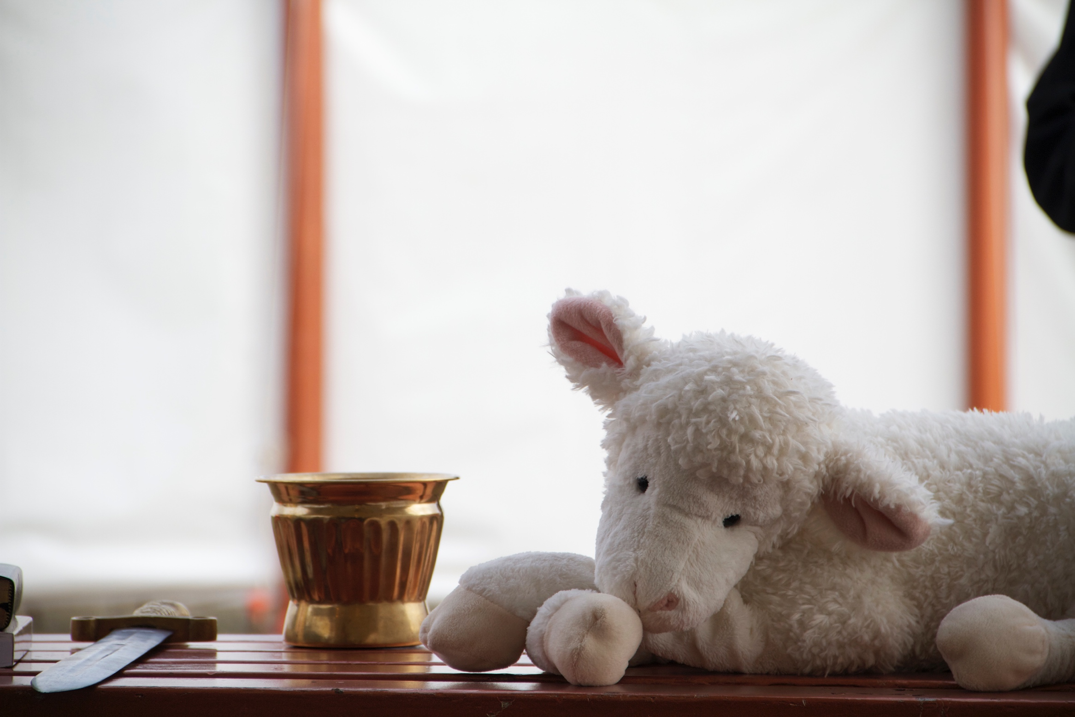
Defiled by Sin
Romans 6:23
Leviticus 4:16-19
The transfer of Sin

Slide 7
Symbolism in the Sanctuary
The Animal (John 1:29)
Altar of Sacrifice
Laver (Titus 3:5)
Showbread (John 6:51, Matt 4:4)
Candlestick (John 9:5, Matt 5:14, Zech 4:1-6, Rev 4:5)
Altar of Incense (Rev 5:8, 8:3-4, Heb 7:25)
Ark of the Covenant
The Priest (Heb 3:1, 4:14)
The Curtains (Heb 10:20, John 10:9)

Slide 8
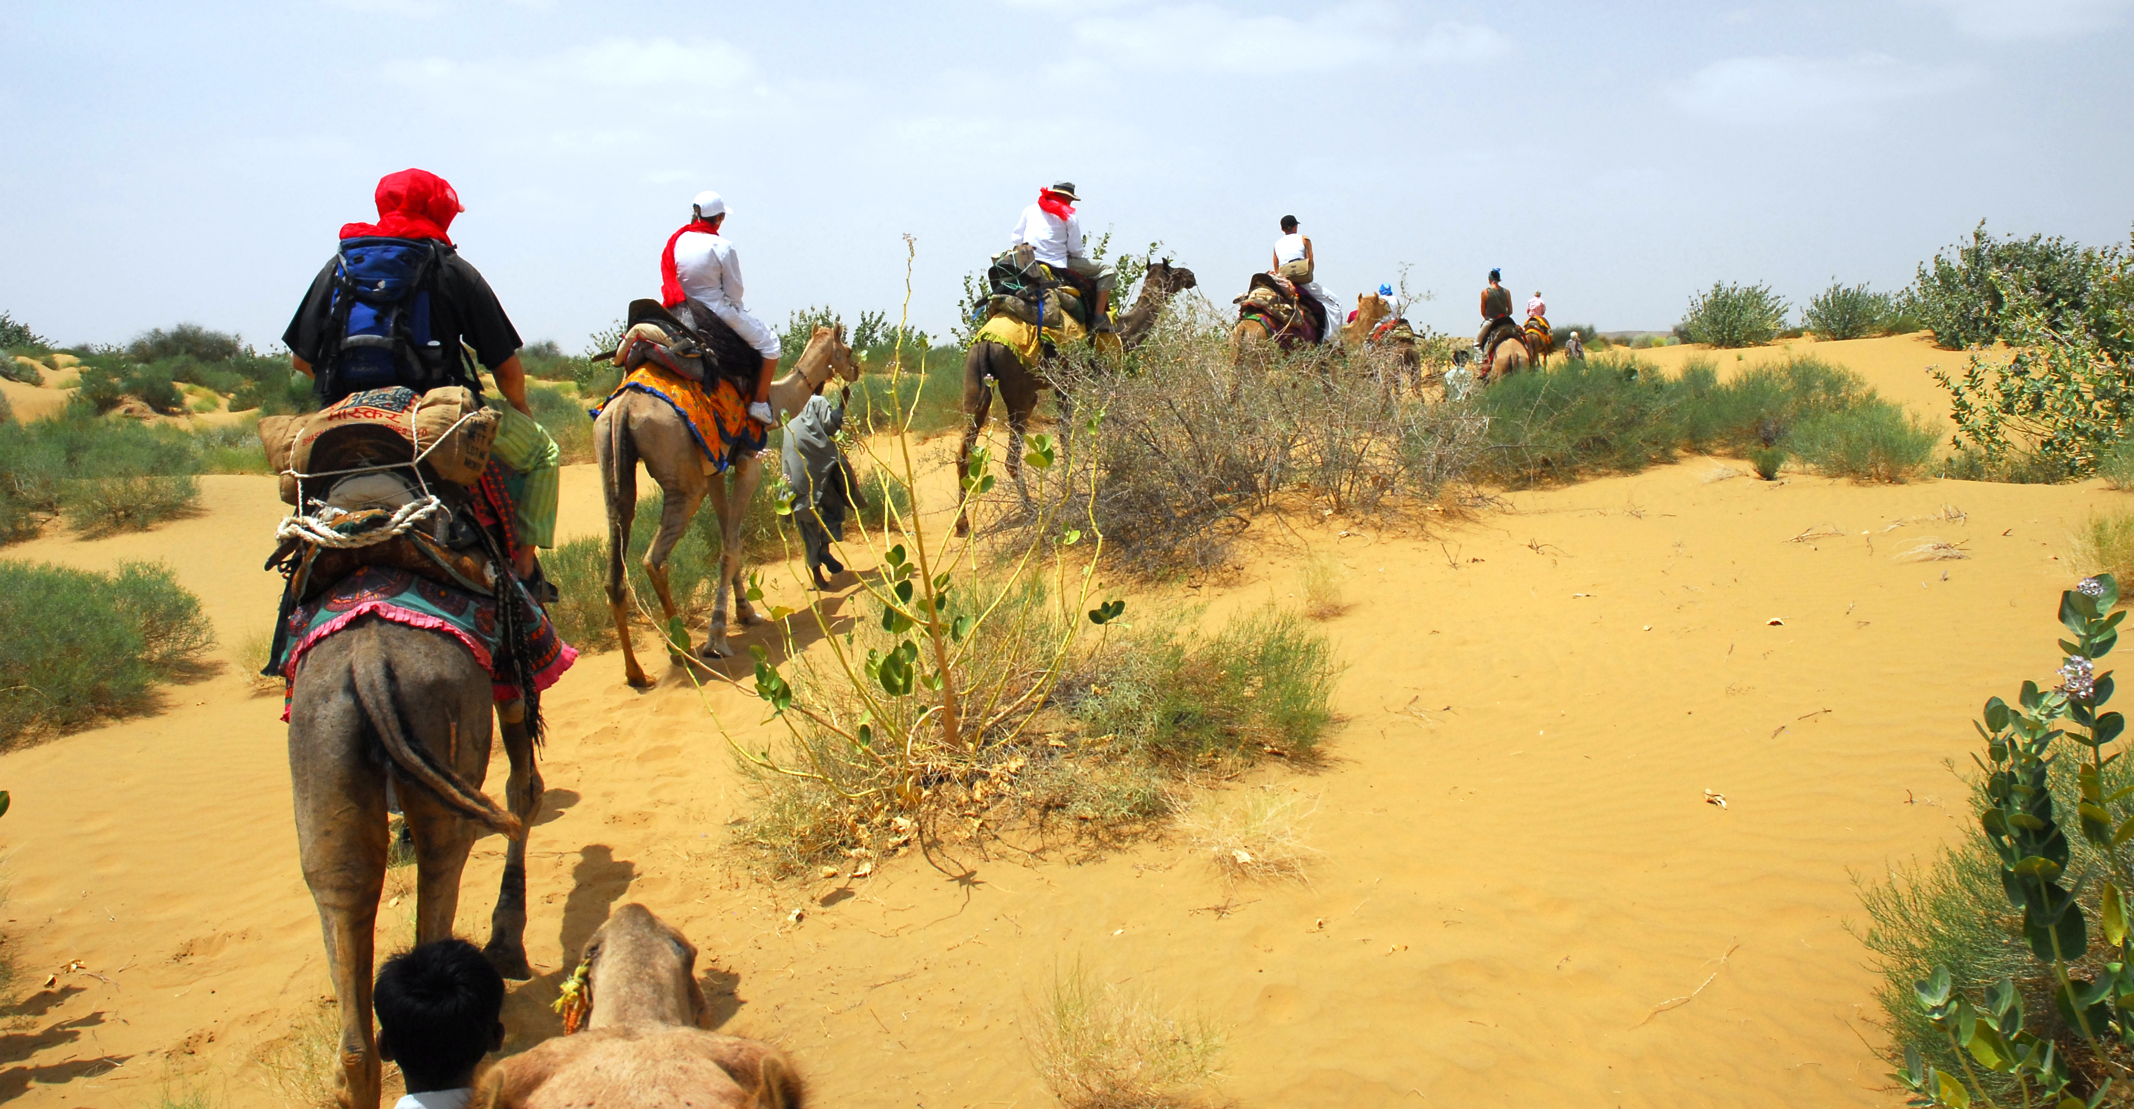
Photo: Zsolt Zatrok

Slide 9
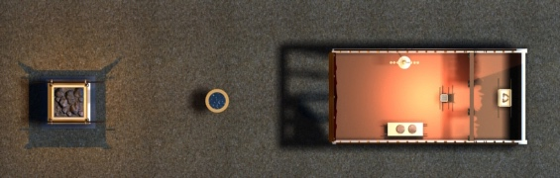
Jesus Way through the Sanctuary

Slide 10
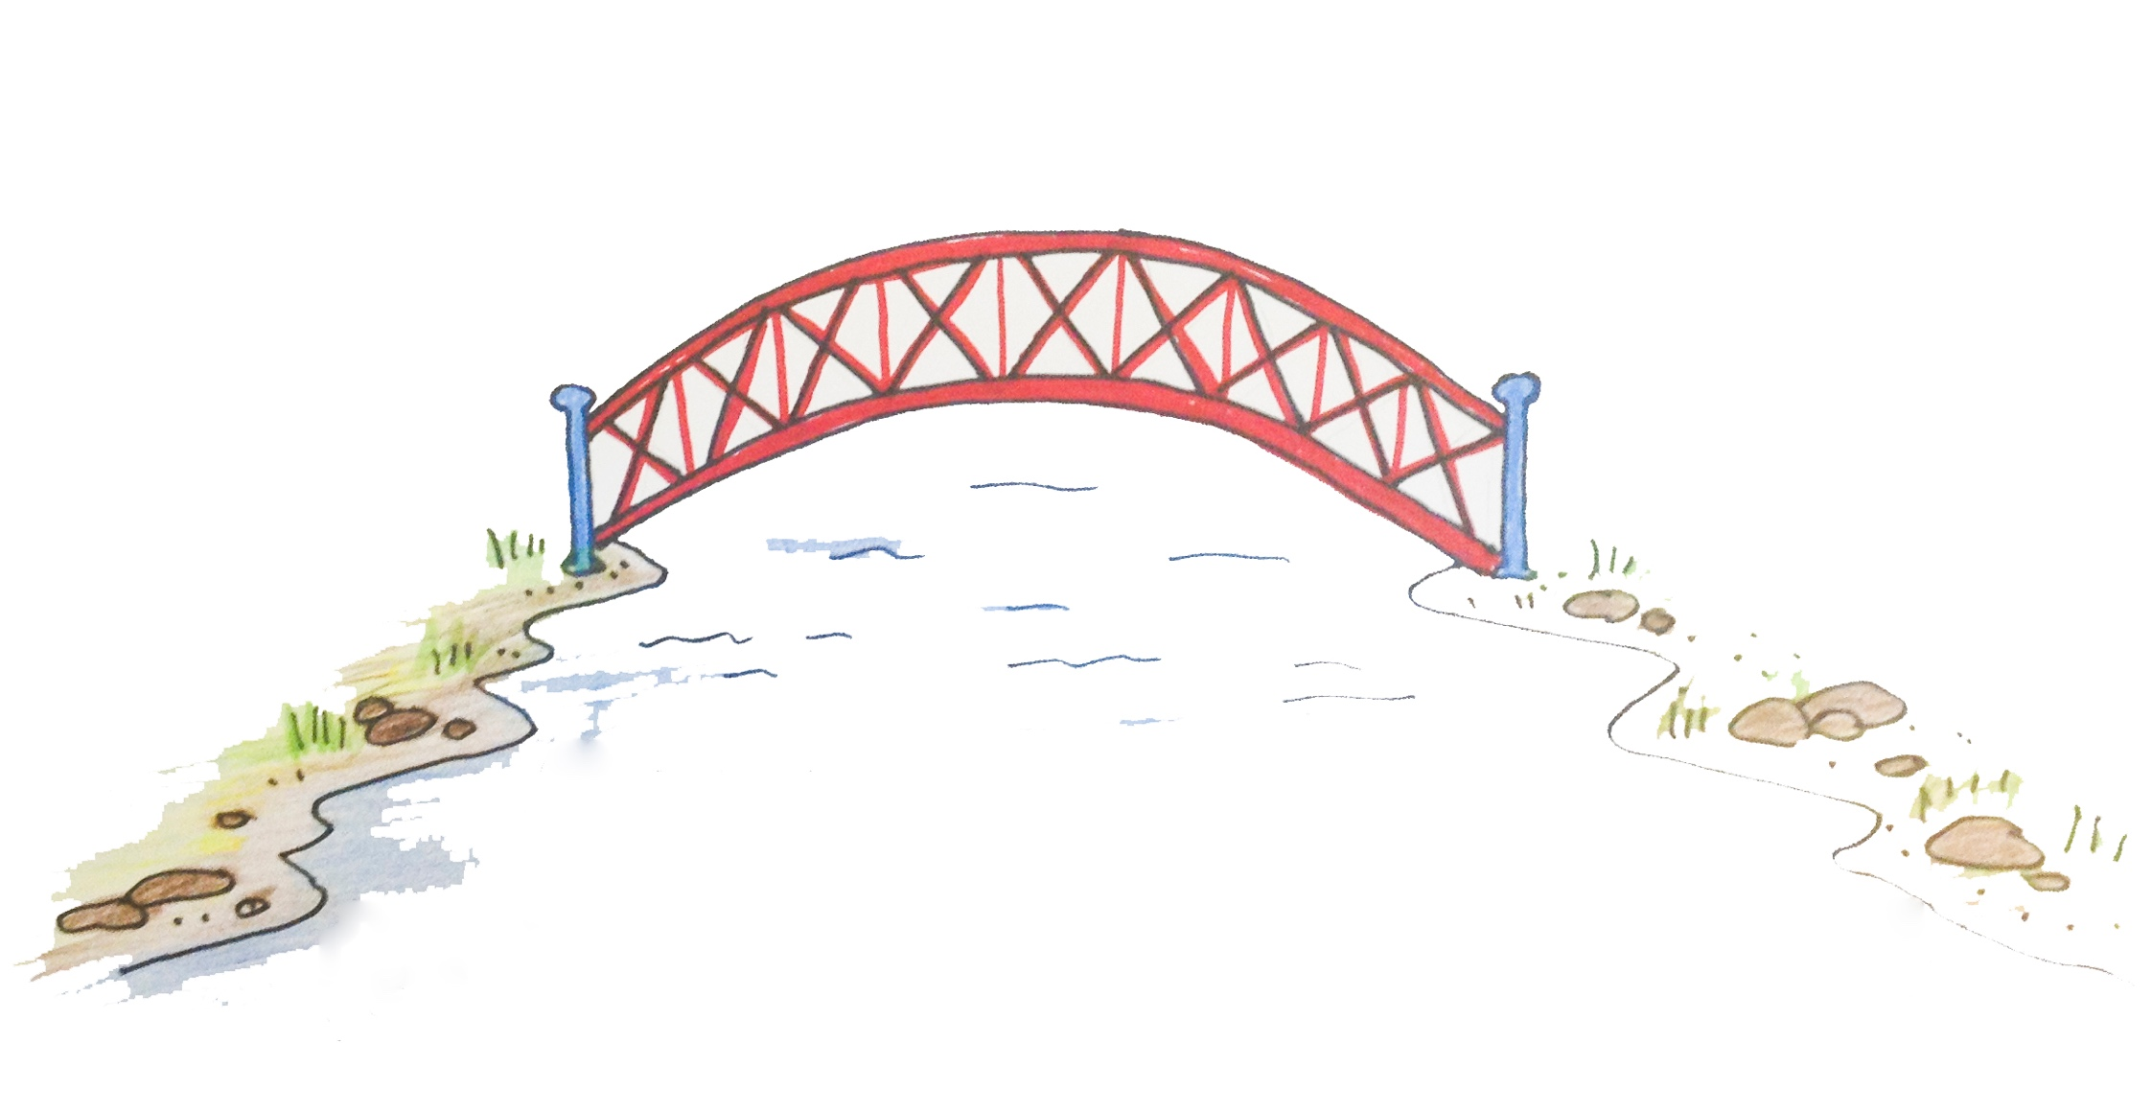
The Day of Atonement
“Now when these things were thus ordained, the priests went always into the first tabernacle, accomplishing the service of God. But into the second went the high priest alone once every year, not without blood, which he offered for himself, and for the errors of the people.”
- Hebrews 9:6-7

Slide 11
Where is the Blueprint from?
“Now this is the main point of the things we are saying: We have such a High Priest, who is seated at the right hand of the throne of the Majesty in the heavens,
a Minister of the sanctuary and of the true tabernacle which the Lord erected, and not man.
For every high priest is appointed to offer both gifts and sacrifices. Therefore it is necessary that this One also have something to offer.”
- Hebrews 8:1-3

Slide 12
Where is the Blueprint from?
“For if He were on earth, He would not be a priest, since there are priests who offer the gifts according to the law;
who serve the copy and shadow of the heavenly things, as Moses was divinely instructed when he was about to make the tabernacle. For He said, “See that you make all things according to the pattern shown you on the mountain.”
- Hebrews 8:4-5

Slide 13
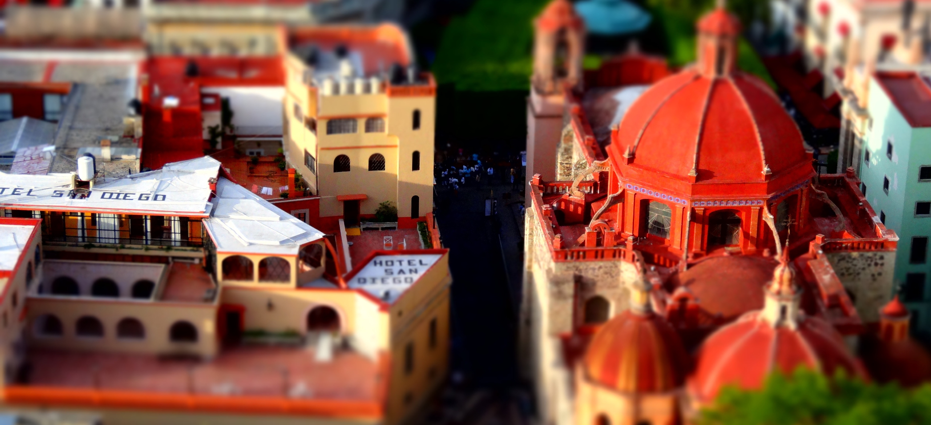
Where is the Blueprint from?
Hebrews 9:11-12, 7:24-25

Slide 14
