Slide 1
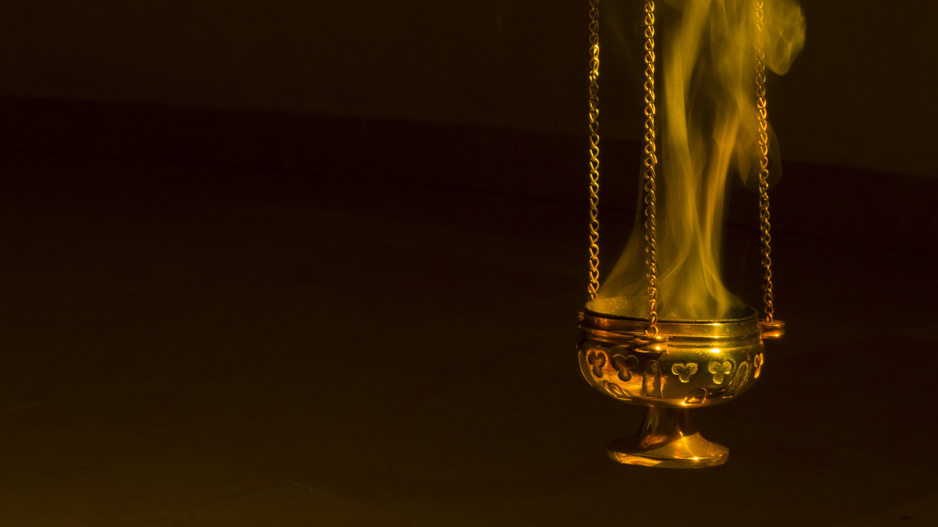
The Seven Last Plagues
Christian Hjortland

Slide 2
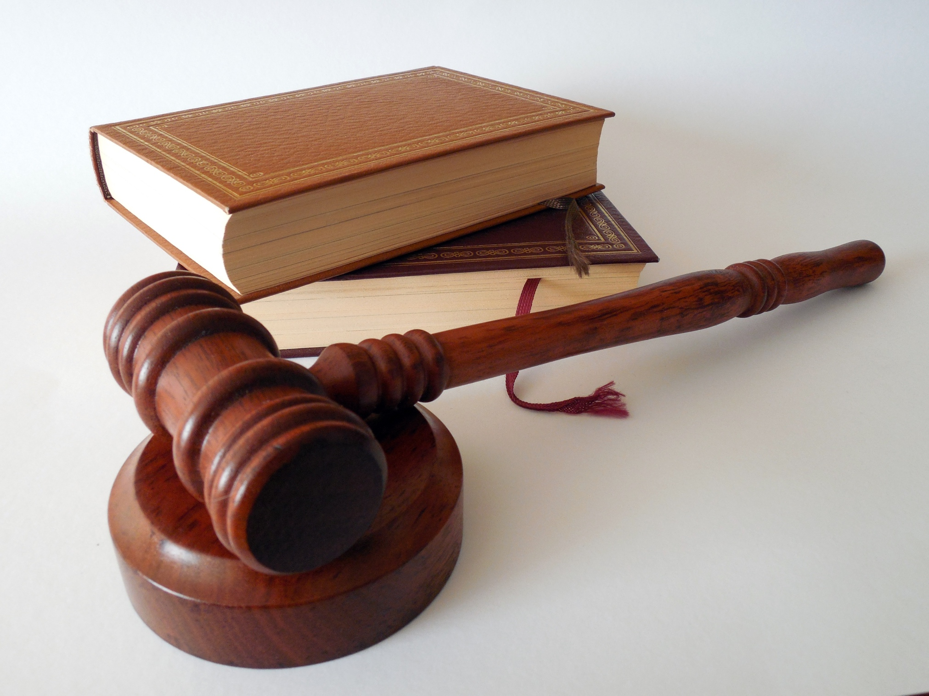

A big time of trouble
Daniel 12:1
The Remnant accused
Revelation 15
The Song of Moses
The Work in the Sanctuary
(EW 280, Rev 22:11)
Revelation 16
  7
  Are the plagues symbolic?

Slide 3
The first Three Plagues
Two groups
Romans 14:11, Philippians 2:10
The Difference
1st Plague – Wounds
Not universal (GC 628)
2nd Plague – Sea as blood
3rd Plague – Rivers and fountains of waters became blood
Exodus 7:19,21,24
Statement of defense

Slide 4
Plagues 4-5
4th Plague – Heat and drought
Amos 8:11-12
An important observation
What is the result of the judgments? Isaiah 26:9-10
5th Plague – darkness
A confirmation

Slide 5
The 6th Plague
1st interpretation – Political/military conflict
Literal
2nd interpretation – Religious conflict
Symbolical
Withdrawal of support from Babylon /Rev 16:18-19, 17:15-18

Slide 6
Three Unclean Spirits
“Through the two great errors, the immortality of the soul and Sunday sacredness, Satan will bring the people under his deceptions. While the former lays the foundation of spiritualism, the latter creates a bond of sympathy with Rome. The Protestants of the United States will be foremost in stretching their hands across the gulf to grasp the hand of spiritualism; they will reach over the abyss to clasp hands with the Roman power; and under the influence of this threefold union, this country will follow in the steps of Rome in trampling on the rights of conscience. {GC 588.1}

Slide 7
Similarities between the two views
1. That it is the last great battle of earth’s history and that it is still future.
2. That it is “the battle of that great day of God” (v. 14).
3. That “the great river Euphrates” is symbolic of human beings. (Rev 17:15)
4. That the three “unclean spirits” (v. 13) represent the papacy, apostate Protestantism, and spiritism (or paganism).
5. That these three “spirits” constitute the agencies that will summon the nations to battle.
6. That the gathering agencies—“three unclean spirits”—are religious in nature and that the forces gathered are political and military.
7. That preparations for the battle take place under the sixth plague, but that the battle itself is fought under the seventh plague.
8. That in one phase it will be a real battle between real people employing real weapons.
9. That there will be bloodshed on an unprecedented scale.
10. That all the nations of earth will be involved.
11. That eventually Christ and the armies of heaven intervene and bring the battle to a close.
12. That the living saints witness the battle, but not as direct participants.

Slide 8
The 6th Plague
Differences
Will some of God’s saints die?
“The people of God will not be free from suffering; but while persecuted and distressed, while they endure privation and suffer for want of food they will not be left to perish. {GC 629.2}
“He gathered”
Place
Armageddon (Megiddo, or Mageddon -from mo’ed, Is 14:13)

Slide 9
The 6th Plague
“Deadly instruments of warfare will be invented. Vessels, with their living cargo, will be entombed in the great deep. All who have not the spirit of truth will unite under the leadership of satanic agencies. But they are to be kept under control till the time shall come for the great battle of Armageddon. {7BC 967.8}
“The battle of Armageddon is soon to be fought. He on whose vesture is written the name, King of kings and Lord of lords, leads forth the armies of heaven on white horses, clothed in fine linen, clean and white (MS 172, 1899). {7BC 982.5}

Slide 10
The 6th Plague
“The power of the Holy Ghost must be upon us, and the Captain of the Lord's host will stand at the head of the angels of heaven to direct the battle. Solemn events before us are yet to transpire. Trumpet after trumpet is to be sounded, vial after vial poured out one after another upon the inhabitants of the earth. Scenes of stupendous interest are right upon us (Letter 112, 1890). {7BC 982.7}

Slide 11
The 7th Plague
All the air
Temple in heaven
It is done
Dressage
“We need to study the pouring out of the seventh vial. The powers of evil will not yield up the conflict without a struggle. But Providence has a part to act in the battle of Armageddon. When the earth is lighted with the glory of the angel of Revelation eighteen, the religious elements, good and evil, will awake from slumber, and the armies of the living God will take the field (MS 175, 1899). {7BC 983.2}

Slide 12
The Sanctuary in relation to the Plagues
Sores upon those who had the mark of the beast, and worshipped him. (16:2) - Ark of the Covenant
Sea became blood (16:3, 1 Cor 10:2) – The laver
Rivers and springs of water became blood. (16:4-6) - Drink offering
The sun became hot like fire. (16:7-9) - Burnt offering
The kingdom of the beast became full of darkness. (16:10-11)
- Candlestick.
Euphrates dries up, and three unclean spirits gathers the world to battle (16:12-16) - Altar of Incense
Great hail fell from heaven (16:17, John 6:58) - Showbread.

Slide 13
