Slide 1
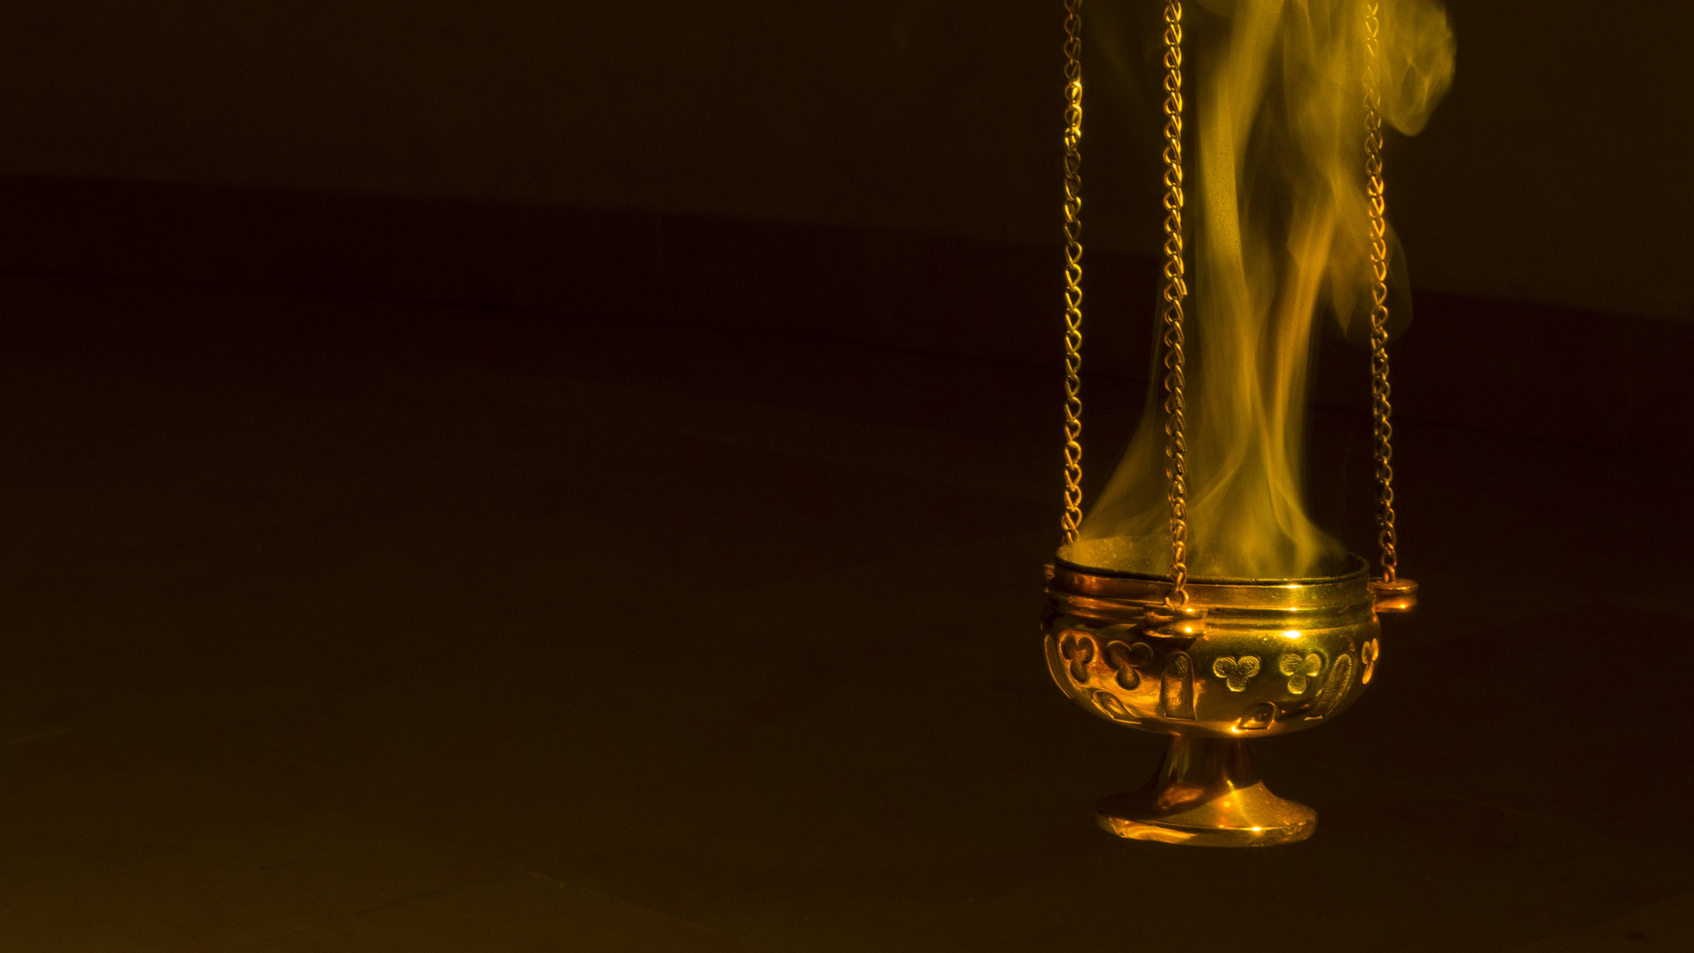
The Mark of the Beast
Christian Hjortland

Slide 2

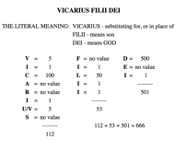

The Number of his Name
Revelation 13:3, 18 – 666
Title
Douay-Rheims version includes this footnote

Slide 3
God’s Seal
Ezekiel 20:12: Moreover also I gave them my sabbaths, to be a sign between me and them, that they might know that I am the Lord that sanctify them.
Exodus 31:17: It is a sign between me and the children of Israel for ever: for in six days the Lord made heaven and earth, and on the seventh day he rested, and was refreshed.
Revelation 7:1-3

Slide 4
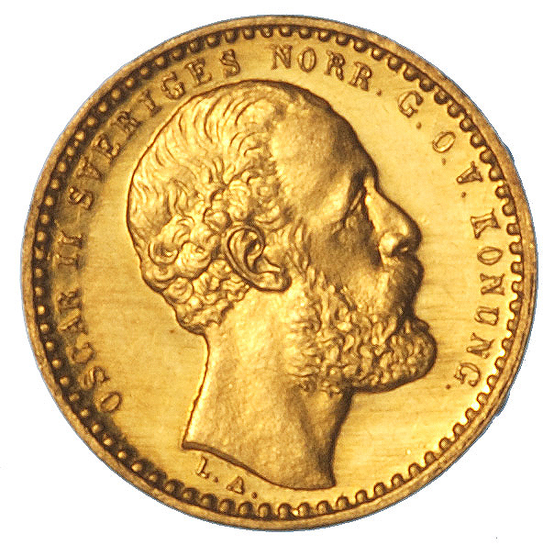
God’s Seal
Revelation 14:7: Saying with a loud voice, Fear God, and give glory to him; for the hour of his judgment is come: and worship him that made heaven, and earth, and the sea, and the fountains of waters.
Exodus 20:8-11
Name: Lord God
Title: Creator
Territory: Heaven and earth

Slide 5
Mark of the Beast
Daniel 7:25 – How was the law attempted changed?
"Sunday is our mark of authority...the church is above the Bible, and this transference of Sabbath observance is proof of that fact." (The Catholic Record of London, Ontario, Canada, September 1, 1923)
”Of course the Catholic Church claims that the change was her act…And the act is a mark of her ecclesiastical power and authority in religious matters.” (Letter from C.F. Thomas, Chancellor of Cardinal Gibbons on October 28, 1895)

Slide 6
Why do protestants keep Sunday?
"Protestants ... accept Sunday rather than Saturday as the day for public worship after the Catholic Church made the change... But the Protestant mind does not seem to realize that ... in observing Sunday, they are accepting the authority of the spokesman for the Church, the pope."
Our Sunday Visitor, February 5th, 1950.
Library of Christian Doctrine

Slide 7
Mark in the right hand and the forehead
Revelation 13:16
What do we have in the forehead?
“This is the covenant that I will make with them after those days, saith the Lord, I will put my laws into their hearts, and in their minds will I write them.” - Hebrews 10:16
Hands – Actions (Ecc 9:10)
Is refraining from work on Sunday taking the mark of the beast?
Rev 14:9-12, John 10;16, 27

Slide 8
What pastors and preachers say
Baptist: "There was and is a commandment to keep holy the Sabbath day, but that Sabbath day was not Sunday. ... It will be said, however, and with some show of triumph, that the Sabbath was transferred from the seventh to the first day of the week. ... Where can the record of such a transaction be found? Not in the New Testament -- absolutely not. There is no scriptural evidence of the change of the Sabbath institution from the seventh to the first day of the week." Dr. Edward T. Hiscox, author of The Baptist Manual, in a paper read before a New York ministers' conference held Nov. 13, 1893. Catholic: "You may read the Bible from Genesis to Revelation, and you will not find a single line authorizing the sanctification of Sunday. The Scriptures enforce the religious observance of Saturday, a day which we [Catholics] never sanctify." James Cardinal Gibbons, The Faith of Our Fathers, 16th edition, 1880, p. 111.

Slide 9
What pastors and preachers say
Church of Christ: "Finally, we have the testimony of Christ on this subject. In Mark 2:27, he says: 'The Sabbath was made for man, and not man for the Sabbath.' From this passage it is evident that the Sabbath was made not merely for the Israelites, as Paley and Hengstenberg would have us believe, but for man ... that is, for the race. Hence we conclude that the Sabbath was sanctified from the beginning, and that it was given to Adam, even in Eden, as one of those primeval institutions that God ordained for the happiness of all men." Robert Milligan, Scheme of Redemption, (St. Louis, The Bethany Press, 1962), p. 165. Congregationalist: "The Christian Sabbath [Sunday] is not in the Scriptures, and was not by the primitive church called the Sabbath." Dwight's Theology, Vol. 4, p. 401.

Slide 10
What pastors and preachers say
Episcopal: "Sunday (Dies Solis, of the Roman calendar, 'day of the sun', because dedicated to the sun), the first day of the week, was adopted by the early Christians as a day of worship. ... No regulations for its observance are laid down in the New Testament, nor, indeed, is its observance even enjoined." "Sunday," A Religious Encyclopedia, Vol. 3, (New York, Funk and Wagnalls, 1883) p. 2259. Lutheran: "The observance of the Lord's day [Sunday] is founded not on any command of God, but on the authority of the church." Augsburg Confession of Faith, quoted in Catholic Sabbath Manual, Part 2, Chapter 1, Section 10. Methodist: "Take the matter of Sunday. There are indications in the New Testament as to how the church came to keep the first day of the week as its day of worship, but there is no passage telling Christians to keep that day, or to transfer the Jewish Sabbath to that day." Harris Franklin Rall, Christian Advocate, July 2, 1942.

Slide 11
What pastors and preachers say
Moody Bible Institute: "The Sabbath was binding in Eden, and it has been in force ever since. This fourth commandment begins with the word 'remember,' showing that the Sabbath already existed when God wrote the law on the tables of stone at Sinai. How can men claim that this one commandment has been done away with when they will admit that the other nine are still binding?" D. L. Moody, Weighed and Wanting, p. 47. Presbyterian: "Until, therefore, it can be shown that the whole moral law has been repealed, the Sabbath will stand. ... The teaching of Christ confirms the perpetuity of the Sabbath." T. C. Blake, D.D., Theology Condensed, pp. 474, 475. Pentecostal: "'Why do we worship on Sunday? Doesn't the Bible teach us that Saturday should be the Lord's Day?' ... Apparently we will have to seek the answer from some other source than the New Testament." David A. Womack, "Is Sunday the Lord's Day?" The Pentecostal Evangel, Aug. 9, 1959, No. 2361, p. 3.

