Slide 1

The Three Angel’s Messages
Christian Hjortland

Slide 2

First Angel: Worship and Judgment
The Everlasting Gospel
Fear God (Ecc 12:13, Prov 8:13)
Radical Lifestyle (Gal 5:19-25, Rom 1:32)
2 Cor 5:17, Phil 2:5
"By receiving His imputed righteousness, through the transforming power of the Holy Spirit, we become like Him." (SDA Bible Commentary, vol. 6, p. 1098)
2 Thessalonians 2:13
The Sanctuary Service
Give glory to Him (John 15:8,16, 1 Cor 10:31)
Worship Him

Slide 3
Second Angel: Babylon is Fallen
Ancient Babylon
Isaiah 14
Revelation 17:2,5-6, 18:1-5
Fallen from what?
Fallen from the truth
Deceives others
The mother of harlots
Persecution of God’s people
Sin, and make others do the same

Slide 4
Second Angel: Babylon is Fallen
"The Church, esp. the Roman Catholic Church, considered as a mother in its functions of nourishing and protecting the believer"
- Oxford English Dictionary
Some protestant teachings taught today:
The Law is no longer valid
The soul is immortal
Sinners burn I hell forever
Sunday as Sabbath
“If Protestants would follow the Bible, they would worship God on the Sabbath Day. In keeping the Sunday they are following a law of the Catholic Church.” - Albert Smith, Chancellor of the Archdiocese of Baltimore

Slide 5
Second Angel: Babylon is Fallen
John 10:16: And other sheep I have, which are not of this fold: them also I must bring, and they shall hear my voice; and there shall be one fold, and one shepherd.
John 10:27: My sheep hear my voice, and I know them, and they follow me
Babylon = Fallen Churches that once were clean but have accepted the false teachings of the harlot.

Slide 6
The Third Angel
The Mark of the Beast
The Patience of the Saints (Rom 2:7)
We need a character transformation
Romans 8:7: Because the carnal mind is enmity against God: for it is not subject to the law of God, neither indeed can be.
v. 3-4 – What happens when we accept Christ?

Slide 7
Need of a Transformation
“The temptations of Satan are manifold; but those to which our attention is called in the text are unbelief and impatience. “Knowing this, that the trying of your faith worketh patience.” Impatience, then, is the result of a lack of faith. “But let patience have her perfect work, that ye may be perfect and entire, wanting nothing.” If we do not maintain the grace of patience, we shall never reach a state of perfection. Some of us have a nervous temperament, and are naturally as quick as a flash to think and to act; but let no one think that he cannot learn to become patient. Patience is a plant that will make rapid growth if carefully cultivated. By becoming thoroughly acquainted with ourselves, and then combining with the grace of God a firm determination on our part, we may be conquerors, and become perfect in all things, wanting in nothing. {HS 134.3}

Slide 8
Need of a Transformation
“Then Peter and the other apostles answered and said, We ought to obey God rather than men.”
Acts 5:29
Revelation 14:4-5 - How will we overcome?
Revelation 12:11, 7:14
“Not every one that saith unto me, Lord, Lord, shall enter into the kingdom of heaven; but he that doeth the will of my Father which is in heaven.” - Matthew 7:21
Are you a fan or a follower?

Slide 9
Fan or Follower?
"Jesus was never interested in having fans. When he defines what kind of relationship he wants, "Enthusiastic Admirer" isn’t an option. My concern is that many of our churches in America have gone from being sanctuaries to becoming stadiums. And every week all the fans come to the stadium where they cheer for Jesus but have no interest in truly following him. The biggest threat to the church today is fans who call themselves Christians but aren’t actually interested in following Christ. They want to be close enough to Jesus to get all the benefits, but not so close that it requires anything from them."
- Kyle Idleman "Not a Fan" p. 25

Slide 10
The Heart of the Third Angel’s Message
“Several have written to me, inquiring if the message of justification by faith is the third angel's message, and I have answered, "It is the third angel's message in verity."--1SM 372 (1890). {LDE 199.4}
“The Lord in His great mercy sent a most precious message to His people through Elders [E.J.] Waggoner and [A. T.] Jones. This message was to bring more prominently before the world the uplifted Saviour, the sacrifice for the sins of the whole world. It presented justification through faith in the Surety; it invited the people to receive the righteousness of Christ, which is made manifest in obedience to all the commandments of God… {LDE 200.1}

Slide 11
The Heart of the Third Angel’s Message
Many had lost sight of Jesus. They needed to have their eyes directed to His divine person, His merits, and His changeless love for the human family. All power is given into His hands, that He may dispense rich gifts unto men, imparting the priceless gift of His own righteousness to the helpless human agent. This is the message that God commanded to be given to the world. It is the third angel's message, which is to be proclaimed with a loud voice, and attended with the outpouring of His Spirit in a large measure.--TM 91, 92 (1895). {LDE 200.2} …
The last message of mercy to be given to the world is a revelation of His character of love. The children of God are to manifest His glory. In their own life and character they are to reveal what the grace of God has done for them.--COL 415, 416 (1900). {LDE 200.4}

Slide 12
The Right Arm
“The Lord desires his church to be a perfect body,--not all arms, not all body without arms, but body and arms together,--and every member working as a part of the one great whole. As the right arm is connected with the body, so the health reform and medical missionary work is connected with the third angel's message, and is to work efficiently as the right arm, for the defense of the body of truth. {RH, June 20, 1899 par. 10}

Slide 13
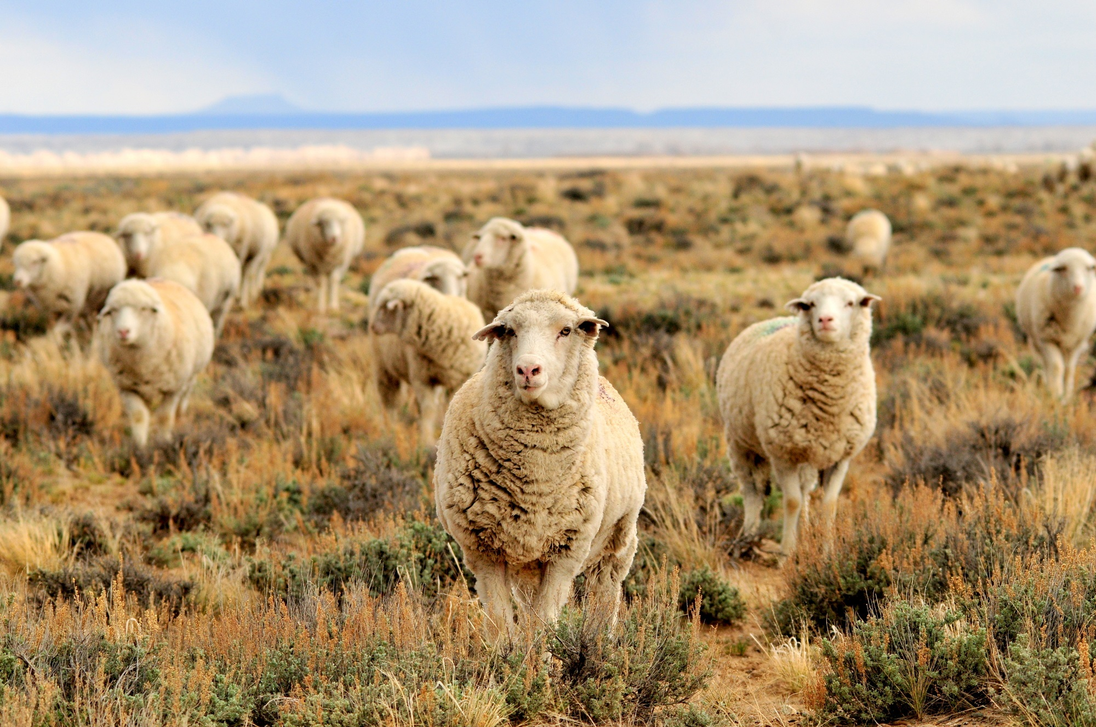

Slide 14
Questions
How can you practically apply the three angel's messages to your own life?
How can we best share this message in the world today? Are there any dangers we have to be careful with?
Mention lessons from ancient Babylon that helps us understand the system of Babylon today.

