Slide 1
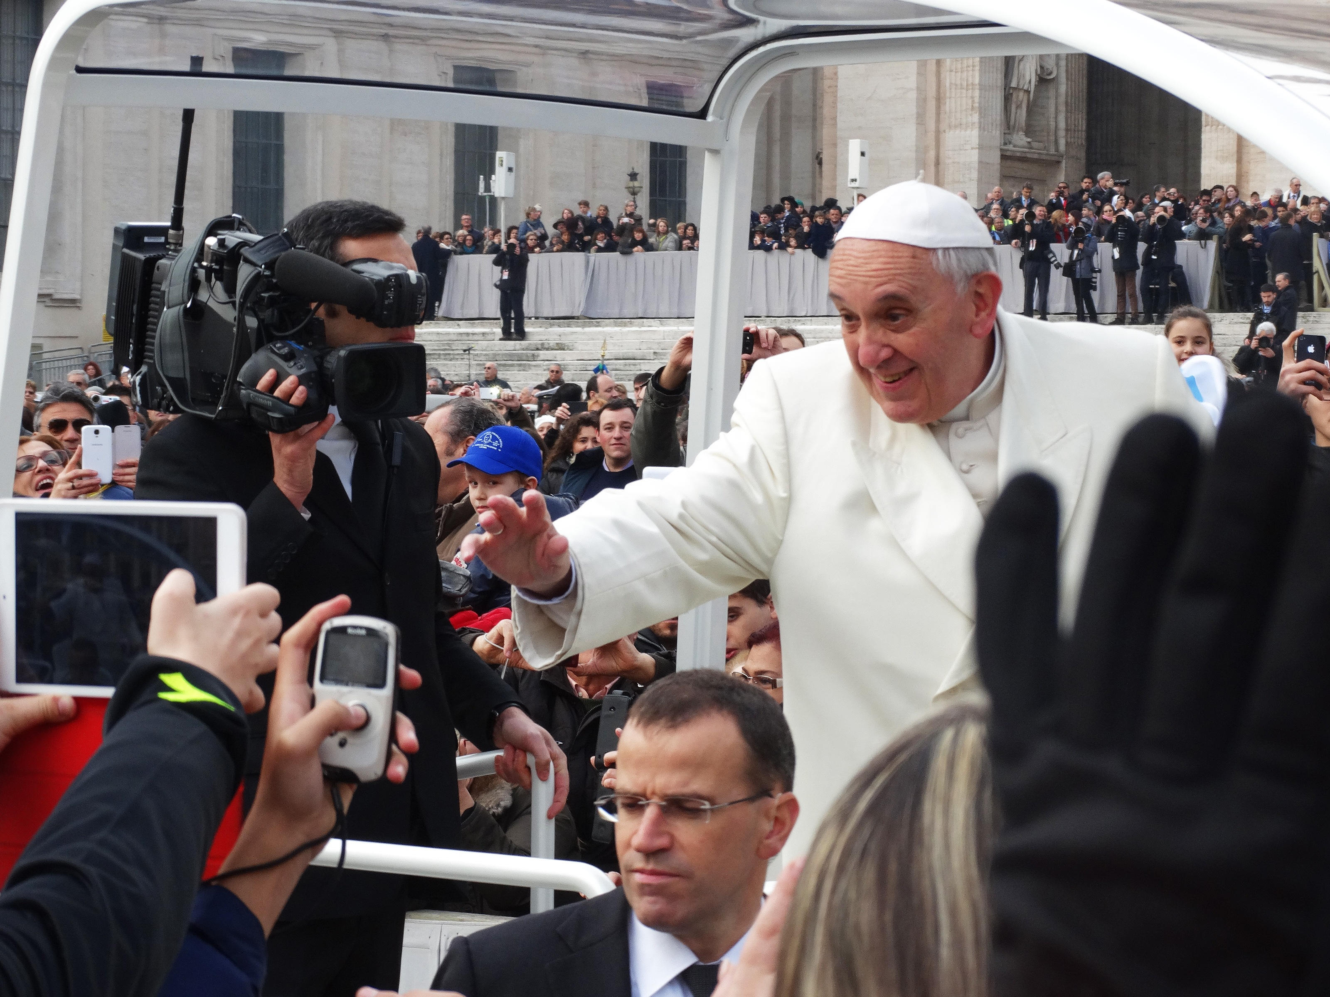
Revelation 13 – The World has Started to Wonder
Christian Hjortland

Slide 2

Similarities Between Dan 7 and Rev 13 | References
1. The beast arises “out of the sea", “up from the sea" | Rev 13:1, Dan 7:3
2. “like unto a leopard", “another, like a leopard" | Rev 13:2, Dan 7:6
3. “feet of a bear", “like unto a bear" | Rev 13:2, Dan 7:5
4. “mouth of a lion", “was like a lion" | Rev 13:2, Dan 7:4
5. “The dragon", “a forth beast, dreadful and terrible" | Rev 13:2, Dan 7:7
6. “Seven heads", (the four beasts have in total seven heads) | Rev 13:1, Dan 7:4-7
7. “ten horns" | Rev 13:1, Dan 7:7
8. The beast and the little horn rule for the same time period: "42 months", “time, times and half a time" (time=year) | Rev 13:5, Dan 7:25
9. “number of a man", “eyes of a man" | Rev 13:18, Dan 7:8
10. The beast and the little horn do the same things: ”Blasphemy against God", “speak great words against the most High” | Rev 13:5-6 Dan 7:8, 20, 25
11. “make war with the saints", “made war with the saints" | Rev 13:7, Dan 7:21
12. Power and position comes from “the dragon”: “gave him power and his seat and great authority:”, “fourth beast, dreadful and terrible, and strong exceedingly…and it had ten horns." | Rev 13:2, Dan 7:7
13. The beast is a religious power that receives worship. “All the world wondered…and they worshiped the beast.”, “shall be diverse” | Rev 13:3-4, Dan 7:24
14. “And he causeth all, to receive a mark”, “think to change times and law.“ | Rev 13:15-17, Dan 7:25 Rom 6:16

Slide 3
The Beast of the Sea (Rev 13:1-2)
Sea (Rev 17:15)
The Name of Blasphemy (Dan 7:8,25, Rev 13:5-6, John 10:33, Mark 2:5-7)
“Have no fear when people call me the "Vicar of Christ," when they say to me "Holy Father," or "Your Holiness," or use titles similar to these, which seem even inimical[cause harm] to the Gospel”
- Pope John Paul II (1995)
“Out of the ruins of political Rome, arose the great moral Empire in the ‘giant form’ of the Roman Church” - A. C. Flick, The Rise of the Mediaeval Church [1900], p. 150

Slide 4
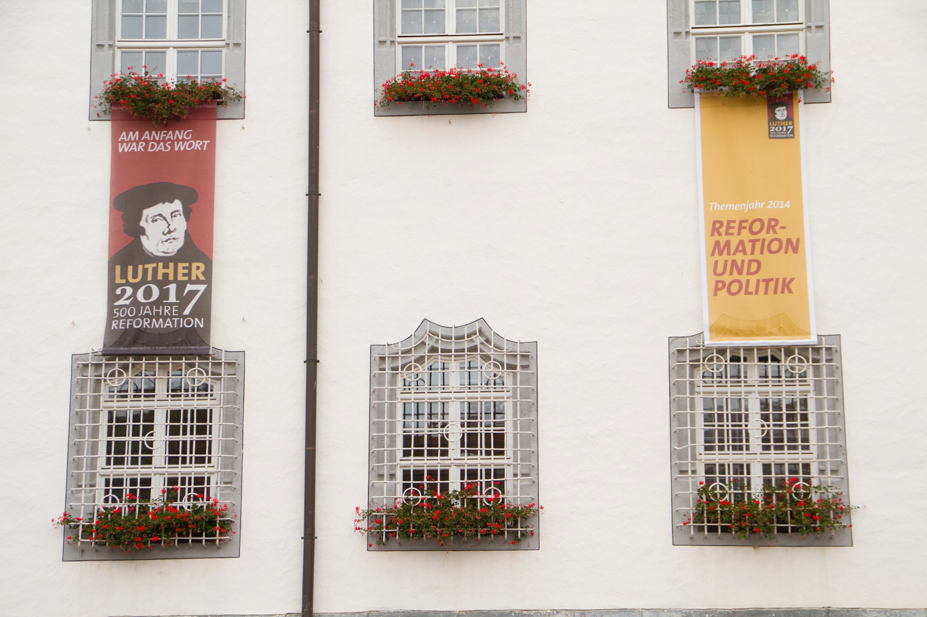
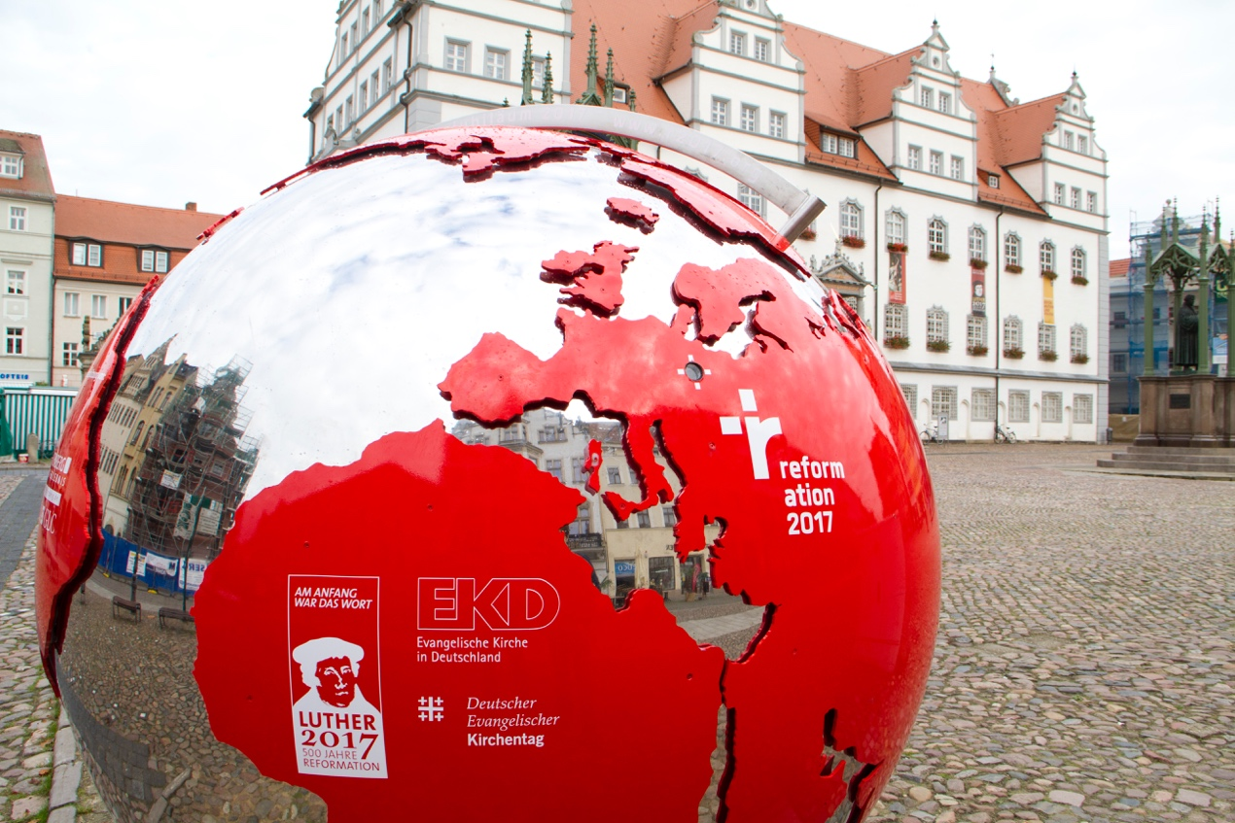
The Beast of the Sea
“Berthier (the general of Napoleon) entered Rome on the tenth of February, 1798, and proclaimed a republic…In 1798 he (Berthier)…made his entrance into Rome, abolished the Papal government and established a secular one.”
The Encyclopedia Americana, 1941.
Is the wound healing?
1929

Slide 5
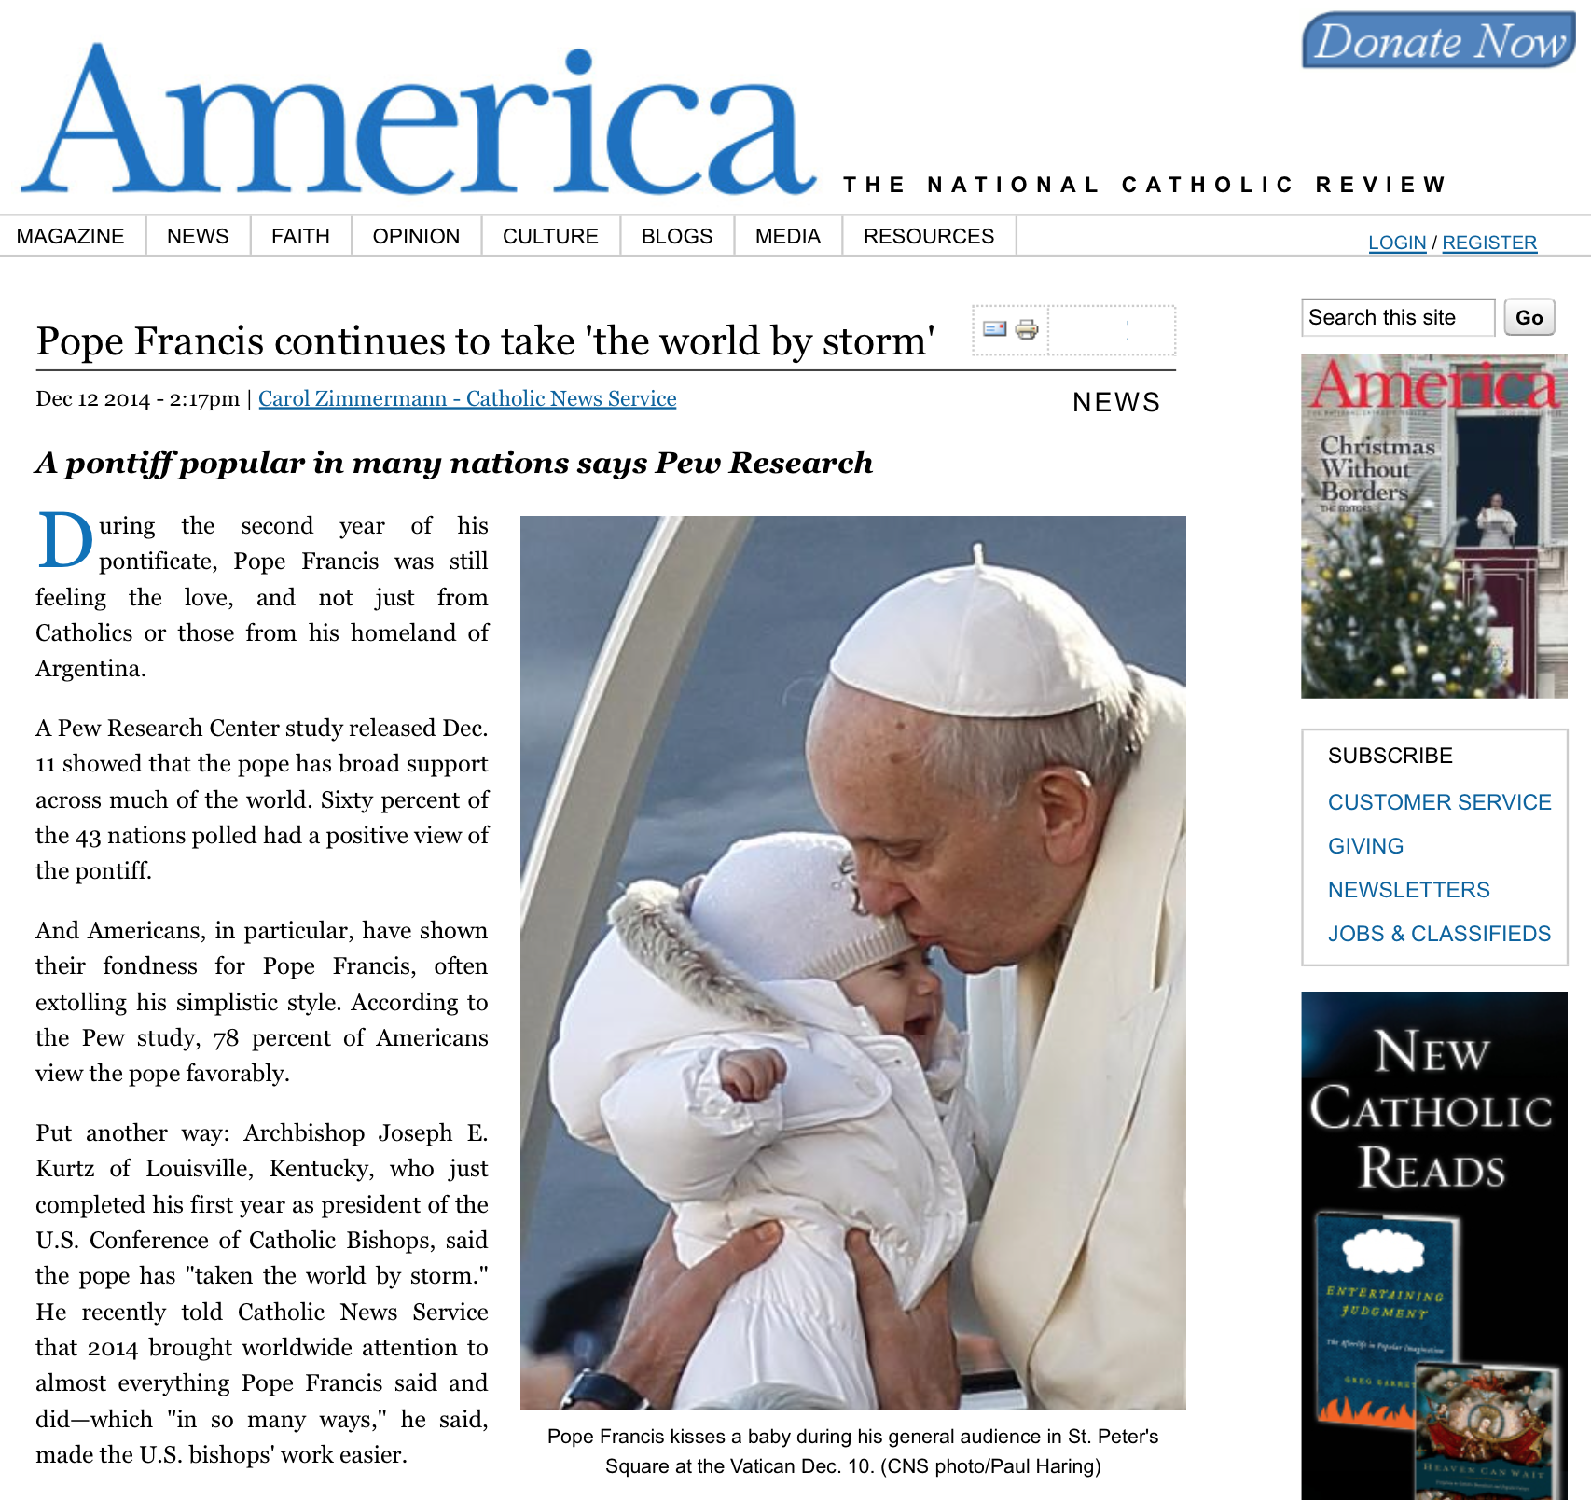
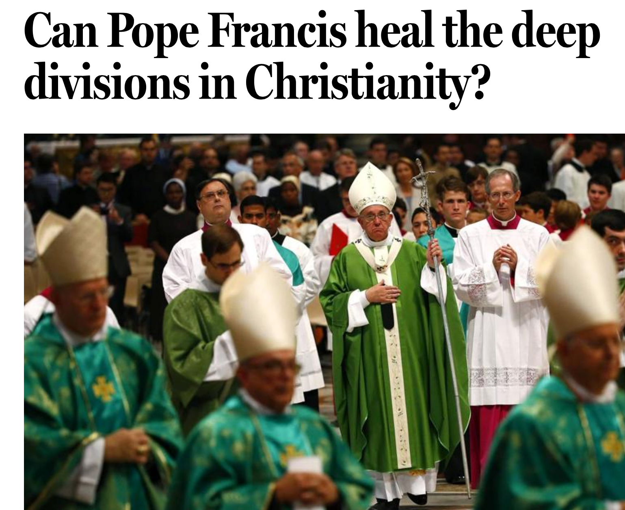

Slide 6
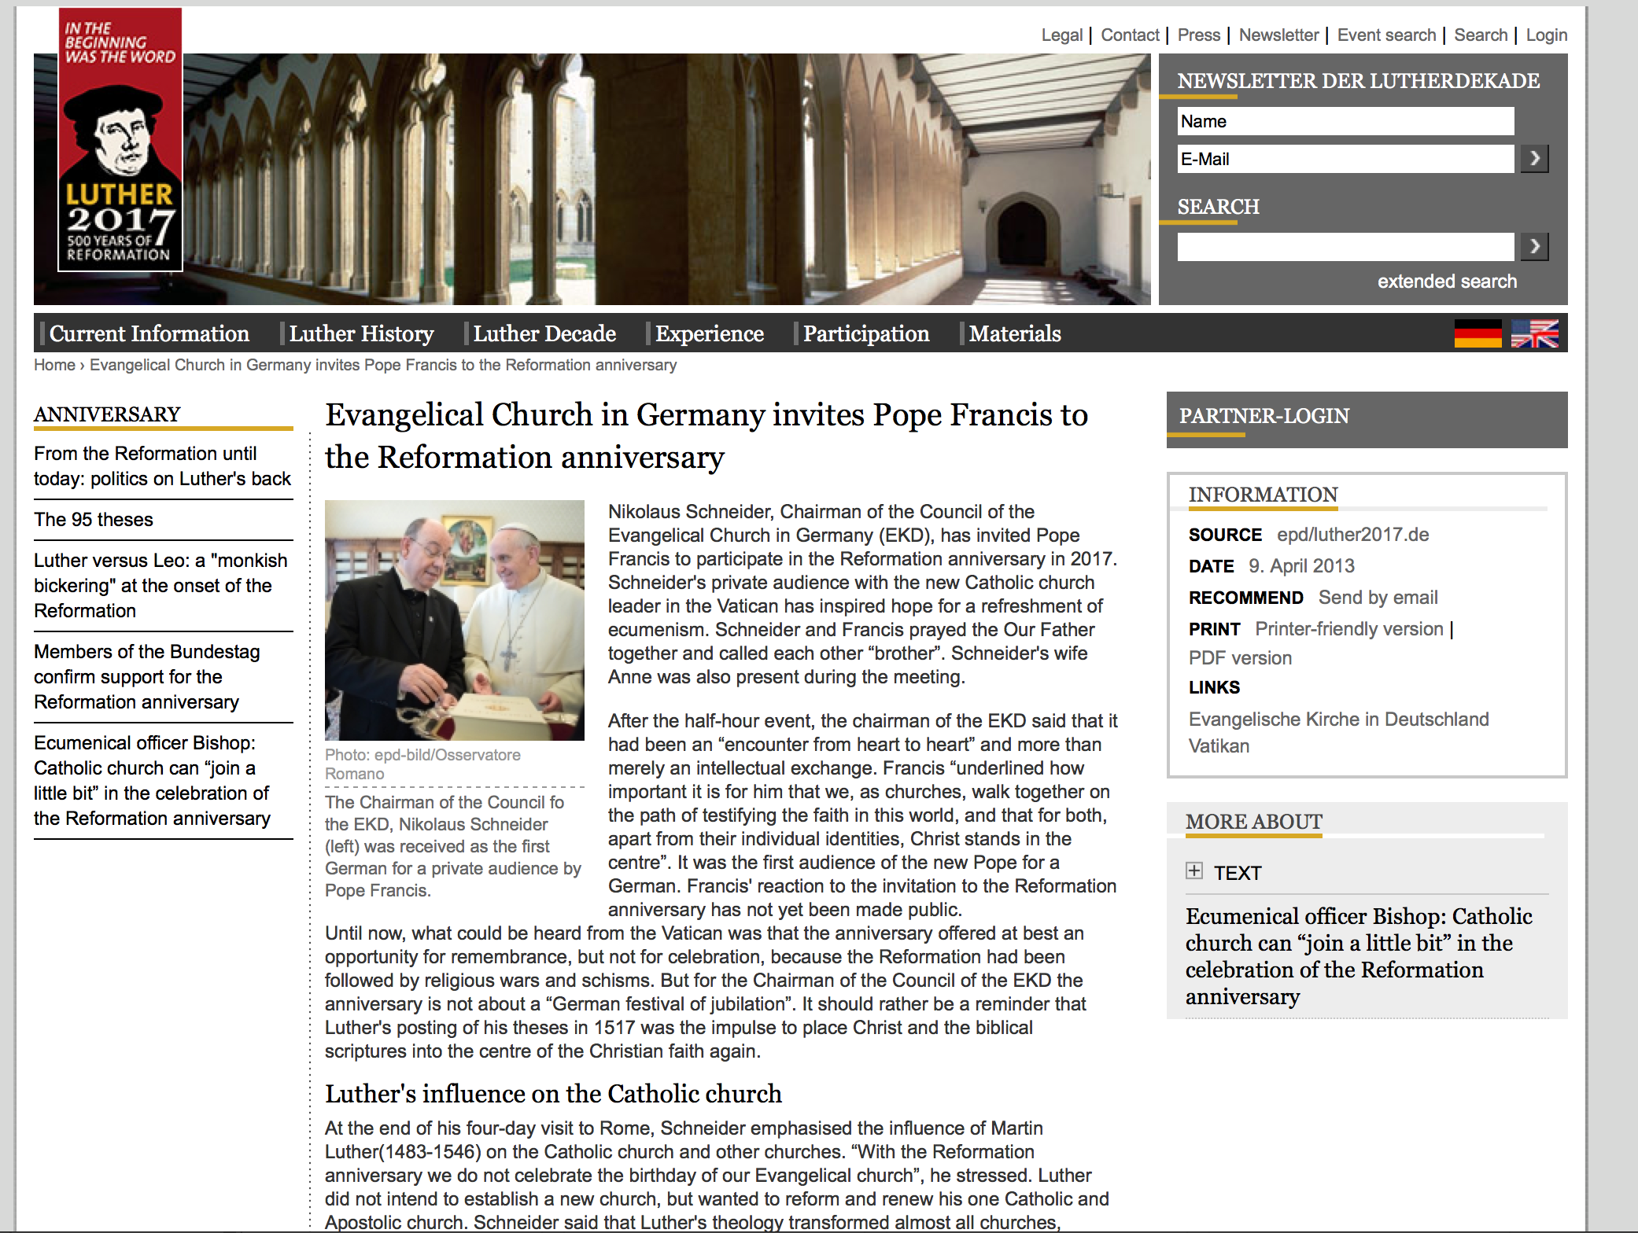

Slide 7
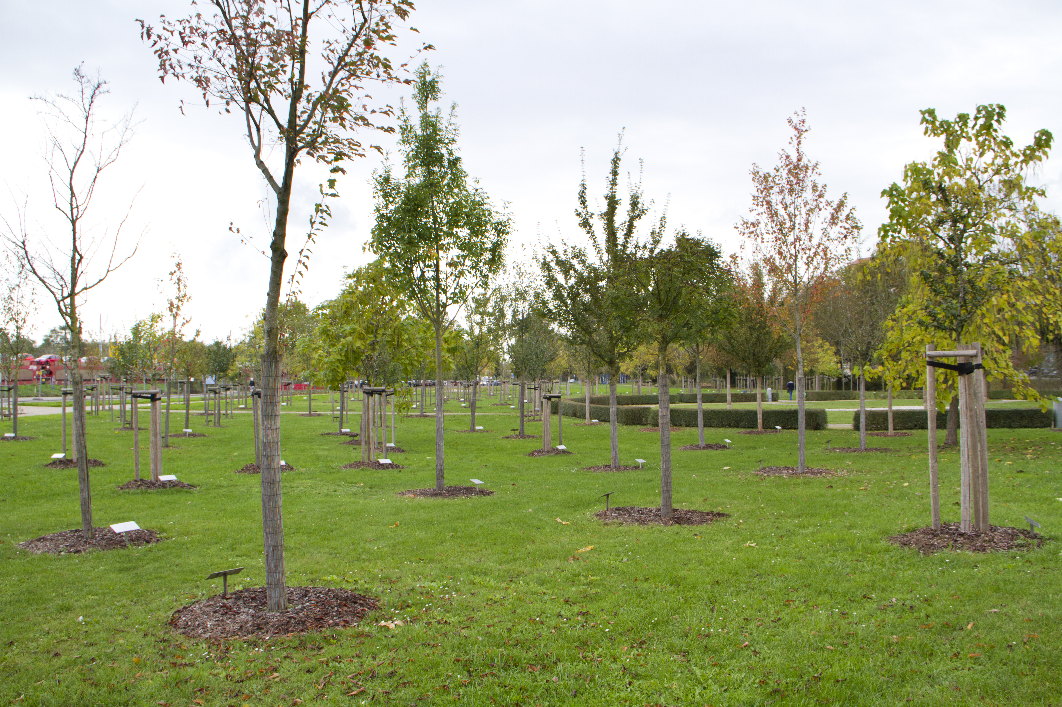

Slide 8
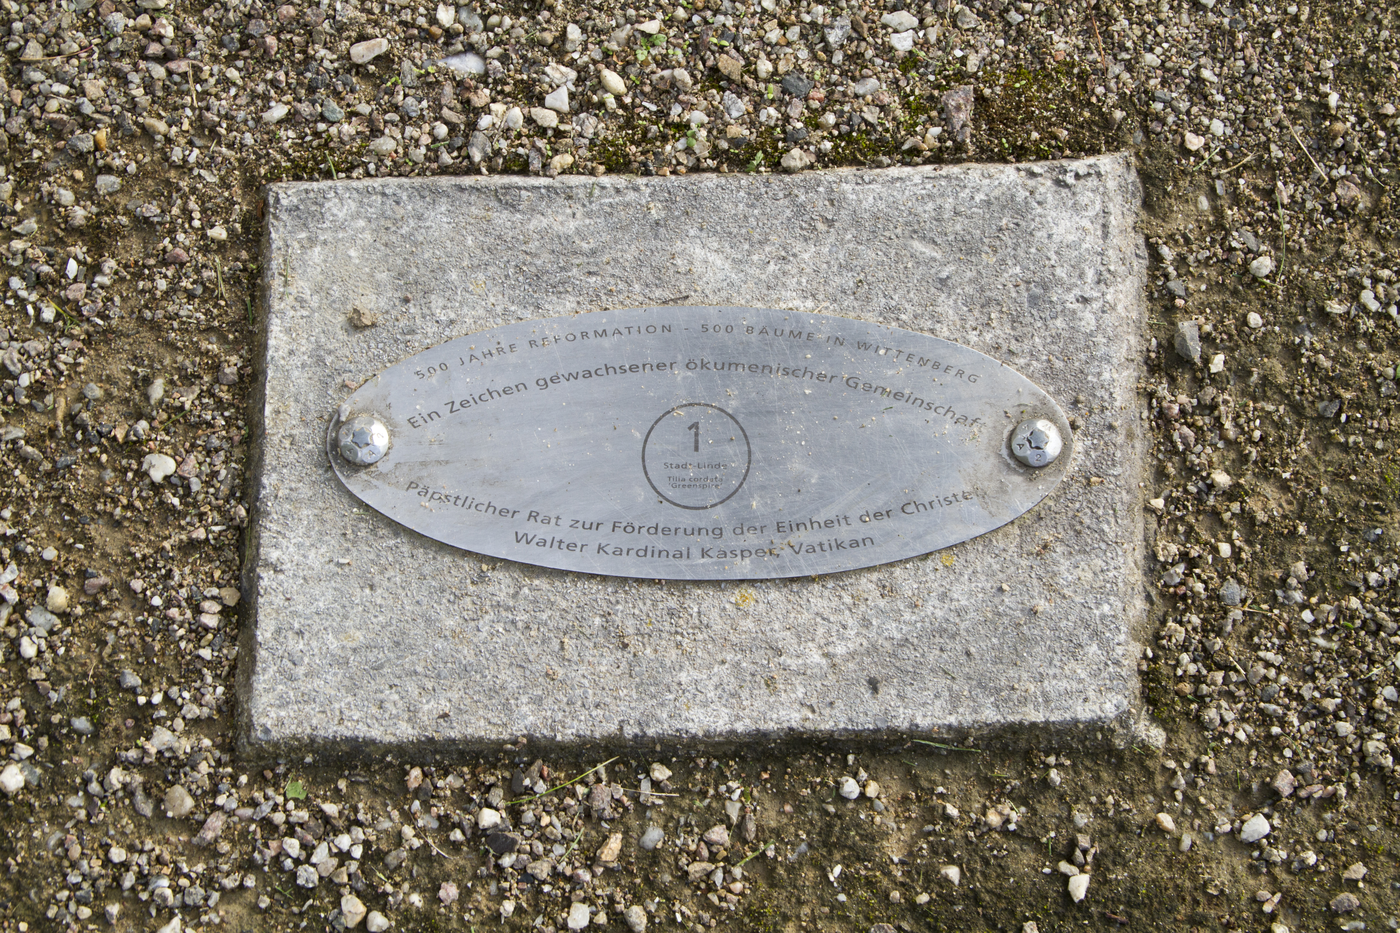
“I hope this garden will one day grow into a park. A park in which people can gather under the trees, a park that grows together, just as our Christian World Religion should grow together one day.”

Slide 9
From Conflict to Communion
“The awareness is dawning on Lutherans and Catholics that the struggle of the sixteenth century is over. The reasons for mutually condemning each other’s faith have fallen by the wayside. Thus, Lutherans and Catholics identify five imperatives as they commemorate 2017 together.”
“In 2017, we must confess openly that we have been guilty before Christ of damaging the unity of the church. This commemorative year presents us with two challenges: the purification and healing of memories, and the restoration of Christian unity in accordance with the truth of the gospel of Jesus Christ (Eph 4:4–6).”
www.vatican.va

Slide 10
Blasphemies and Persecution (Rev 13:5-8)
“This great antichristian power robbed the church of its gospel light and plunged the world into the Dark Ages....One thousand years covers the crest of the persecutions when from 50,000,000 to 150,000,000 martyrs died of the sword, at the stake, in dungeons, and of starvation because of the confiscation of their earthly possessions.”
Bunch, Taylor, The Book of Daniel, 1950, p. 170, 185.
Them that dwell in heaven
“Indeed, the excellence and power of the Roman pontiff is not only in the sphere of heavenly things, earthly things, and those of the lower regions, but even above the angels, than whom he himself is greater” (translated from Lucius Ferraris, “Papa II,” Prompta Bibliotheca, Vol. VI, p. 27

Slide 11
The Wound (Rev 13:9-10)
“Then said Jesus unto him, Put up again thy sword into his place: for all they that take the sword shall perish with the sword.”
Matthew 26:52
Romans 5:3

Slide 12
The Beast of the Earth (Rev 13:11)
Time Frame
Earth (12:16)
  Persecution → Fleeing
Growing process
Independence 1776, Constitution 1787, Bill of Rights 1791
“Like a silent seed we grew into empire.”
- G. A. Townsend, The New World Compared With the Old, p. 462
Liberty and gentleness (Republicanism and Protestantism)
7BC 975, GC 441
Speaks like a dragon

Slide 13
Toward a New World Order (Rev 13:12)
“By the decree enforcing the institution of the papacy in violation of the law of God, our nation will disconnect herself fully from righteousness. When Protestantism shall stretch her hand across the gulf to grasp the hand of the Roman power, when she shall reach over the abyss to clasp hands with spiritualism, when, under the influence of this threefold union, our country shall repudiate every principle of its Constitution as a Protestant and republican government, and shall make provision for the propagation of papal falsehoods and delusions, then we may know that the time has come for the marvelous working of Satan and that the end is near. {5T 451.1}

Slide 14
Focus on the Climate
“I welcome His Holiness Pope Francis’s encyclical, and deeply admire the Pope’s decision to make the case – clearly, powerfully, and with the full moral authority of his position – for action on global climate change.”
…
“...it is my hope that all world leaders–and all God’s children–will reflect on Pope Francis’s call to come together to care for our common home.”
Barack Obama

Slide 15
Calamities and Sunday Laws
“Satan puts his interpretation upon events, and they think, as he would have them, that the calamities which fill the land are a result of Sunday-breaking. Thinking to appease the wrath of God, these influential men make laws enforcing Sunday observance. They think that by exalting this false rest day higher and still higher, compelling obedience to the Sunday law, the spurious sabbath, they are doing God service” (10MR 239).
Signs and Wonders (Rev 13:13, 2 Thess 2:9, Matt 24:24)
“The Protest is over”

Slide 16
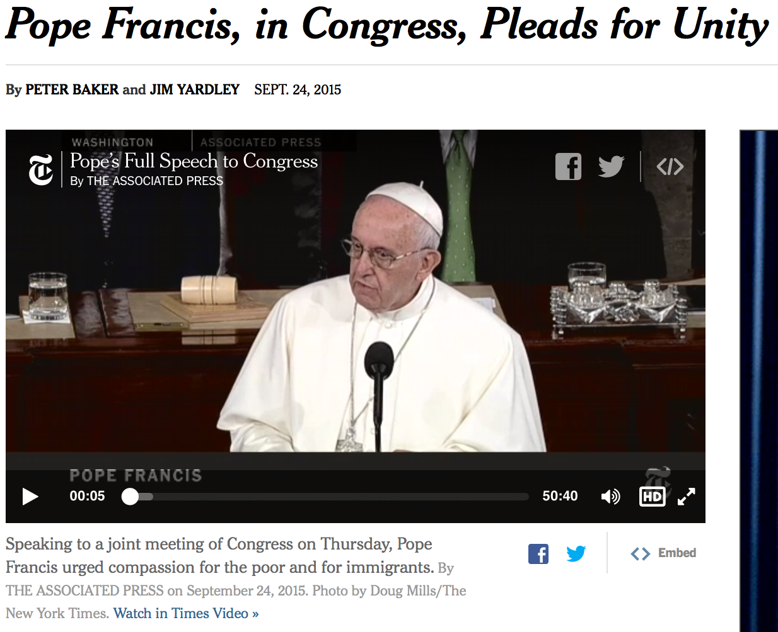
The Image of the Beast
What is an image?
GC 445
Against the Constitution
Worship the beast!
(Luke 4:7, Luke 21:17)
Fundamentalism

Slide 17
Pope’s US Visit 2015
“Lawmakers snapped photographs with smartphones and interrupted the speech about 30 times with applause…Not long ago, the prospect of the head of the Catholic Church addressing Congress would have been unthinkable. Catholics in politics were a source of suspicion and a subject of slander for generations. Today, the pendulum has swung. ”
- New York Times
GC 590

Slide 18
Papacy Unchanged
“The Roman Church now presents a fair front to the world, covering with apologies her record of horrible cruelties. She has clothed herself in Christlike garments; but she is unchanged. Every principle of the papacy that existed in past ages exists today. The doctrines devised in the darkest ages are still held. Let none deceive themselves. The papacy that Protestants are now so ready to honor is the same that ruled the world in the days of the Reformation, when men of God stood up, at the peril of their lives, to expose her iniquity. She possesses the same pride and arrogant assumption that lorded it over kings and princes, and claimed the prerogatives of God. Her spirit is no less cruel and despotic now than when she crushed out human liberty and slew the saints of the Most High. {GC 571.1}

Slide 19
Give the Warnings!
“We are to give to the people the warnings contained in Revelation. But many workers are engaged in a line of work that is disqualifying them to preach the word and do the very work God has appointed them to do. The truth in regard to the Sabbath of the Lord is to be proclaimed. The seventh-day is to be shown to be the seal of the living God. People are to be shown what they may expect from the papal power. The time has come when the Protestant churches are reaching out to grasp the hand of the power that has made void the law of God… This is the message Satan would have silenced…Shall this message be considered an inferior matter? “
– Ellen G. White, 4MR 426.1

Slide 20
Questions
What events/movements do you see in the world today that is fulfilling the prophecy in Revelation 13?
What is the best we can do, not to be deceived?
A protestants, how are we to protest?
Is it time to leave the cities?
Give reasons for your answers

