Slide 1

End Time Lessons in Daniel 1-6
Christian Hjortland

Slide 2
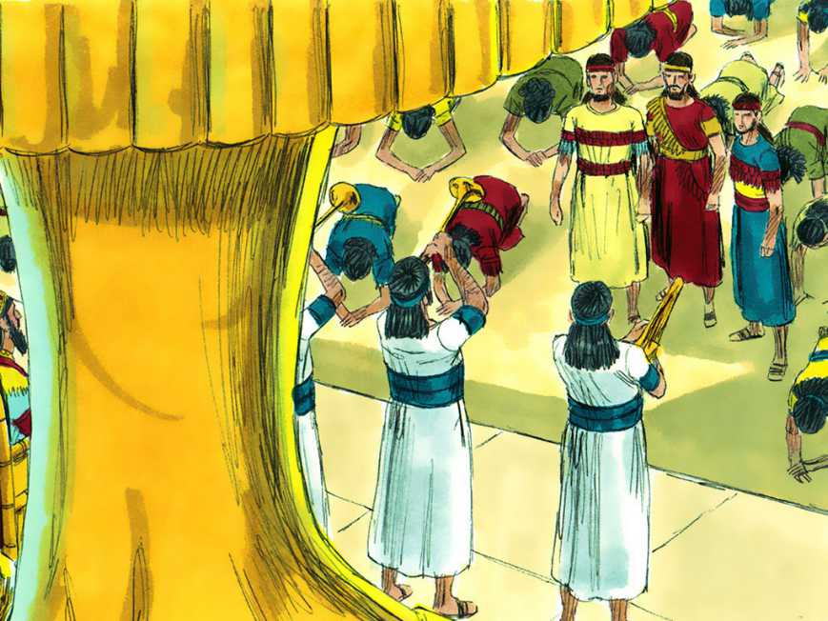

Is there any end time lessons in Daniel?
Daniel 2-7 – outline.
1. Rise and fall of kingdoms.
2. Rise and fall of kings.
3. Persecution of the saints by the state
What about the end time?

Slide 3
History vs. Future
“I have also spoken by the prophets, and I have multiplied visions, and used similitudes, by the ministry of the prophets.”
Hosea 12:10
Ecclesiastes 1:9-10
Has history repeated itself?
- Passover
- 12 tribes of Israel – disciples...
Babylon
Persecution of God’s people

Slide 4

End Time Lessons in Daniel 3
Nebuchadnezzar's dream in Daniel 2.
Daniel 3:1-6

Slide 5
Glorify God – always”
“These three Hebrews possessed genuine sanctification. True Christian principle will not stop to weigh the consequences. It does not ask, What will people think of me if I do this? or, How will it affect my worldly prospects if I do that? With the most intense longing the children of God desire to know what He would have them do, that their works may glorify Him. The Lord has made ample provision that the hearts and lives of all His followers may be controlled by divine grace, that they may be as burning and shining lights in the world. {RC 87.6}

Slide 6
Music and worship
“Those things which have been in the past will be in the future. Satan will make music a snare by the way in which it is conducted. God calls upon His people, who have the light before them in the Word and in the Testimonies, to read and consider, and to take heed.” {2SM 38.1}

Slide 7
Music and worship
“The things you have described as taking place in Indiana, the Lord has shown me would take place just before the close of probation. Every uncouth thing will be demonstrated. There will be shouting, with drums, music, and dancing. The senses of rational beings will become so confused that they cannot be trusted to make right decisions. And this is called the moving of the Holy Spirit. The Holy Spirit never reveals itself in such methods, in such a bedlam of noise. This is an invention of Satan to cover up his ingenious methods for making of none effect the pure, sincere, elevating, ennobling, sanctifying truth for this time. Better never have the worship of God blended with music than to use musical instruments to do the work which last January was represented to me would be brought into our camp meetings. The truth for this time needs nothing of this kind in its work of converting souls. A bedlam of noise shocks the senses and perverts that which if conducted aright might be a blessing. The powers of satanic agencies blend with the din and noise, to have a carnival, and this is termed the Holy Spirit's working. {2SM 36.3}

Slide 8
End Time Lessons in Daniel
Revelation 13:11-15
1. An image is set up.
2. All peoples and nations must worship.
3. Combining of Religion and State.
4. Death penalty for those who refuse to worship.
5. Speaking with the voice of a dragon.

Slide 9
End Time Lessons in Daniel
“History will be repeated. False religion will be exalted. The first day of the week, a common working day, possessing no sanctity whatever, will be set up as was the image at Babylon. All nations and tongues and peoples will be commanded to worship this spurious sabbath. This is Satan's plan to make of no account the day instituted by God, and given to the world as a memorial of creation. The decree enforcing the worship of this day is to go forth to all the world. In a limited degree, it has already gone forth. In several places the civil power is speaking with the voice of a dragon, just as the heathen king spoke to the Hebrew captives. {7BC 976.8}
Daniel 3:7-11, 12, 13-18

Slide 10
End Time Lessons in Daniel
1. An image is set up.
2. All peoples and nations must worship.
3. Combining of Religion and State.
4. Death penalty for those who refuse to worship.
5. Speaking with the voice of a dragon.
6. Keeping God's commandments
7. Persecution of the saints. (Rev 12:13-17, 13:7).
8. Following God wherever He goes
9. Not defiled by Babylon (Revelation 14:4-5)

Slide 11
End Time Lessons in Daniel
10. Innocent before God
Daniel 6:22, 1:4
Revelation 14:5
11. God's people tried in fire – Daniel 3:19-23
Does God's end time people need to be tried in fire?
Revelation 3:18
Persecution

Slide 12
End Time Lessons in Daniel
12. Jesus is with His people as they go through fiery trials.
Daniel 3:24-25.
Revelation 12:14
Revelation 7:1-3
13. A wound that was healed
Daniel 4:30-34
Revelation 13:3, 5, 12

Slide 13
End Time Lessons in Daniel
14. Judgment of the wicked (and the righteous) (Dan 6:24)
Daniel 2:34-35 - The stone
Daniel 5:25-27 - Writing on the wall
Revelation 14:7
Revelation 22:12
Rev 20:4,9,15 – ultimate destruction.
Revelation 16 – 7 Last plagues
15. God ultimately deliver His people and give them a reward.
Daniel 3:26-30, 6:20-23, 28
Revelation 19:1, 22:12-14

Slide 14


Slide 15
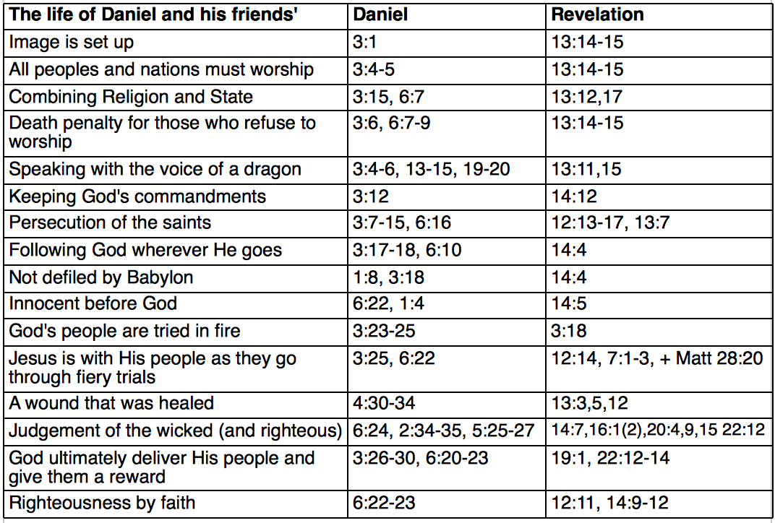
End Time Lessons in Daniel

Slide 16
Lessons of Prayer
“Having therefore, brethren, boldness to enter into the holiest by the blood of Jesus” - Hebrews 10:19
Sometimes it may take time:
Daniel 10 – Praying and fasting.

Slide 17
3 Angel's Messages in Daniel 1-6
1. Angel
Fear God and Give Glory to Him (Dan 1:8, 3+6)
The Hour of His judgment (Dan 2,3,4,5:27,6)
Worship Him… (Dan 3+6)
2. Angel
Babylon is fallen (Dan 4:31, 5:2-3)
3. Angel
Worship the beast/image (Dan 3+6:7)
Judgment (Dan 6)
Righteousness by faith (Dan 6:22-23)

Slide 18
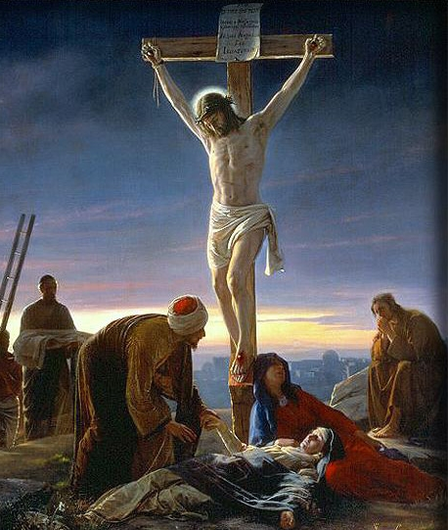
Circumstances vs. Principle

Slide 19
Questions for discussion
In groups of 3-4, discuss the following questions. Think first yourself, and then share with the group.
1. A. What can we learn from Daniel and his friends how we personally need to be prepared, and act in these end time days?
B. How can you practically apply it to you your life?
2. Can we learn anything from their evangelism efforts?
Write down your answers with references.

