Slide 1

Revelation 12
Christian Hjortland

Slide 2
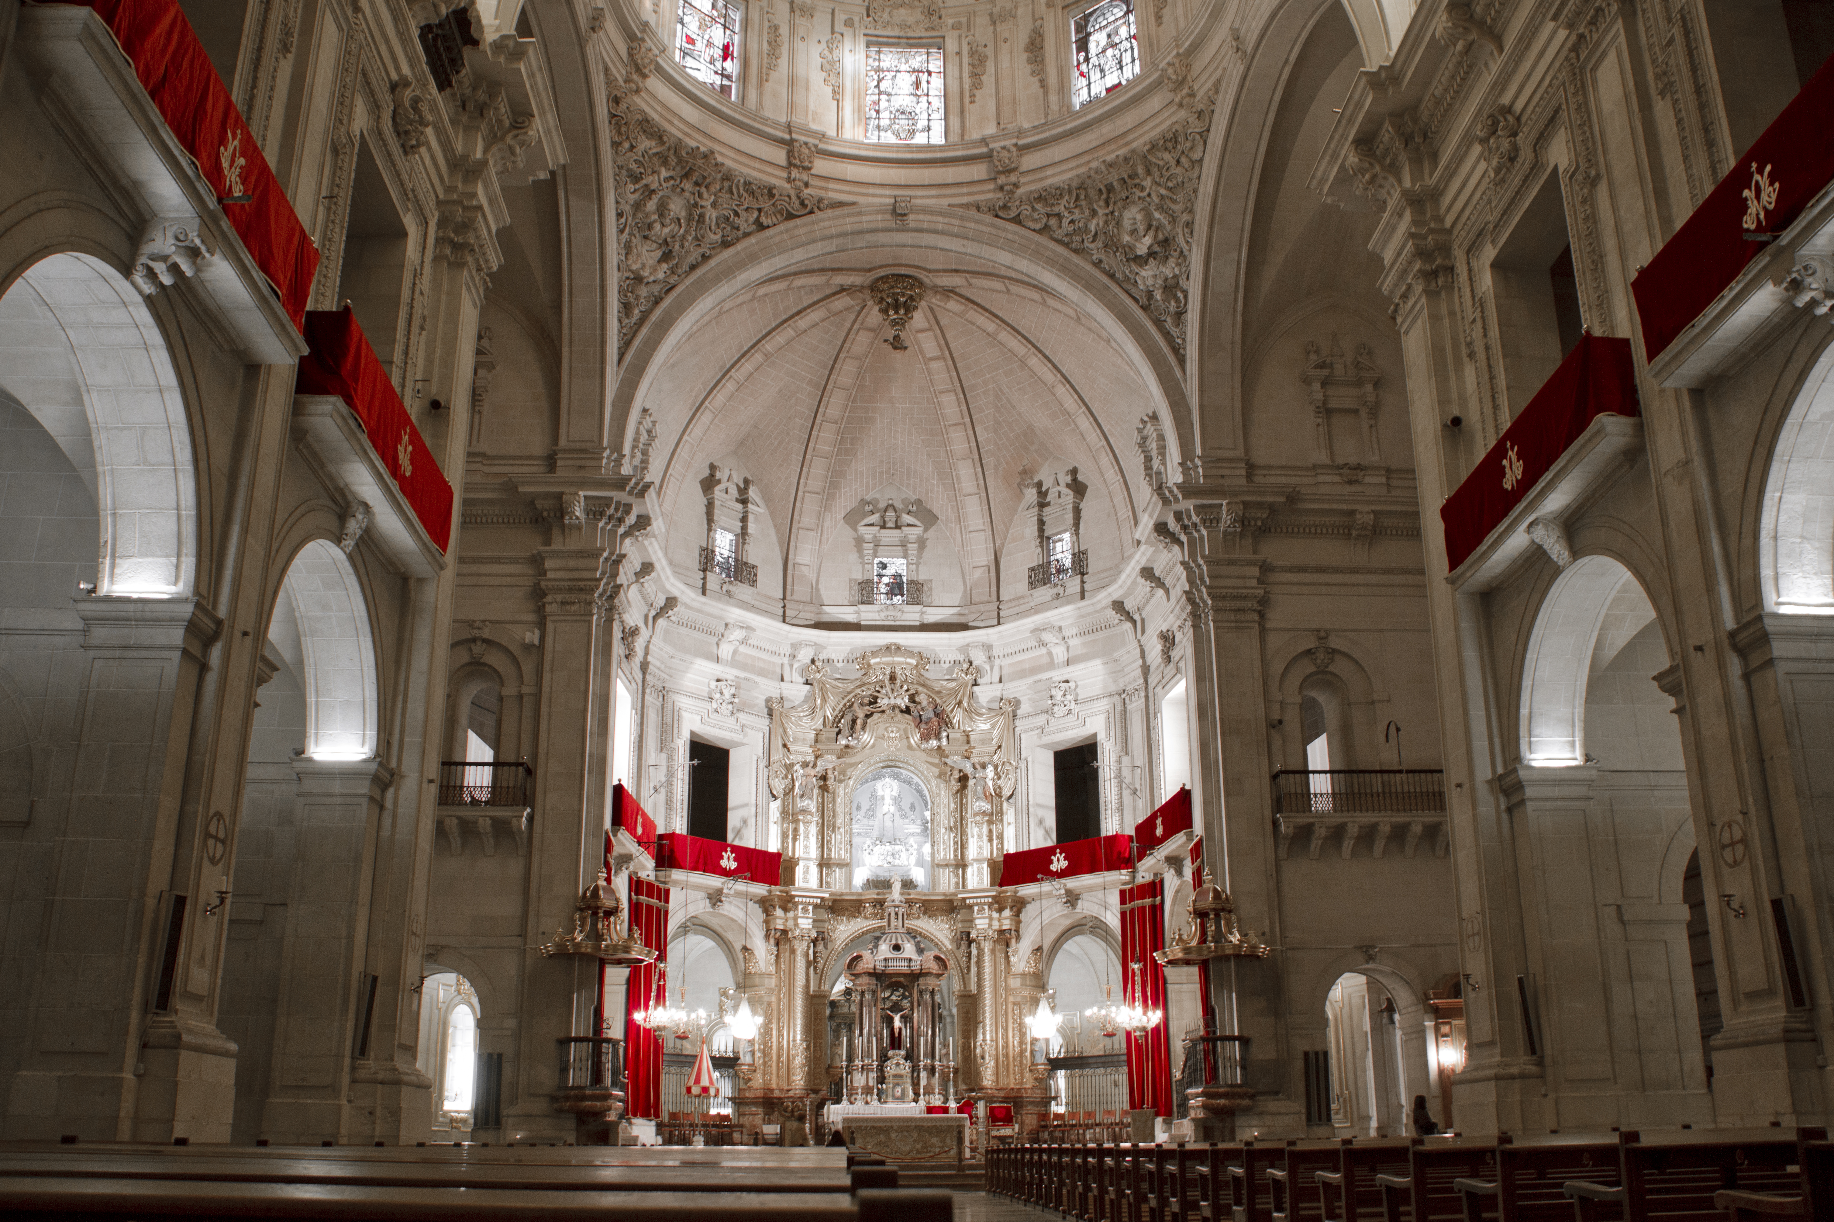


Slide 3
Revelation 12 – Persecution of a Child
Revelation 12:1-2
Sun (Malachi 4:2, Matthew 17: 2; Ps 84:11)
12 stars
Crown
Child (Is 26:17, 66:7)
v.3-4 – A red dragon with ten horns
Seven heads with ten horns (Rev 17:3, 9-10)

Slide 4
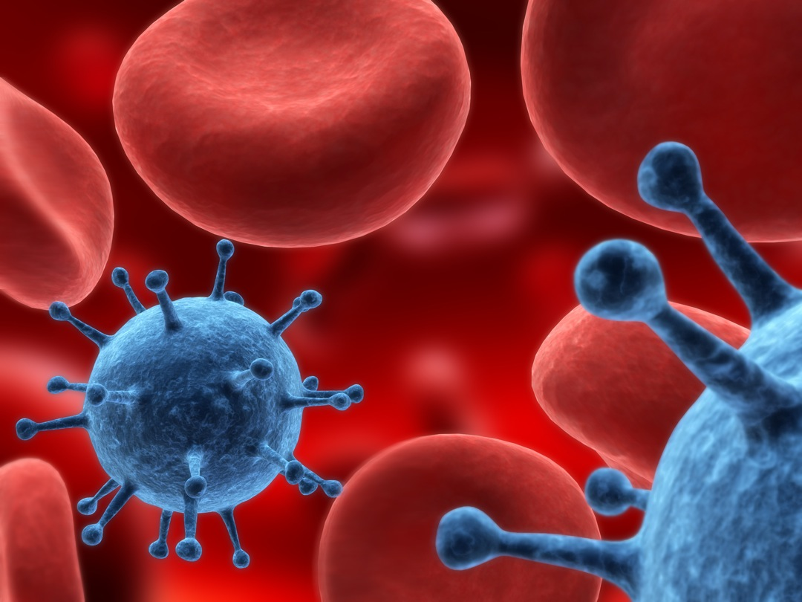
The War in Heaven
v. 7-9 War in heaven.
Michael the prince (Daniel 10:13, 12:1-2, Jude 1:9,
1 Thess 4:16, John 5:25, Dan 9:25)
What was Lucifer’s problem?
Isaiah 14:12-14
The casting down
Ruler of the world (Job 1:6-7, DA 834)
DA 761
Access to heaven (John 12:31
Accuser of the brethren (Job 1:6-12)
Photo: Laura sofia muñoz oquedo / CC 4.0

Slide 5
Revelation 12:11-14 – Persecution
Loved not their lives until death – John 12:25, Gal 2:20
Roaring lion – 1 Pet 5:8
Wings – Exodus 19:4
1260 days – 538-1798 of Papal power
Dan. 7:25 - “a time, times, and the dividing of time”’
Dan. 12:7 – “a time, times, and an half”
Rev. 11:2 – “forty and two months”
Rev. 11:3 – “a thousand two hundred and threescore days”
Rev. 12:6 - “twelve hundred and sixty days”
Rev. 12:14 - “a time, times, and half a time”
Rev. 13:5 - “Forty two months”
Day/year principle – Ezekiel 4:6, Numbers 14:34, Luke 13:32

Slide 6
1260 Years of Persecution
“Vigilius ascended the papal chair in (538 A.D.) under the military protection of Belisarius.”
- History of the Christian Church, vol. 3, p.327.
“Berthier (the general of Napoleon) entered Rome on the tenth of February, 1798, and proclaimed a republic…In 1798 he (Berthier)…made his entrance into Rome, abolished the Papal government and established a secular one.”
- The Encyclopedia Americana, 1941.
Revelation 12:15 – Water (Rev 17:15)

Slide 7
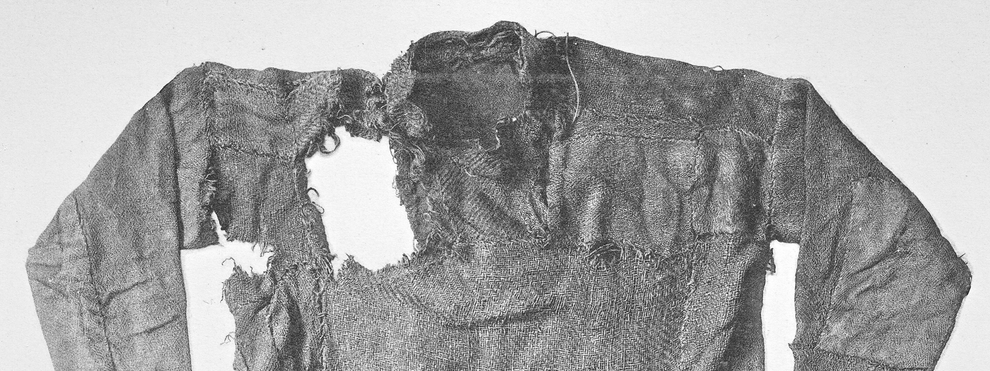
A Remnant Rising
Revelation 12:16-17 – Out of the Wilderness
How can we identify God’s Remnant Church?
What is the testimony of Jesus?

Slide 8
Who is God’s Remnant Church?
“but if I am delayed, I write so that you may know how you ought to conduct yourself in the house of God, which is the church of the living God, the pillar and ground of the truth.”
- 1 Timothy 3:15
What is Truth?
John 17:17, 14:6, Psalms 119:142

Slide 9
Characteristics of God’s Last Church
It did not exist as an organization before 1798.
They follow all of God's Ten Commandments, including the fourth.
It has the gift of prophecy
Revelation 19:10, 22:8-9
“And he gave some, apostles; and some, prophets; and some, evangelists; and some, pastors and teachers;
For the perfecting of the saints, for the work of the ministry, for the edifying of the body of Christ.” (Ephesians 4:11-12)

Slide 10
The Remnant will Accept God’s GPS
The Animal - Jesus (John 1:29)
Altar of Sacrifice – The Cross
Laver – Baptism (Titus 3:1)
Showbread – The Bible + Jesus (John 6:51, Matt 4:4)
Candlestick – Witnessing, Holy Spirit, Jesus (John 9:5, Matt 5:1, Zech 4:1-6, Rev 4:5)
Altar of Incense – Prayers (Rev 5:8, 8:3-4, Heb 7:25)
Ark of the Covenant (Ten Commandments, etc.)
The Priest – Jesus (Heb 3:1, 4:14)
The Curtains - Jesus (Heb 10:20, John 10:9)

Slide 11
5 Characteristics of God’s Last Church in Rev 12-14
Did not exist as an Organization before 1798
Follows all God’s ten Commandments
Has the gift of Prophecy
A World Wide Movement that Proclaims the Gospel
Accepting and Preaching the Three Angel’s Messages

Slide 12


