Slide 1
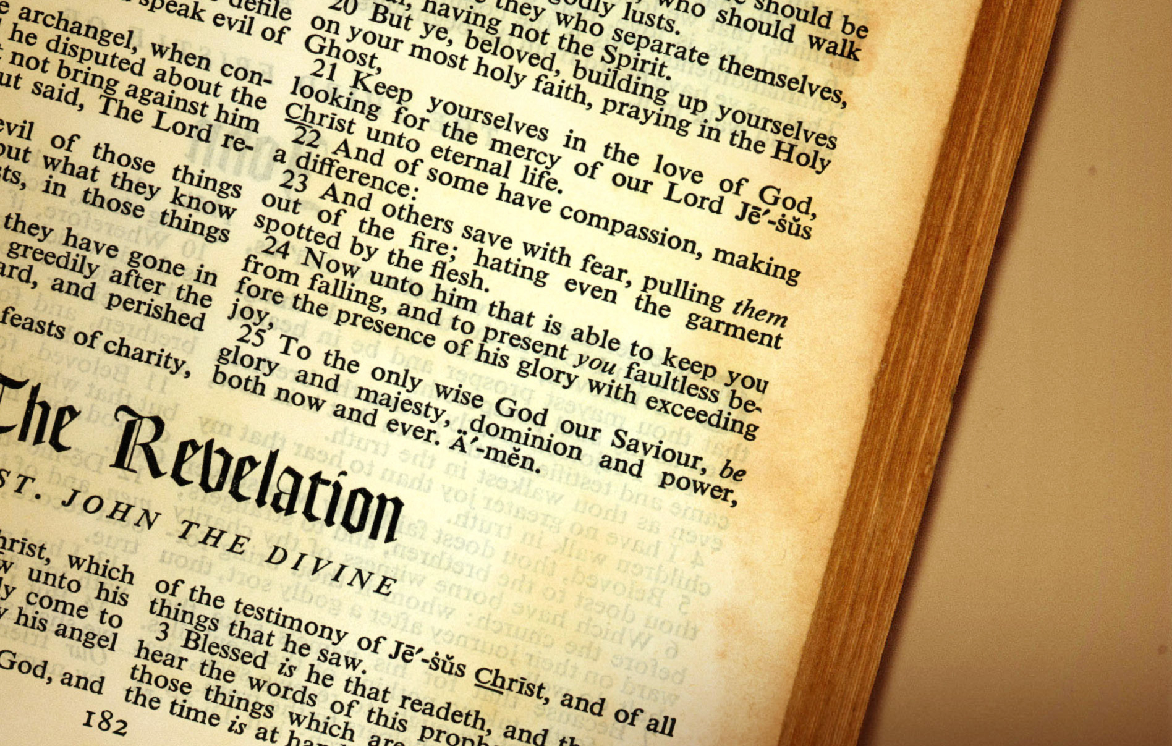
Revelation’s Seven Seals
Christian Hjortland

Slide 2

The Importance of Rev. 5
“The fifth chapter of Revelation needs to be closely studied. It is of great importance to those who shall act a part in the work of God for these last days. There are some who are deceived. They do not realize what is coming on the earth. Those who have permitted their minds to become beclouded in regard to what constitutes sin are fearfully deceived. Unless they make a decided change they will be found wanting when God pronounces judgment upon the children of men. They have transgressed the law and broken the everlasting covenant, and they will receive according to their works. {9T 267.1}

Slide 3
The Importance of Rev. 5
Revelation 5:1-6
Lion (Rev 9:8,17, 10:3, 13:2,5)
Lamb
Seven eyes – Zech 4:10
Revelation 5:7
The Destiny of Humanity
Revelation 5:8-14

Slide 4
The Cross made the difference!
“Well, then, might the angels rejoice as they looked upon the Saviour's cross; for though they did not then understand all, they knew that the destruction of sin and Satan was forever made certain, that the redemption of man was assured, and that the universe was made eternally secure. Christ Himself fully comprehended the results of the sacrifice made upon Calvary. To all these He looked forward when upon the cross He cried out, "It is finished." {DA 764.4}

Slide 5
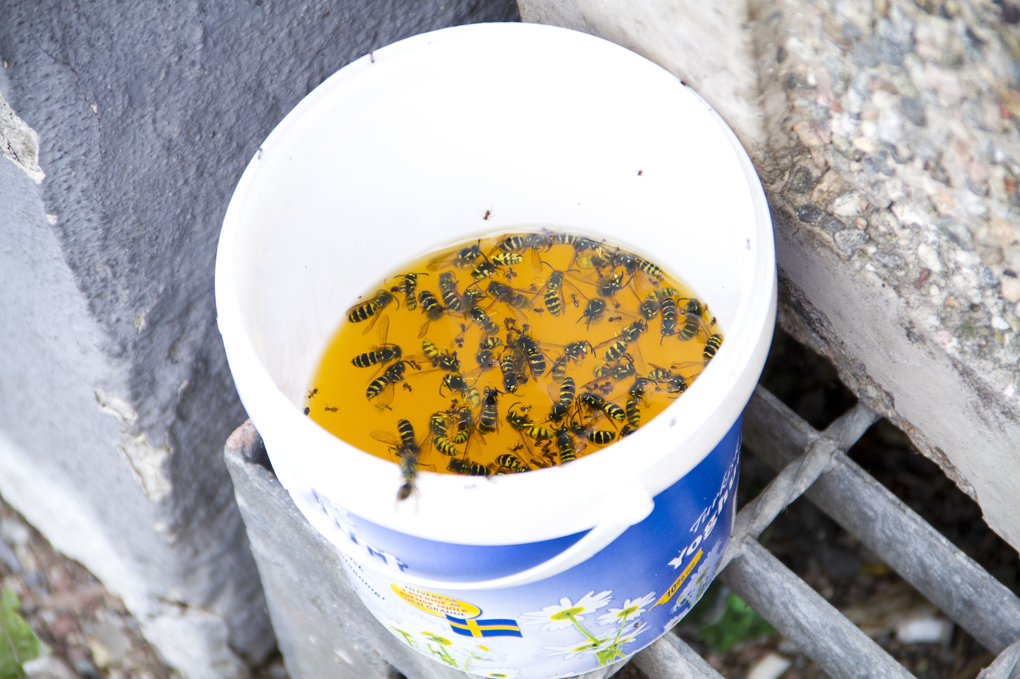

Slide 6
He who knew no sin, became sin for us
“In what contrast is the second Adam as He entered the gloomy wilderness to cope with Satan singlehanded! Since the Fall the race had been decreasing in size and physical strength, and sinking lower in the scale of moral worth, up to the period of Christ's advent to the earth. And in order to elevate fallen man, Christ must reach him where he was. He took human nature, and bore the infirmities and degeneracy of the race. He, who knew no sin, became sin for us. He humiliated Himself to the lowest depths of human woe, that He might be qualified to reach man, and bring him up from the degradation in which sin had plunged him. {1SM 268.2}

Slide 7
Opening of the Seals
What time frame are we in?
Lamb slain
“Their [the Jewish leaders] decision [to crucify Christ] was registered in the book which John saw in the hand of Him that sat upon the throne, the book which no man could open. In all its vindictiveness this decision will appear before them in the day when this book is unsealed by the Lion of the tribe of Judah” (COL 294)

Slide 8
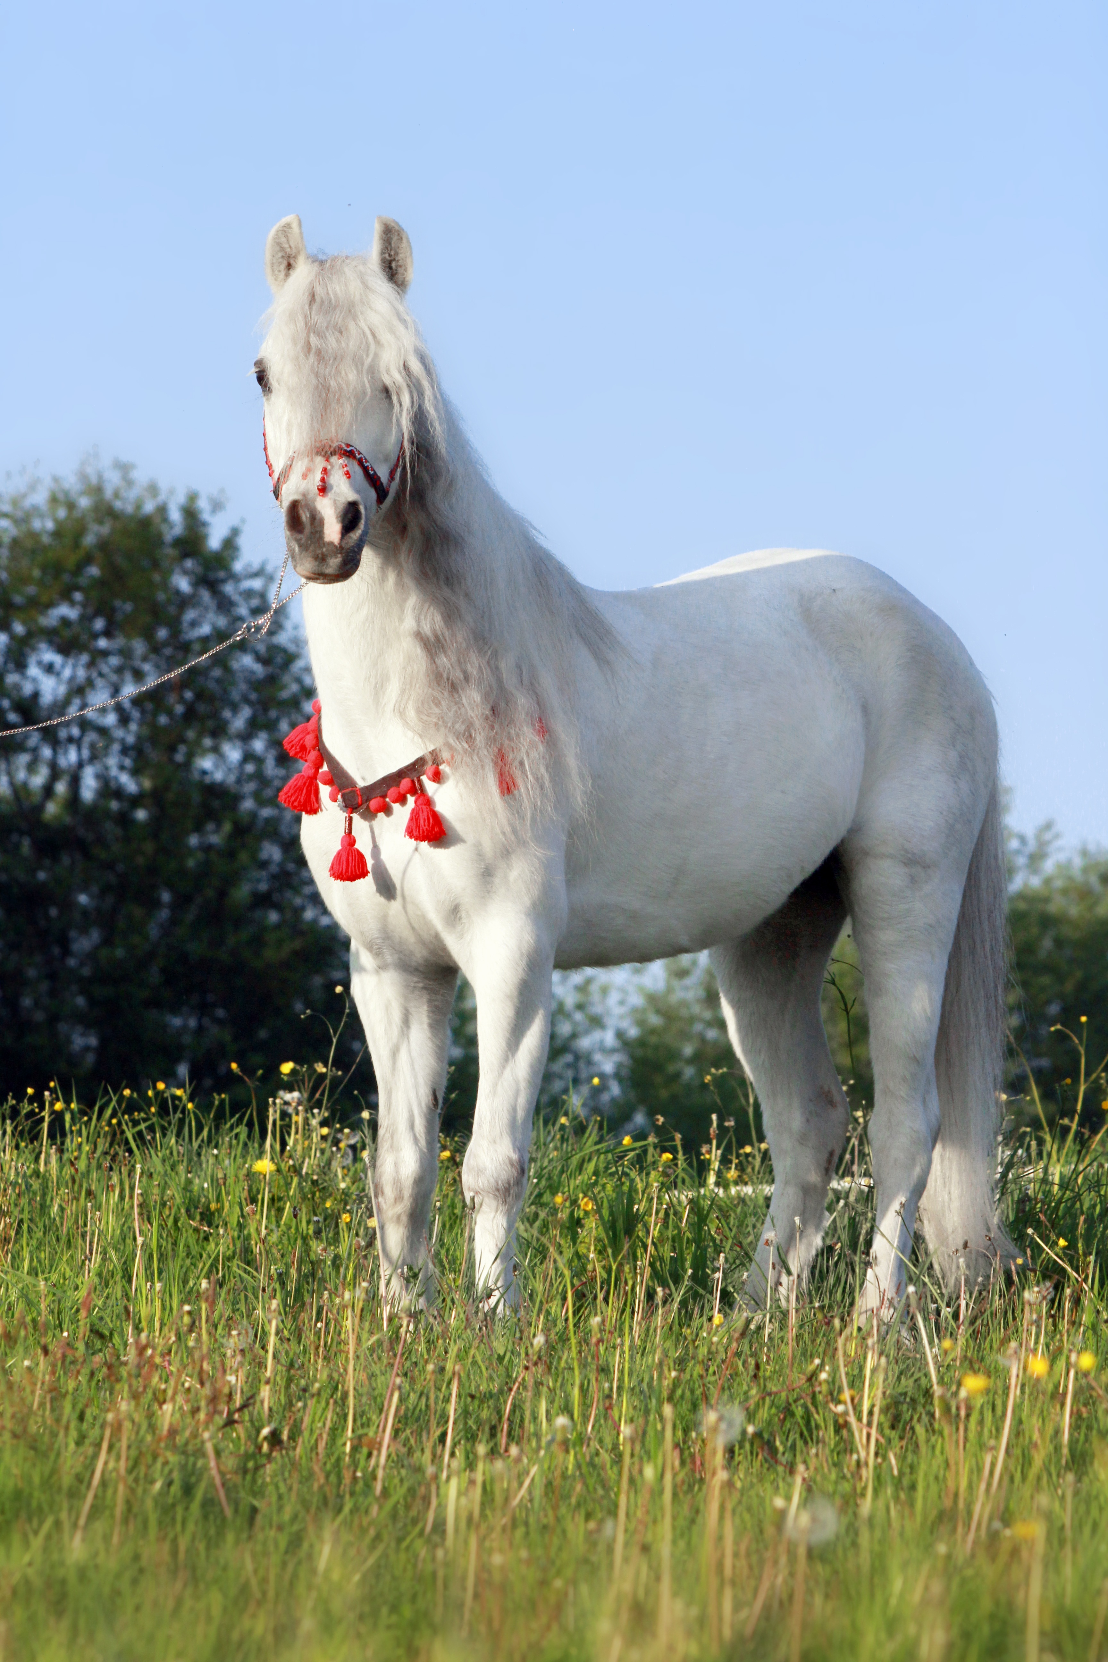
First Seal – The Pure Church (31-100 A.D.)
COL 294
GC 666
RH, January 1, 1884
RH, November 4, 1884
Horse (Proverbs 21:31)
Colors – White (Rev 7:14, 19:8, Is 1:18)
Crown
Revelation 19:11

Slide 9
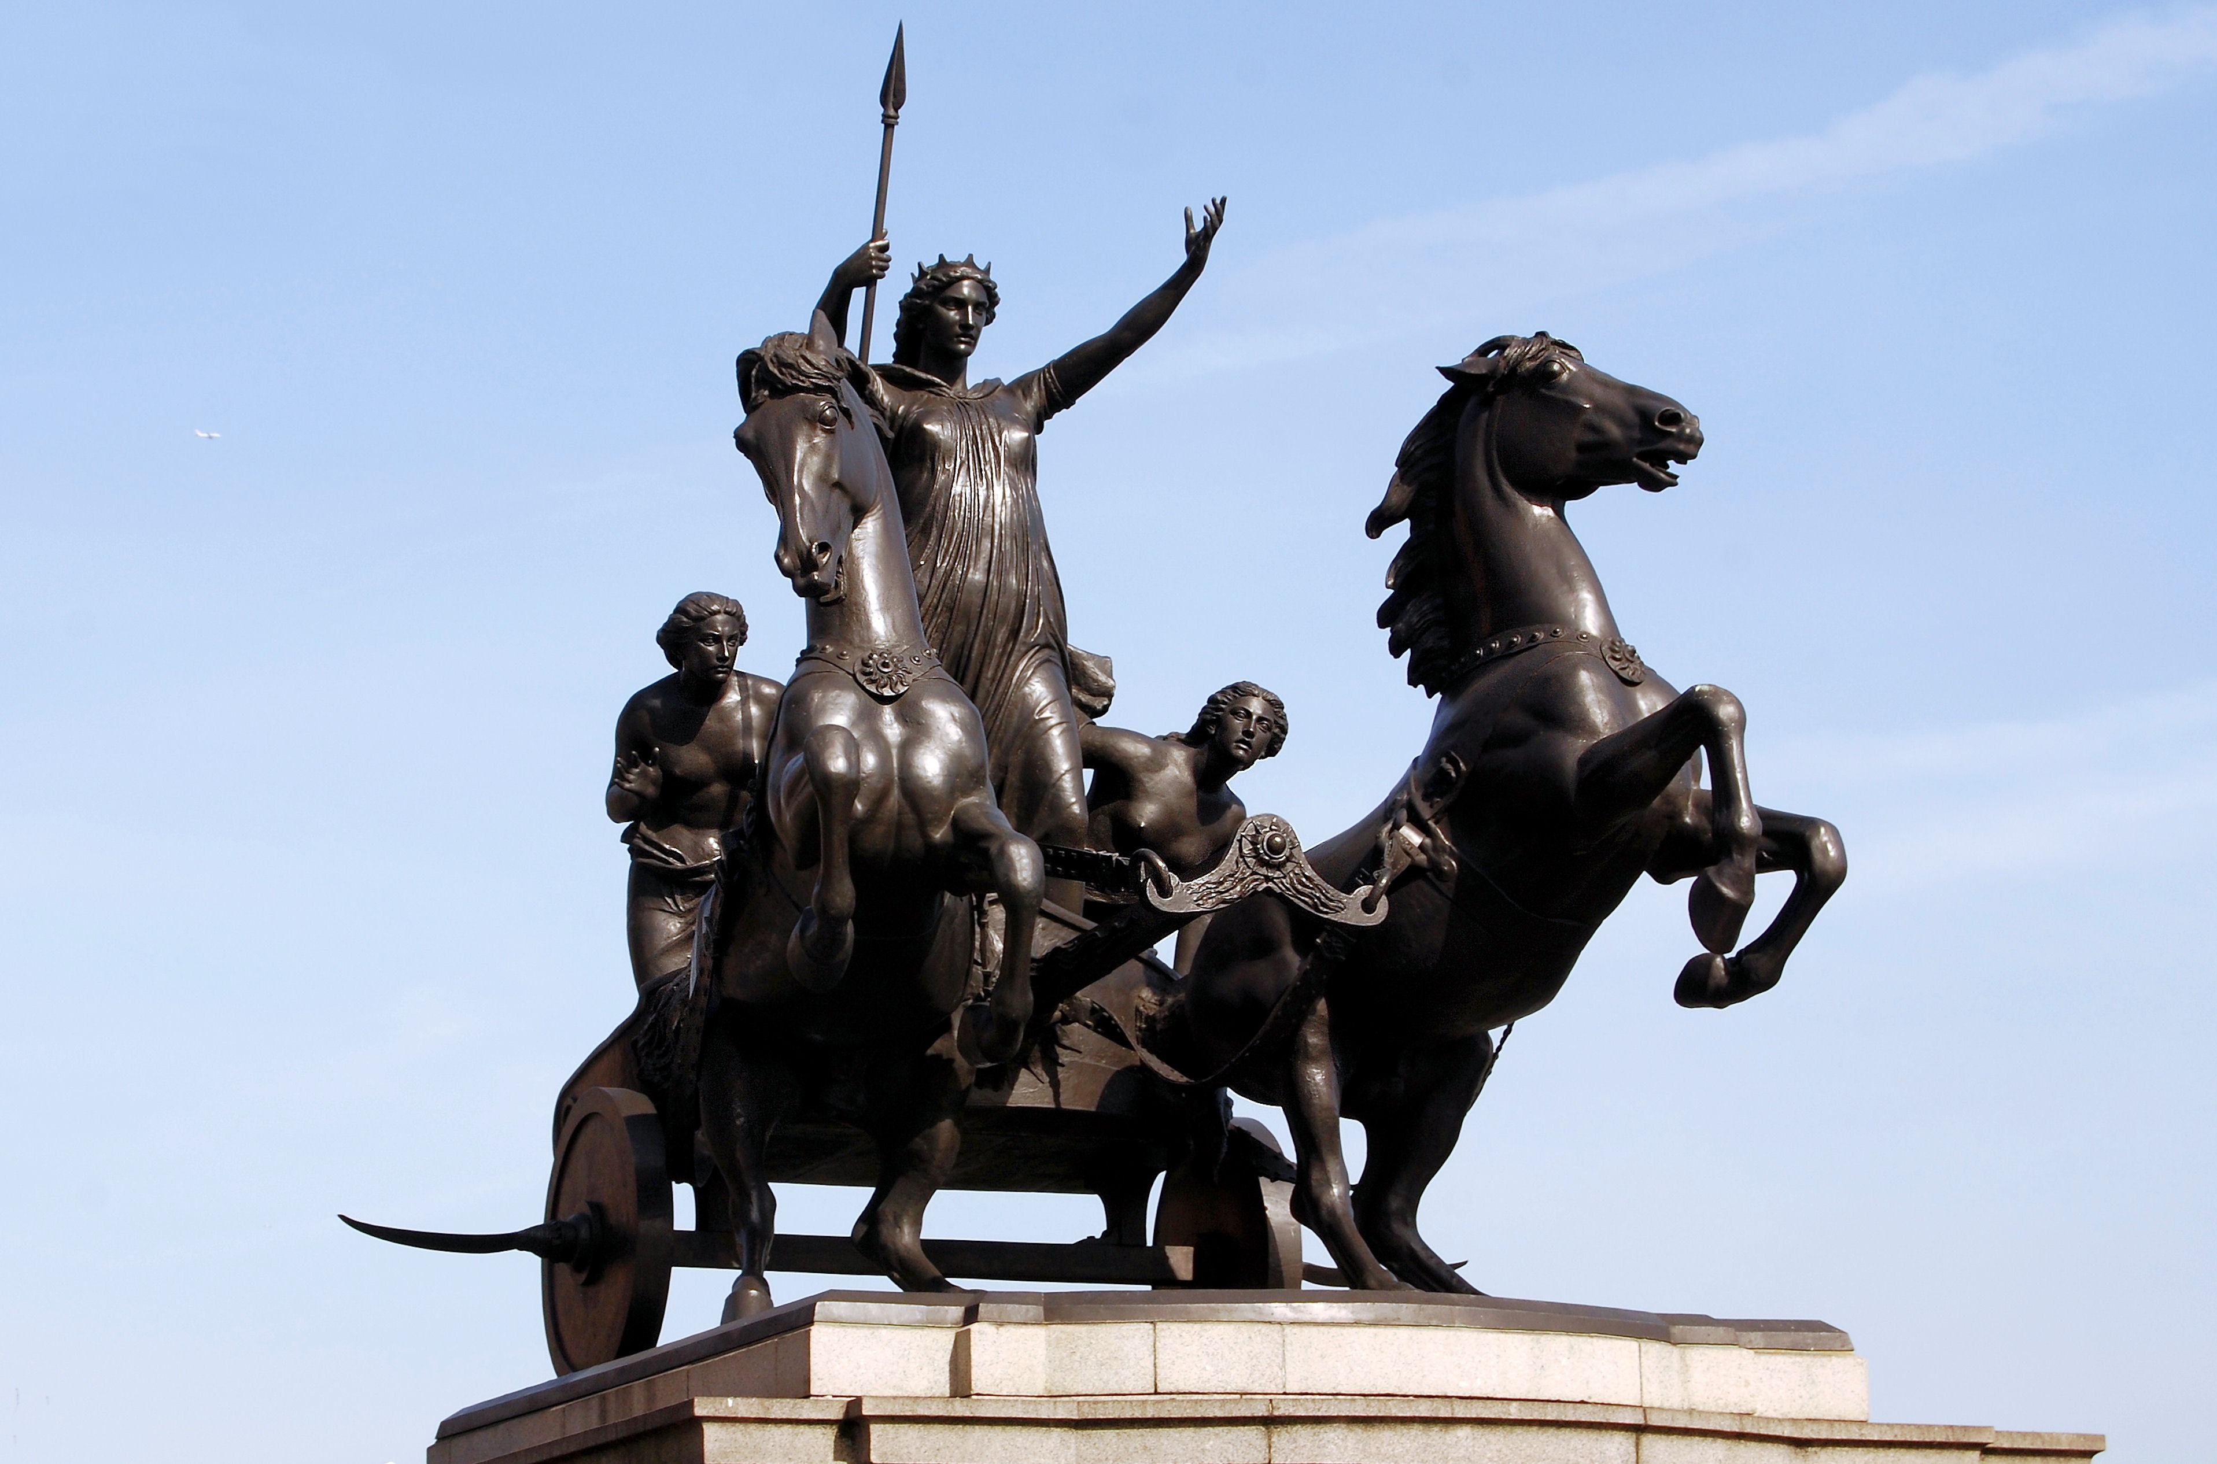
Second Seal – The Persecuting Church
Red (Is 1:18, 63:1-3)
Sword (Rom 13:1-4)
Constantine

Slide 10
Third Seal – The Corrupt Church
Black
A pair of balances, measure, penny
Control of other believers
Oil and wine

Slide 11
Third Seal – The Corrupt Church
"In order to secure man to Himself and ensure his eternal salvation, Christ left the royal courts of heaven and came to this earth, endured the agonies of sin and shame in man's stead, and died to make him free. In view of the infinite price paid for man's redemption, how dare any professing the name of Christ treat with indifference one of His little ones? How carefully should brethren and sisters in the church guard every word and action lest they hurt the oil and the wine! How patiently, kindly, and affectionately should they deal with the purchase of the blood of Christ! How faithfully and earnestly should they labor to lift up the desponding and the discouraged! How tenderly should they treat those who are trying to obey the truth and have no encouragement at home, who have constantly to breathe the atmosphere of unbelief and darkness! {5T 614.2}

Slide 12
Fourth Seal – The Dead Church
Pale
Persecution
“Whenever the Church takes up the sword to coerce the conscience, a famine of God’s Word results.”

Slide 13
Fifth Seal – The Martyred Church
Blood - The Sanctuary (Lev 4:7)
Soul (Acts 2:41, Genesis 2:7)
Martyrs
Blood crying out (Genesis 4:8-10, Heb 12:24)
How long… Dan 8:13
"When the fifth seal was opened, John the Revelator in vision saw beneath the altar the company that were slain for the Word of God and the testimony of Jesus Christ. After this came the scenes described in the eighteenth of Revelation, when those who are faithful and true are called out from Babylon [Revelation 18:1-5 quoted] (Manuscript 39, 1906).

Slide 14
Sixth Seal – The End Time Church
A great earth quake – Lisbon 1755
Sun black and moon red –New England 1780 (Matt 24:29,33)
Falling of stars – November 13, 1833
Two groups

Slide 15
Seventh Seal
Why a break?
Silence in heaven for half an hour
“We all entered the cloud together, and were seven days ascending to the sea of glass, when Jesus brought the crowns, and with His own right hand placed them on our heads.” {EW 16.2}

Slide 16
Questions
Give some reasons for how we can know that the 7 seals starts from the time of Christ, and not after 1844.
What does it mean when Revelation is talking about Seven Spirits of God?
Why do you think Ellen White said that “The fifth chapter of Revelation needs to be closely studied. It is of great importance to those who shall act a part in the work of God for these last days....” ? {9T 267.1}

