Slide 1
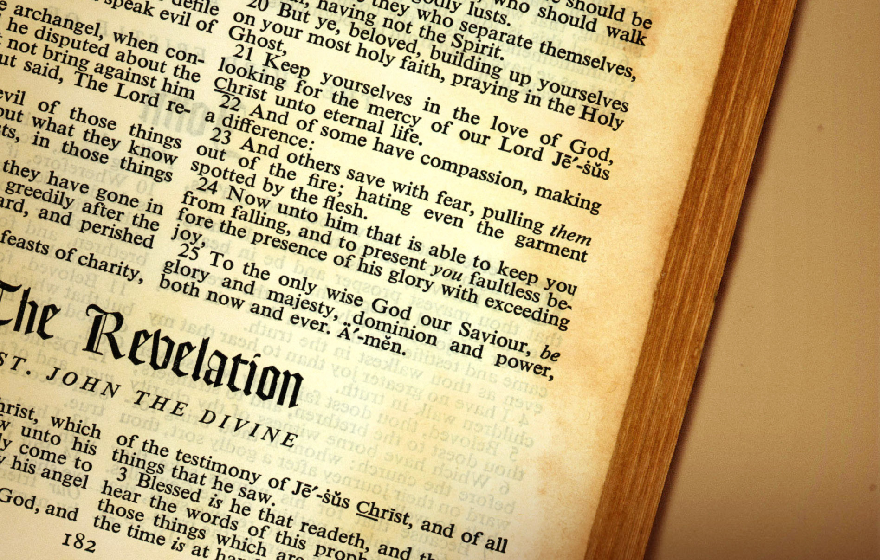
Revelation 4 – 24 Elders and 4 Living Creatures
Christian Hjortland

Slide 2

The 24 Elders
Revelation 4
White raiment – John 20:11, 12, Acts 1:10)
Job 38:4-7
Stars (Rev 12:3-5, 9)
Job 1:6-7, 2:1
“The Scriptures declare that upon one occasion, when the angels of God came to present themselves before the Lord, Satan came also among them (Job 1:6), not to bow before the Eternal King, but to further his own malicious designs against the righteous. With the same object he is in attendance when men assemble for the worship of God” - GC 519

Slide 3
The 24 Elders
Representation
UN
“There is the throne, and around it the rainbow of promise. There are cherubim and seraphim. The commanders of the angel hosts, the sons of God, the representatives of the unfallen worlds, are assembled. The heavenly council before which Lucifer had accused God and His Son, the representatives of those sinless realms over which Satan had thought to establish his dominion,--all are there to welcome the Redeemer. They are eager to celebrate His triumph and to glorify their King. {DA 834.1}

Slide 4
The 24 Elders
“And I wept much, because no man was found worthy to open and to read the book, neither to look thereon.And one of the elders saith unto me, Weep not: behold, the Lion of the tribe of Juda, the Root of David, hath prevailed to open the book, and to loose the seven seals thereof.” – Revelation 5:4-5
“His soul was wrought up to such a point of agony and suspense that one of the strong angels had compassion on him, and laying his hand on him assuringly, said, "Weep not: behold, the Lion of the tribe of Juda, the Root of David, hath prevailed to open the book, and to loose the seven seals thereof" [verse 5]. {12MR 296.4}
Revelation 7:13 – ST December 22, 1887

Slide 5
The 24 Elders
“And the devil said unto him, All this power will I give thee, and the glory of them: for that is delivered unto me; and to whomsoever I will I give it.”
Luke 4:6
“Now is the judgment of this world; now the ruler of this world will be cast out.”
- John 12:31

Slide 6
The 4 Living Creatures
Revelation 4:5-6
Universal
Ezekiel 1:5-6, 10:20-22
Revelation 4:7
Ezekiel 1:10
Lion, Calf, Face of a Man, Flying Eagle
“O Lord of hosts, God of Israel, that dwellest between the cherubims, thou art the God, even thou alone, of all the kingdoms of the earth: thou hast made heaven and earth.”
- Isaiah 37:16

Slide 7
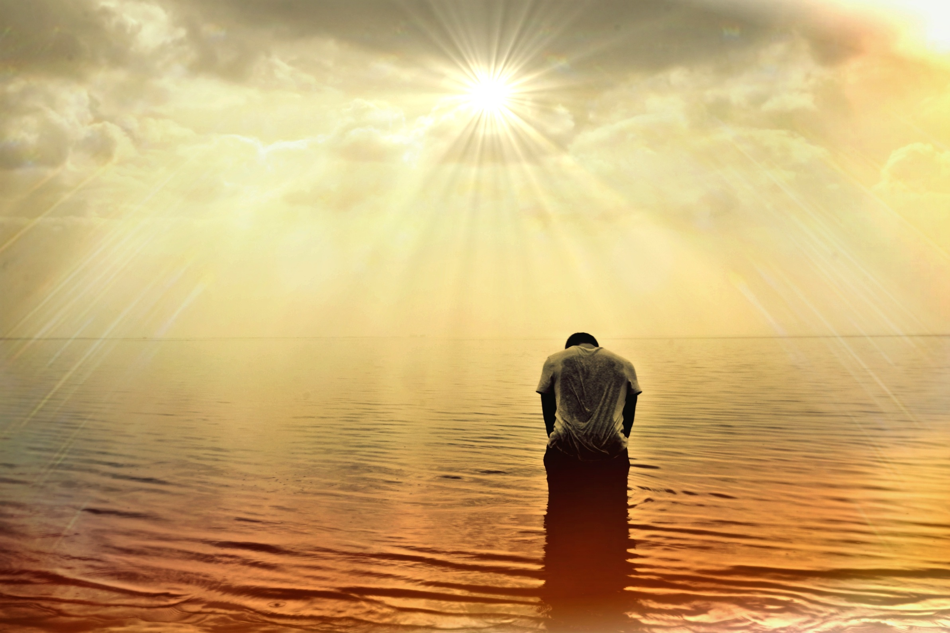
Revelation 4:8-11

Slide 8
Great and Marvelous
G D Em
Great and marvelous are thy works,
Am
Lord God Almighty;
G D G just and true are thy ways,
D
thou King of saints.
G D Em Who shall not fear thee, O Lord,
F
and glorify thy name?
G D G D Em For thou only art ho - ly: for all nations shall
B Em B
come and worship before thee;
C B for thy judgments are made manifest,
C B
for thy judgments are made manifest.
G D C G Great and marvelous are thy works.

