Slide 1
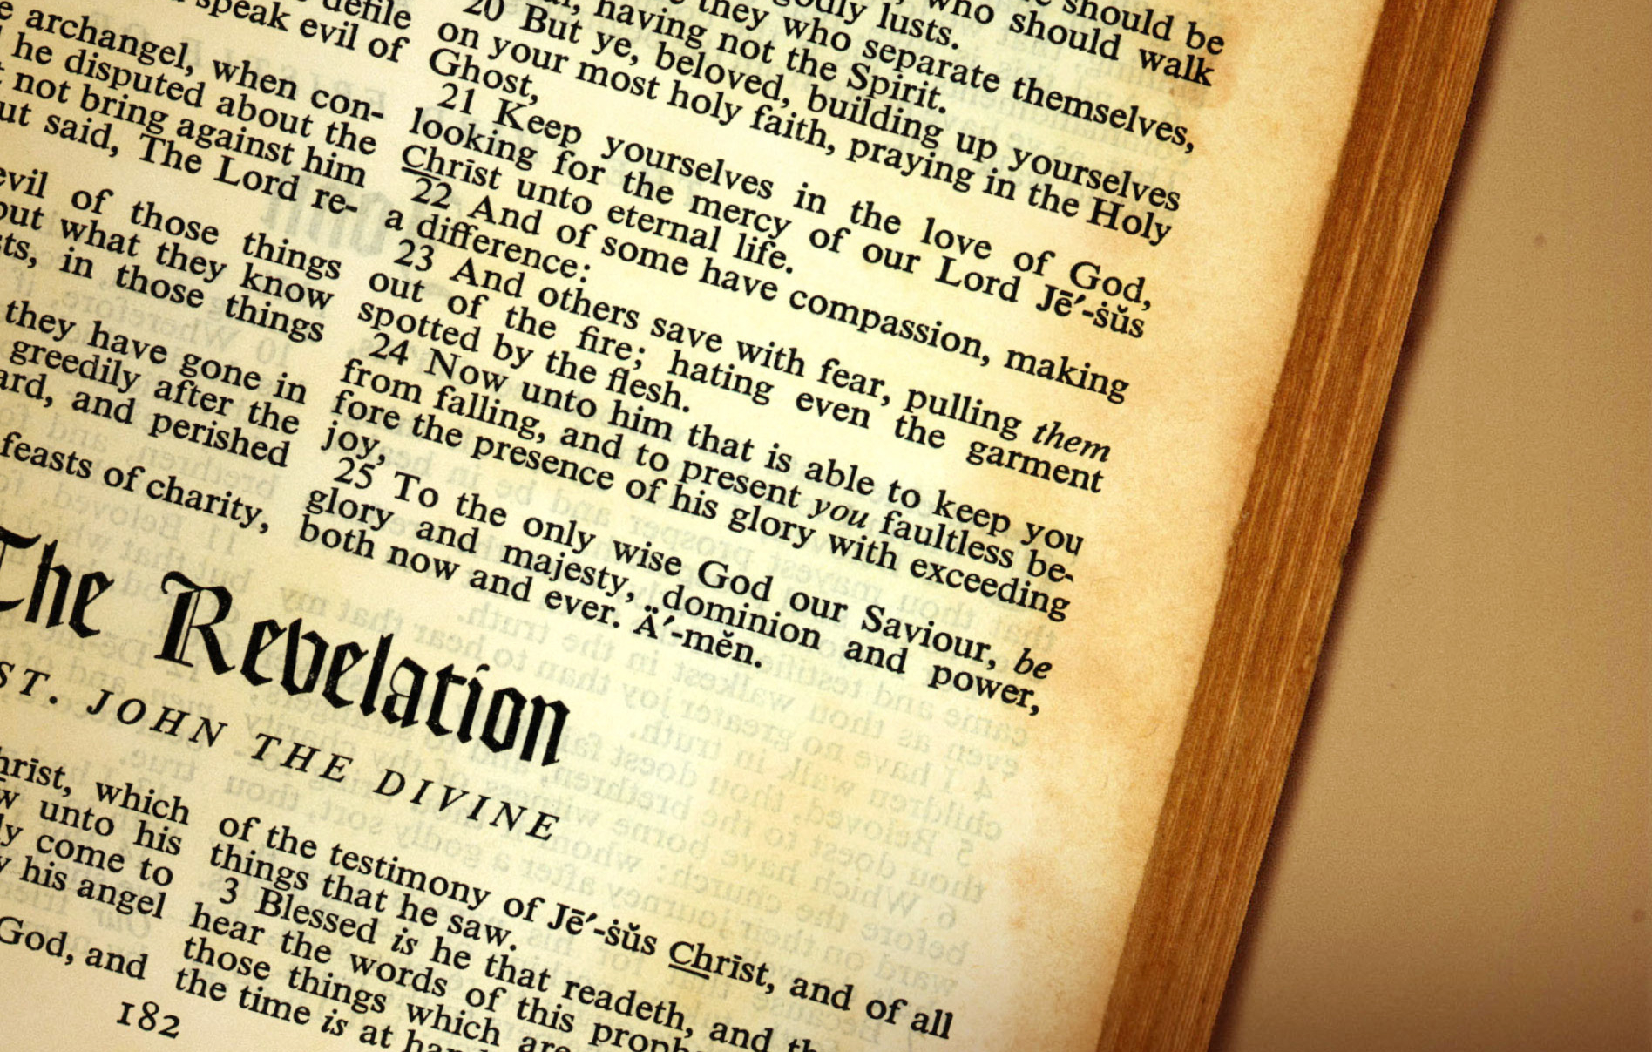
Revelation’s Seven Churches
Christian Hjortland

Slide 2
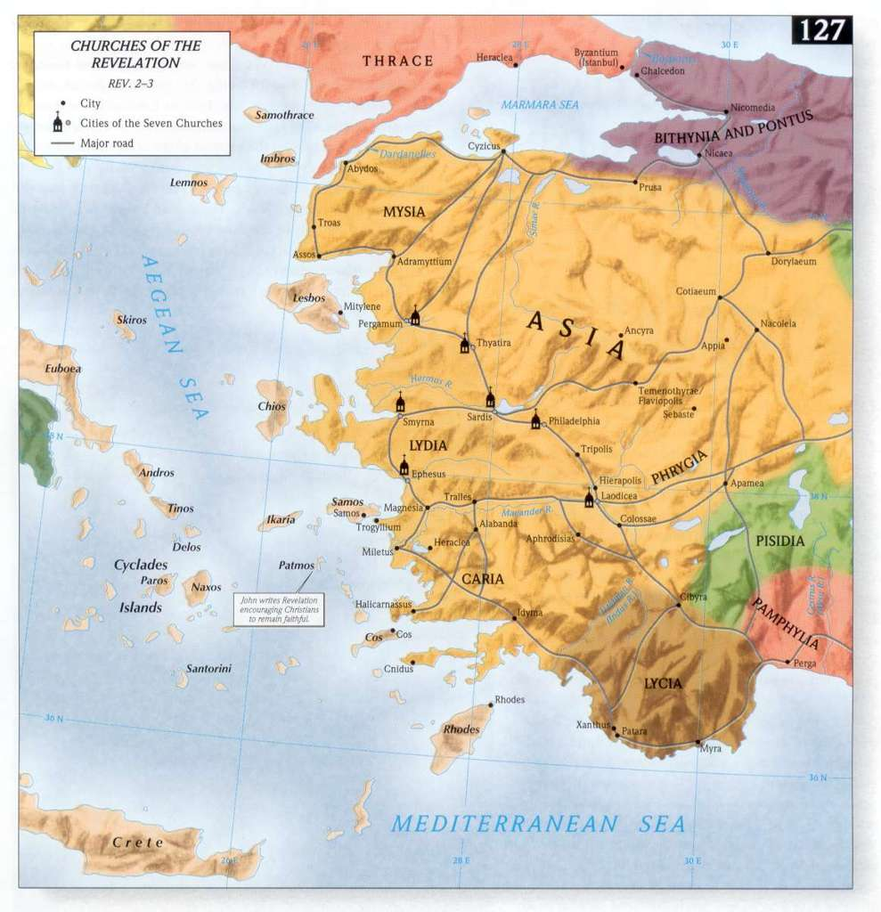


Slide 3
1. The Church of Ephesus (A.D. 31-100 – The Apostolic Period)
Meaning: Desirable
Paul’s missionary journeys (Acts 18-19)
Central location of the Christian World
Paul’s Warnings – Acts 20:29-30
What is the remedy?
God’s Patience – 2 Peter 3:9
Nicolaitans – Faith vs. works

Slide 4
1. The Church of Ephesus (A.D. 31-100 – The Apostolic Period)
“This church had been highly favored. It was planted by the apostle Paul. In the same city was the temple of Diana, which, in point of grandeur, was one of the marvels of the world. The Ephesian church met with great opposition, and some of the early Christians suffered persecution; and yet some of these very ones turned from the truths that had united them with Christ’s followers, and adopted, in their stead, the specious errors devised by Satan.
This change is represented as a spiritual fall. “Remember therefore from whence thou art fallen, and repent, and do the first works”—as outlined in the preceding verses. The believers did not sense their spiritual fall. They knew not that a change had taken place in their hearts, and that they would have to repent because of the noncontinuance of their first works. But God in His mercy called for repentance, for a return to their first love and to the works that are always the result of true, Christlike love” (Manuscript 11, 1906).

Slide 5

2. The Church of Smyrna (100-313 AD – The Age of Martyrdom)
Meaning: Sweet smelling
Great Persecution
Rome’s first official policy against Christianity
Spiritually rich
303-313 AD – An attempt to wipe out Christianity

Slide 6
3. The Church of Pergamos (313-538 AD – Age of Popularity)
Meaning: Height/Elevation
Capital twice
Satan’s Throne
  Cult of the emperor
  Worship of goddess
  Hellenistic
  Constantine’s conversion
Balaam and Balak (Numbers 25, 31) - leading Israel into idolatry

Slide 7
3. The Church of Pergamos (313-538 AD – Age of Popularity)
“Constantine labored at his time untiringly to unite the worshippers of the old and the new faith in one religion. All his laws and contrivances are aimed at promoting this amalgamation of religions. He would by all means melt together a purified heathenism and a moderate Christianity…His injunction that the “Day of the Sun” should be a general rest day was characteristic of his standpoint…Of all his blending and melting together of Christianity and heathenism, none is more easy to see through than this making of his Sunday law. The Christians worshipped their Christ, the heathen their sun god; according to the opinion of the Emperor, the objects for worship in both religions were essentially the same."
- Christian Edwardson, Facts of Faith (TEACH Inc., 2001).

Slide 8
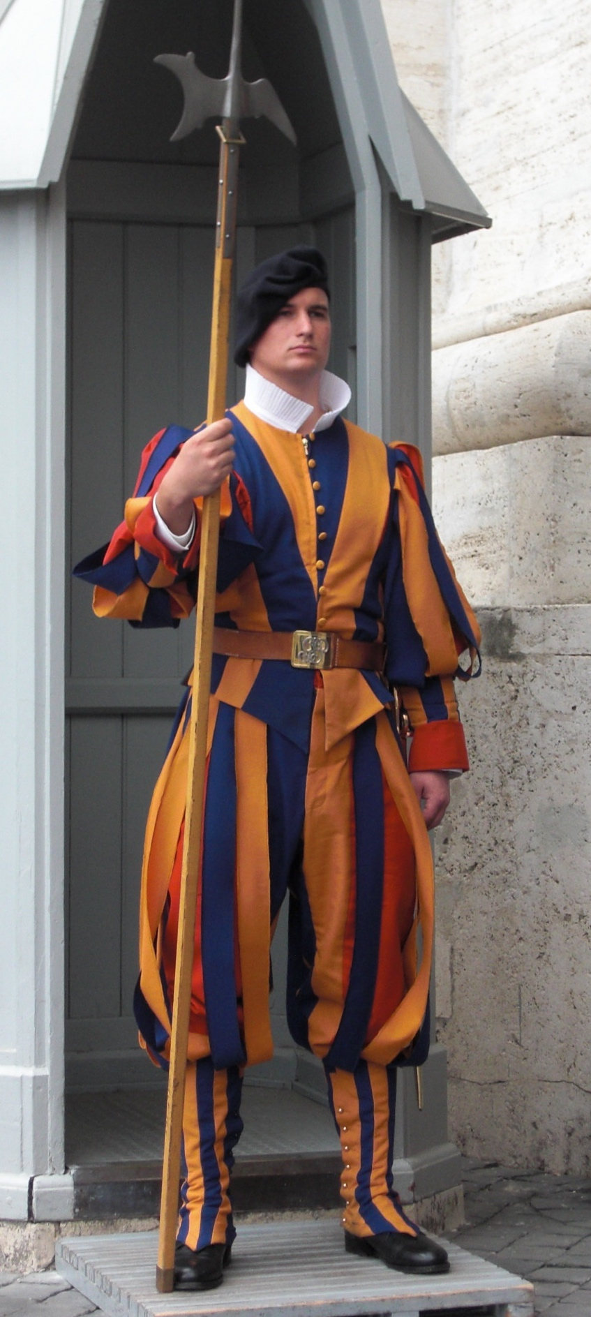
4. The Church of Thyatira (The Age of Adversity, 538-1517)
Meaning: Sacrifice of contrition
Bible vs. tradition
Jesus our Mediator
Waldenses
Jezebel pushing for idol worship.
3,5 years of persecution

Slide 9
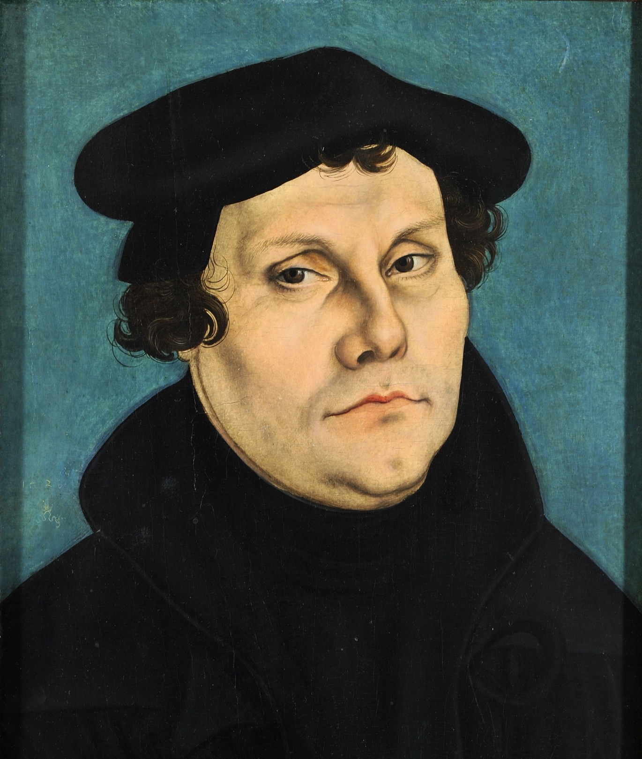
5. The Church of Sardis (1517-1700 – The Reformation)
Meaning: “That which remains” or “the escape of the remnant”
A focus on the later part
Dead
Name?

Slide 10

6. The Church of Philadelphia (1790-1844 – Advent Movement)
Meaning: Brotherly love
Key of David
Shut and open door
Patience

Slide 11
7. The Church of Laodicea (1844)
Meaning: Judging the people
The ancient city
Darwin’s theory of evolution
The dangers of being lukewarm
The Testing of faith (1 Pet 1:8, Job 23:10, Luke 3:16)
What is the antidote?

Slide 12
7. The Church of Laodicea (1844)
“I saw that many have so much rubbish piled up at the door of their heart that they cannot get the door open. Some have difficulties between themselves and their brethren to remove. Others have evil tempers, selfish covetousness, to remove before they can open the door. Others have rolled the world before the door of their heart, which bars the door. All this rubbish must be taken away, and then they can open the door and welcome the Saviour in....Oh, how precious was this promise, as it was shown to me in vision! "I will come in to him, and will sup with him, and he with Me." Oh, the love, the wondrous love of God! After all our lukewarmness and sins He says: "Return unto Me, and I will return unto thee, and will heal all thy backslidings." This was repeated by the angel a number of times. "Return unto Me, and I will return unto thee, and will heal all thy backslidings.” {1T 143.3}

Slide 13

The Promises of Jesus to the 7 Churches

Slide 14
Questions
How can we know that the letters to the seven Churches is a picture of Church history?
What can you personally learn from each of the seven Churches?
What is Laodicea's big problem?
Is there hope for Laodicea? If so, what?

