Slide 1
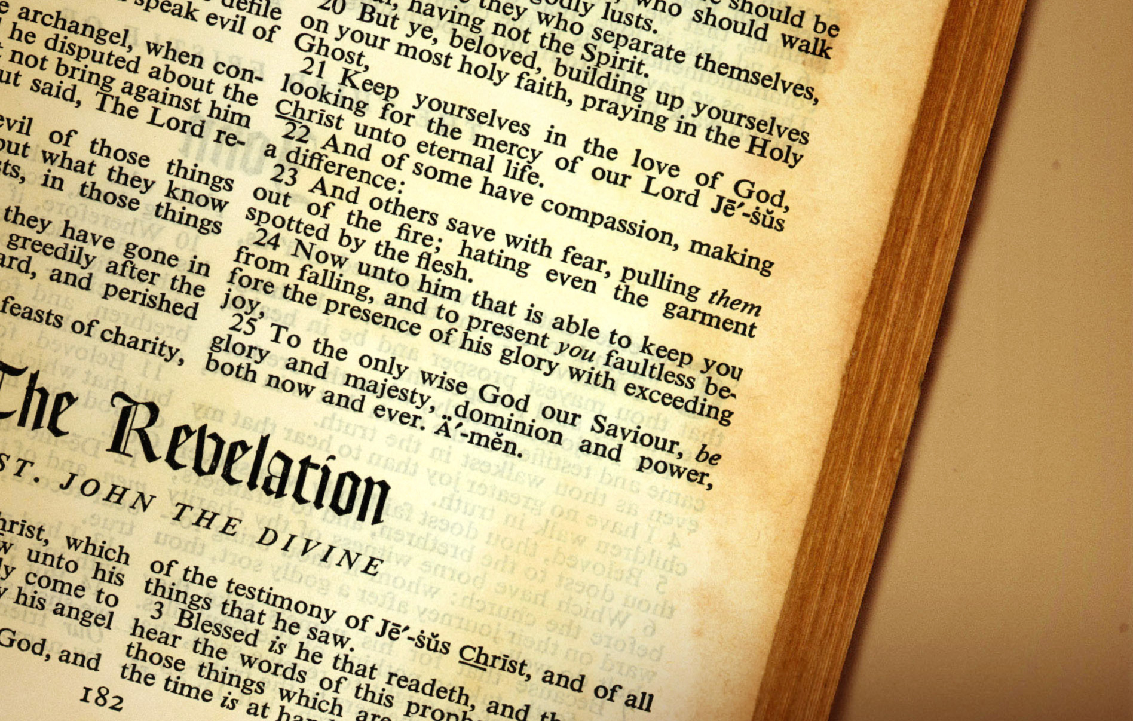
8 S’s of Revelation 1 – Mission and Message
Christian Hjortland

Slide 2
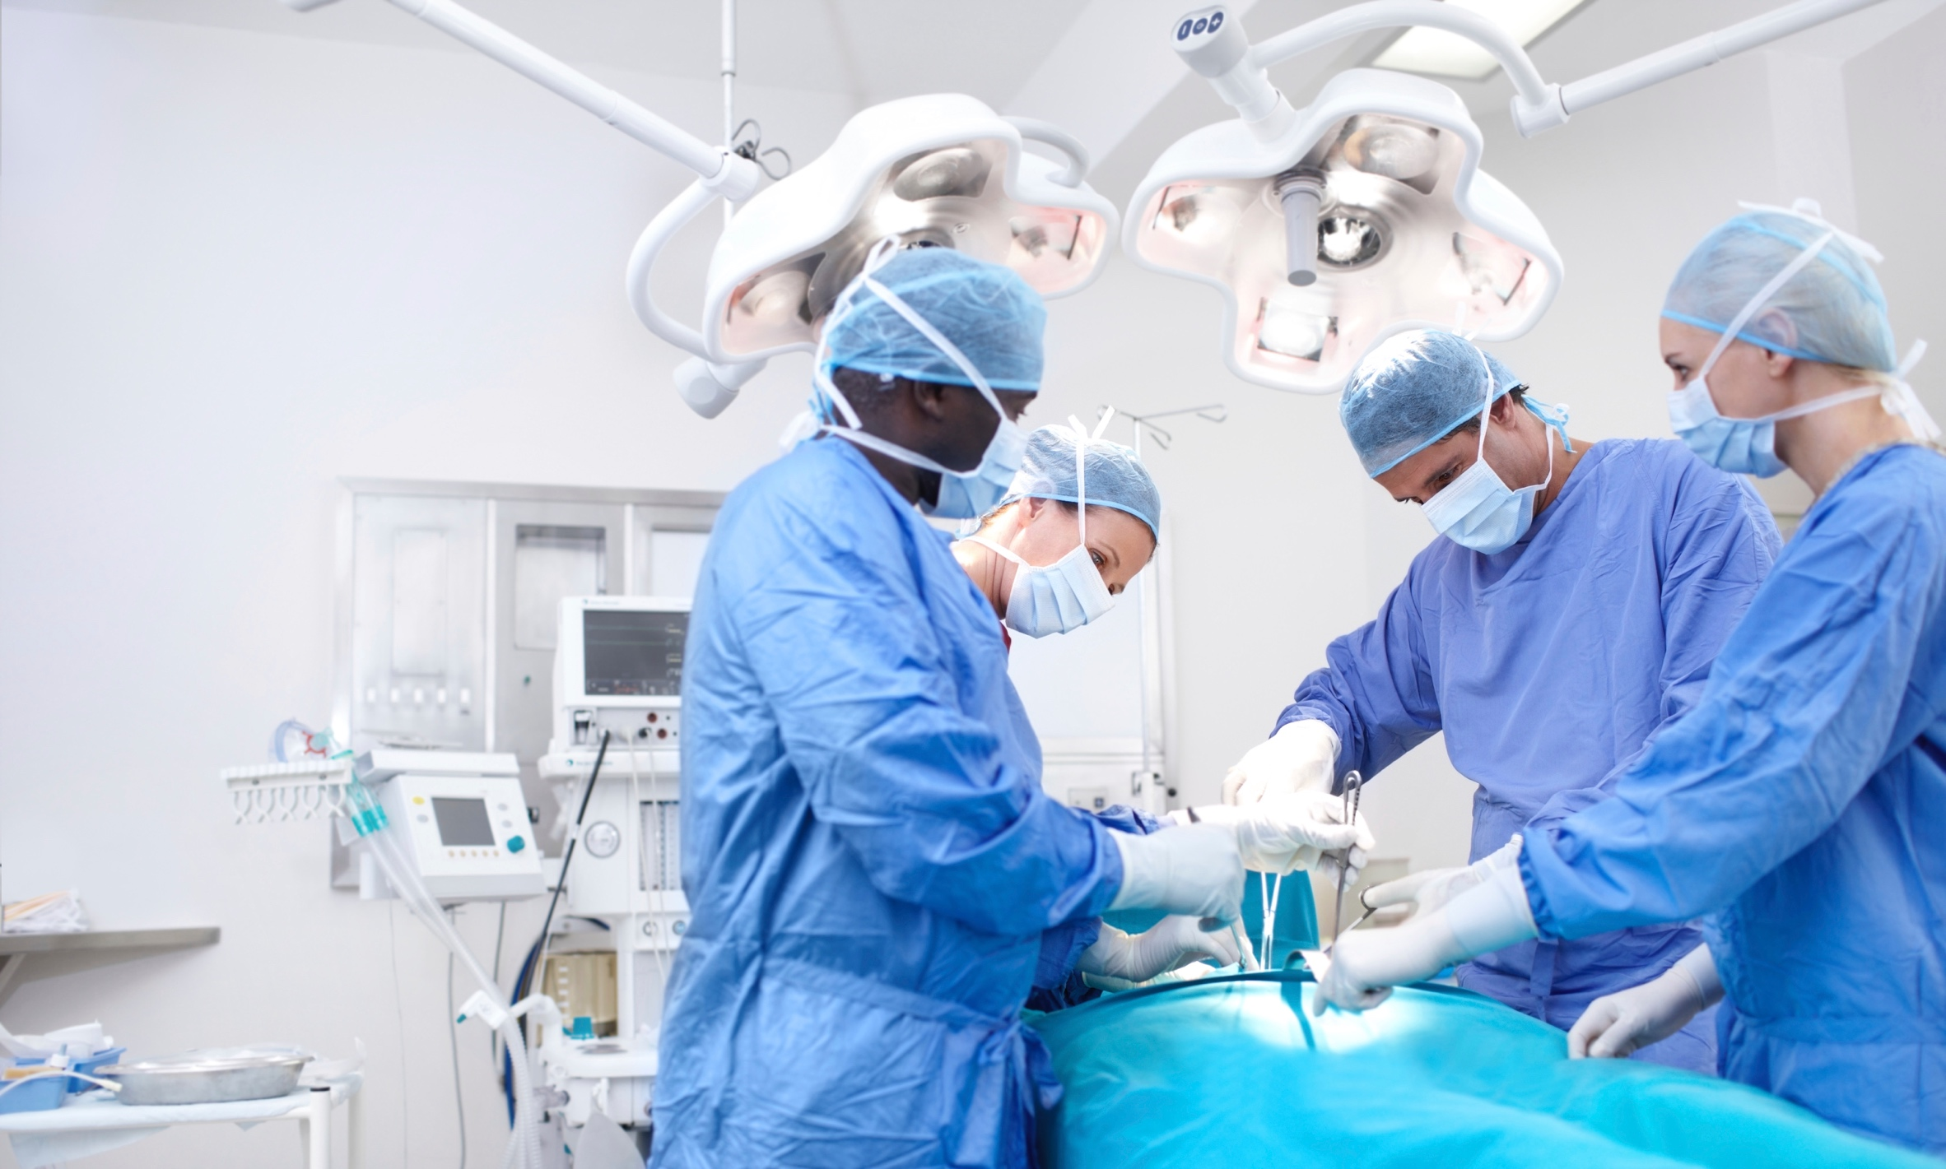

Revelation 1:1-3
The Scriptures
- Central pillar of our faith.
2 Timothy 3:16

Slide 3
Revelation 1:4-6
2. Salvation
88% of the world's population believe in God.(Cambridge University 2005)
Survey among Adventists:
63 percent say they have an 'intimate relationship with Christ.
34 percent study the Bible daily
33 percent have family worship
73 percent report they have assurance of eternal life. - Adventist Review
John 17:3

Slide 4
Salvation
“And this is life eternal, that they might know thee the only true God, and Jesus Christ, whom thou hast sent.” (John 17:3)
“While good works will not save even one soul, yet it is impossible for even one soul to be saved without good works.” {1SM 377.1}
“Religion does not consist in works, but religion works; it is not dormant. The pure religion of Jesus is the fountain from which flow streams of charity, love, self-sacrifice.... With the love of Christ in the heart, the lips will utter His praise and magnify His name. There will be a pressure upon the soul filled with Christ’s love...” {SD 271.2}
1 John 2:6

Slide 5
Revelation 1:7, 9-10
3. The Second Coming
Visible: “every eye shall see him”
Audible: 1 Thess 4:16-17, 2 Peter 3:9
Sudden: 2 Peter 3:10
4. The Sabbath
Matthew 12:8: For the Son of man is Lord even of the sabbath day.
A sign between God and His people (Ezekiel 20:12)

Slide 6
Revelation 1:12
5. The Sanctuary
Psalms 77:13
“Those who would share the benefits of the Saviour's mediation should permit nothing to interfere with their duty to perfect holiness in the fear of God. The precious hours, instead of being given to pleasure, to display, or to gain seeking, should be devoted to an earnest, prayerful study of the word of truth. The subject of the sanctuary and the investigative judgment should be clearly understood by the people of God. All need a knowledge for themselves of the position and work of their great High Priest. Otherwise it will be impossible for them to exercise the faith which is essential at this time or to occupy the position which God designs them to fill. Every individual has a soul to save or to lose. Each has a case pending at the bar of God. {GC 488.2}

Slide 7
The Sanctuary
“The intercession of Christ in man's behalf in the sanctuary above is as essential to the plan of salvation as was His death upon the cross.” {GC 489.1}
Dr Semmelweis - Autopsy

Slide 8
Revelation 1:17-18
6. The State of the Dead
Revelation 18:23b: ...for thy[Babylon] merchants were the great men of the earth; for by thy sorceries were all nations deceived.
Entertainment – Rom 1:28-32, Phil 4:8, Ps 101:3, Gal 5
Revelation 16:13-14
GC 588

Slide 9
Revelation 1:19
7. The Spirit of Prophecy
Revelation 12:17
“I am not aware of anyone who was more on point than Ellen White. Given her background, she is truly an amazing woman…I am convinced that almost 100% of her statements are now substantially supported by the scientific evidence that has been developed during the past 2-3 decades. What I have come to realize, to even deeply worry about, is why it is that this message of Ellen White and others has been so mislaid on shelves out of sight…It is abundantly clear to me that now is the time to bring this forward in whatever way that each of us are able to do.”
- Dr T. Colin Campbell

Slide 10
The Spirit of Prophecy
“The very last deception of Satan will be to make of none effect the testimony of the Spirit of God.” (2SM 78:2)
“Abundant light has been given to our people in these last days. Whether or not my life is spared, my writings will constantly speak, and their work will go forward as long as time shall last.” (3SM 76:4)
Proverbs 29:18: Where there is no vision, the people perish: but he that keepeth the law, happy is he.

Slide 11
Revelation 1:11, 20
8. The Saints – Church
1 Timothy 3:15: But if I tarry long, that thou mayest know how thou oughtest to behave thyself in the house of God, which is the church of the living God, the pillar and ground of the truth.
How is the church the pillar and ground of truth?
“During ages of spiritual darkness the church of God has been as a city set on a hill. From age to age, through successive generations, the pure doctrines of heaven have been unfolding within its borders. Enfeebled and defective as it may appear, the church is the one object upon which God bestows in a special sense His supreme regard. It is the theater of His grace, in which He delights to reveal His power to transform hearts. {AA 12.1}

Slide 12
The Purpose and Mission of the Church
“The church is God's appointed agency for the salvation of men. It was organized for service, and its mission is to carry the gospel to the world. From the beginning it has been God's plan that through His church shall be reflected to the world His fullness and His sufficiency. The members of the church, those whom He has called out of darkness into His marvelous light, are to show forth His glory. The church is the repository of the riches of the grace of Christ; and through the church will eventually be made manifest, even to "the principalities and powers in heavenly places," the final and full display of the love of God. Ephesians 3:10. {AA 9.1}

Slide 13
Christ’s Mission and Method
Ekklesia
Luke 19:10
Matthew 9:35
“Christ's method alone will give true success in reaching the people. The Saviour
mingled with men as one who
desired their good.
He showed His sympathy for them,
ministered to their needs,
and won their confidence.
Then He bade them, "Follow Me." {MH 143.3}

Slide 14
The Church’s Mission and Method
Acts 2:47b: And the Lord added to the church daily those who were being saved.
“Preaching is a small part of the work to be done for the salvation of souls. God's Spirit convicts sinners of the truth, and He places them in the arms of the church. The ministers may do their part, but they can never perform the work that the church should do. God requires His church to nurse those who are young in faith and experience, to go to them, not for the purpose of gossiping with them, but to pray, to speak unto them words that are "like apples of gold in pictures of silver." {Ev 352.1}

Slide 15
The Church’s Mission and Method
Acts 4:9-12
Physical healing
Salvation
“God's purpose in committing to men and women the mission that He committed to Christ is to disentangle His followers from all worldly policy and to give them a work identical with the work that Christ did.”--MS. 130, 1902. {MM 24.5}
“The health reform is one branch of the great work which is to fit a people for the coming of the Lord. It is as closely connected with the third angel's message as the hand is with the body.” {CH 20.3}

Slide 16
The Church’s Mission and Method
“Hanging upon the cross Christ was the gospel. Now we have a message, "Behold the Lamb of God, which taketh away the sins of the world." Will not our church members keep their eyes fixed on a crucified and risen Saviour, in whom their hopes of eternal life are centered? This is our message, our argument, our doctrine, our warning to the impenitent, our encouragement for the sorrowing, the hope for every believer....They thus receive their lesson. Whosoever will come after Me, let him deny himself, and take up his cross, and follow Me. He whose eyes are fixed on Jesus will leave all. He will die to selfishness. He will believe in all the Word of God, which is so gloriously and wonderfully exalted in Christ. {21MR 37.1}

Slide 17
Questions
1. What can we do, to see more unity in our church, without compromising on doctrines?
2. How can you in your ministry for God combine medical missionary work with the gospel?

