Slide 1
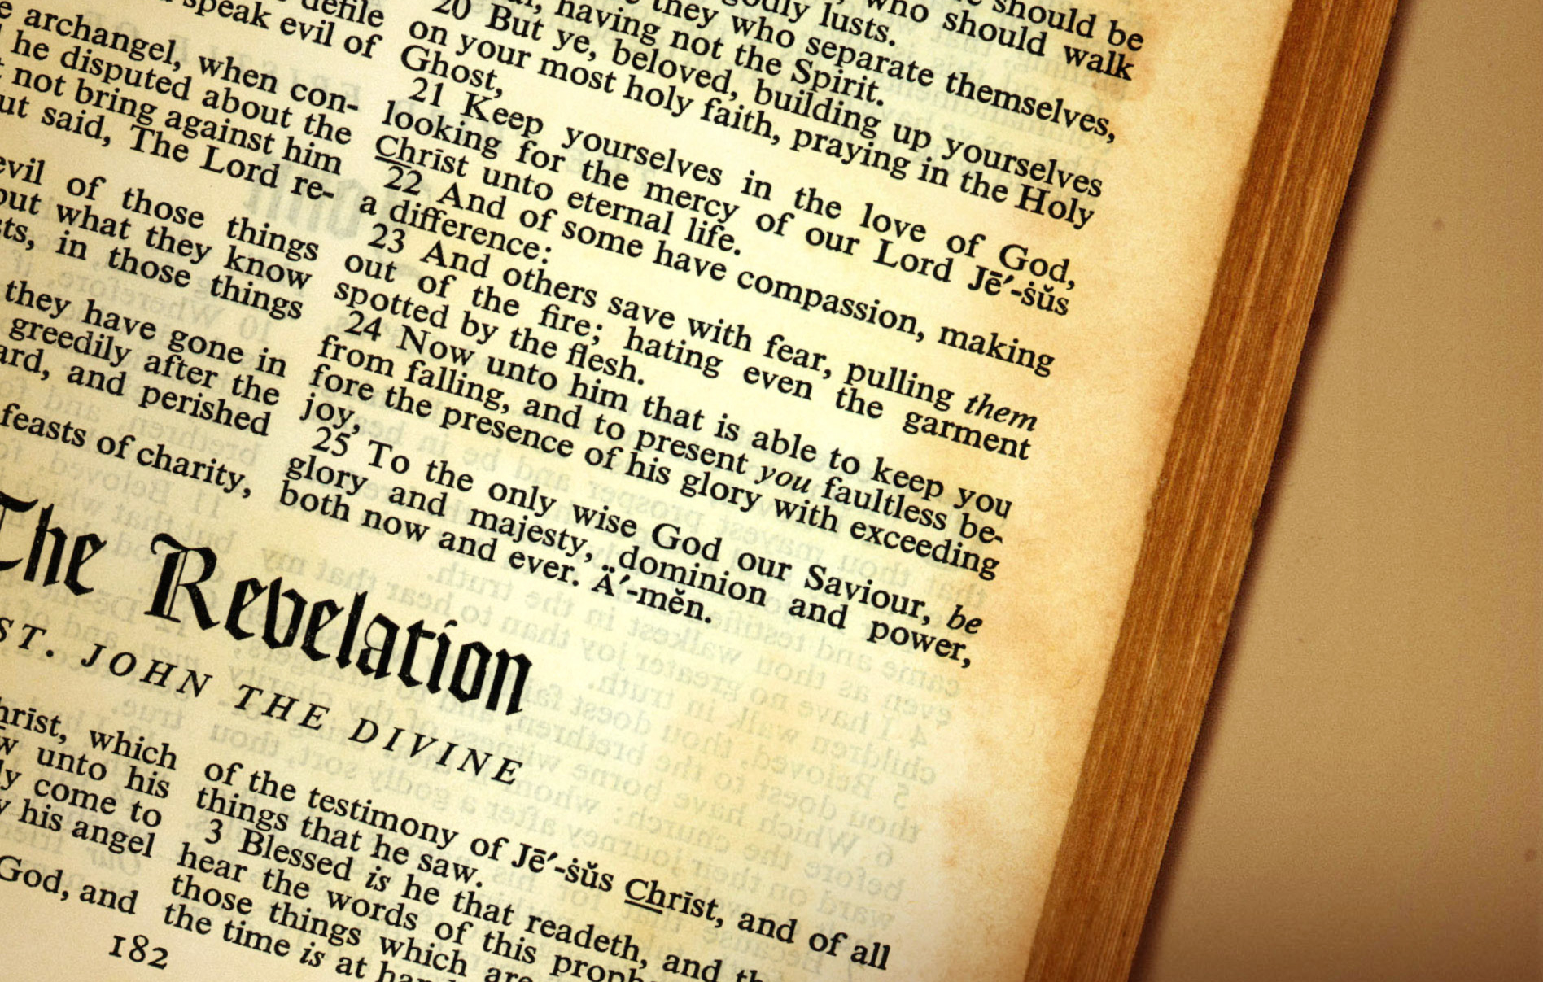
Revelation Introduction
Christian Hjortland

Slide 2

Blessed is he that reads...
“Blessed is he that readeth, and they that hear the words of this prophecy, and keep those things which are written therein: for the time is at hand.”
Revelation 1:3
Author: John.
Written at Patmos
Keys to understand: OT+NT
Daniel 2, 7, 8, 11 – a continuation
Illustration: Bartek Ambrozik

Slide 3
Historical context
“The rulers of the Jews were filled with bitter hatred against John for his unwavering fidelity to the cause of Christ....John was accordingly summoned to Rome to be tried for his faith. Here before the authorities the apostle's doctrines were misstated... John answered for himself in a clear and convincing manner, and with such simplicity and candor that his words had a powerful effect. His hearers were astonished at his wisdom and eloquence. But the more convincing his testimony, the deeper was the hatred of his opposers.... John was cast into a caldron of boiling oil; but the Lord preserved the life of His faithful servant, even as He preserved the three Hebrews in the fiery furnace.”{AA 569-570}

Slide 4
Historical context
“...By the emperor's decree John was banished to the Isle of Patmos, condemned "for the word of God, and for the testimony of Jesus Christ." Revelation 1:9. Here, his enemies thought, his influence would no longer be felt, and he must finally die of hardship and distress. Patmos, a barren, rocky island in the Aegean Sea, had been chosen by the Roman government as a place of banishment for criminals; but to the servant of God this gloomy abode became the gate of heaven. {AA 570}

Slide 5
Structure and Background
Two main parts of the book:
1. Historical
1:1-8 – Prologue
1:10-3:22 – 7 Churches
4:1-8:1 – 7 Seals
8:2-11:18 – 7 Trumpets
11:19-14:20 – Great Controversy
2. Eschatological
15:1-16:21 – 7 Last Plagues
17:1-19:10 – Fall of Babylon
19:11-21:8 – The Millennium
21:9-22:9 – The New Jerusalem
22:10-17 – Epilogue
Understanding Revelation
Is it sealed?
Rev 22:10
When is the end time?
- Daniel 12:4-7.
Little book.
- “Knowledge shall increase”.
Connection with Old Testament
Out of 404 verses, 276 of them are taken from stories and prophecies in the Old Testament.

Slide 6
How shall it be treated?
“The book of Revelation opens to the world what has been, what is, and what is to come; it is for our instruction upon whom the ends of the world are come. It should be studied with reverential awe. We are privileged in knowing what is for our learning. But do we treat the word of God with the reverence which is his due, and with the gratitude which God would be pleased to see? "All Scripture is given by inspiration of God, and is profitable for doctrine, for reproof, for correction, for instruction in righteousness: that the man of God may be perfect, thoroughly furnished unto all good works."
{RH, August 31, 1897 par. 4}

Slide 7
Symbols, Numbers and Focus
Number seven – perfection/completeness. Genesis 2:1-4, Psalms 119:164, Exodus 20:8-11.
Seven churches, seals and trumpets
7 Beatitudes of Revelation: 1:3, 14:13, 16:15, 19:9, 20:6, 22:7, 22:14
Jesus in the Book of Revelation
Who is it revealing?
To whom is it written?
OT, gospels, Revelation
Photo: Mikhail Lavrenov

Slide 8
A focus on Jesus
“The prophecies of Daniel and Revelation should be carefully studied and in connection with them the words “Behold the Lamb of God which takes away the sin of the world.” John 1:29
(GW 148)
John 1:14
- skenoo
Rev 1:17- Johns reaction

Slide 9
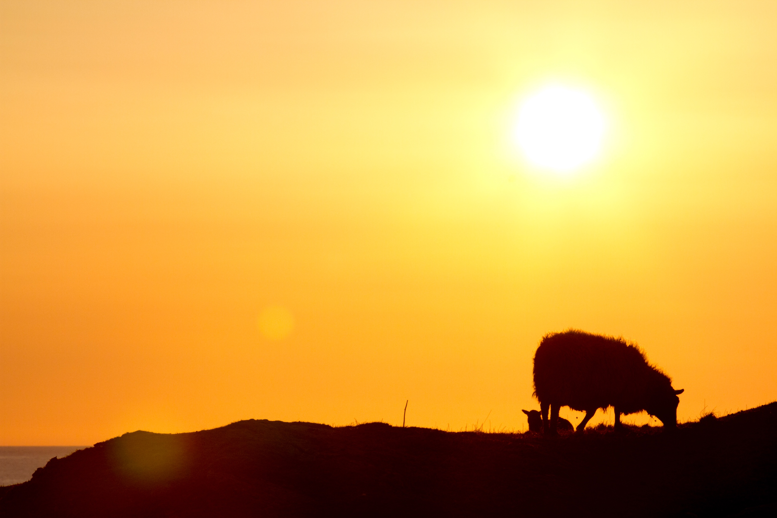
What did Jesus sacrifice?

Slide 10
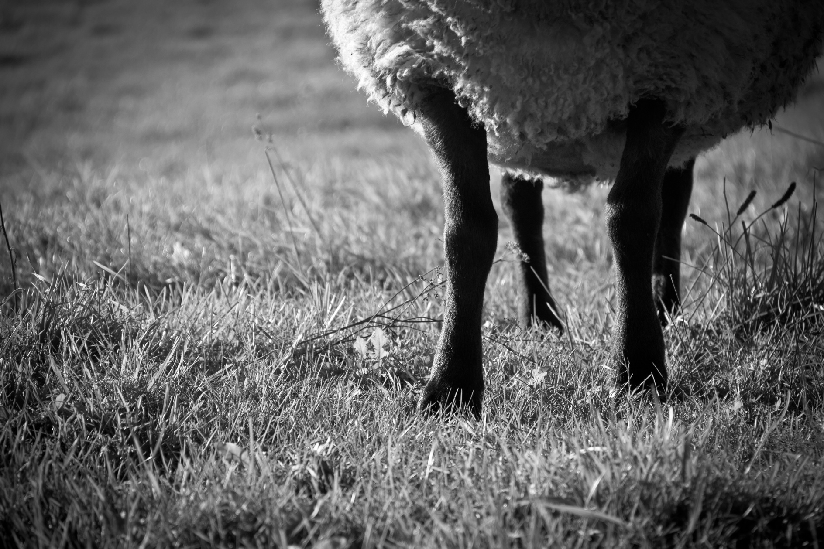
Jesus Sacrifice
Honor and glory Rev 13:8
Earthly Resources and Interests Luke 2:48, Matt 4:1-4, 8:11
Time Matt 4:18-23 Matt 14:13-14
Life

