Slide 1
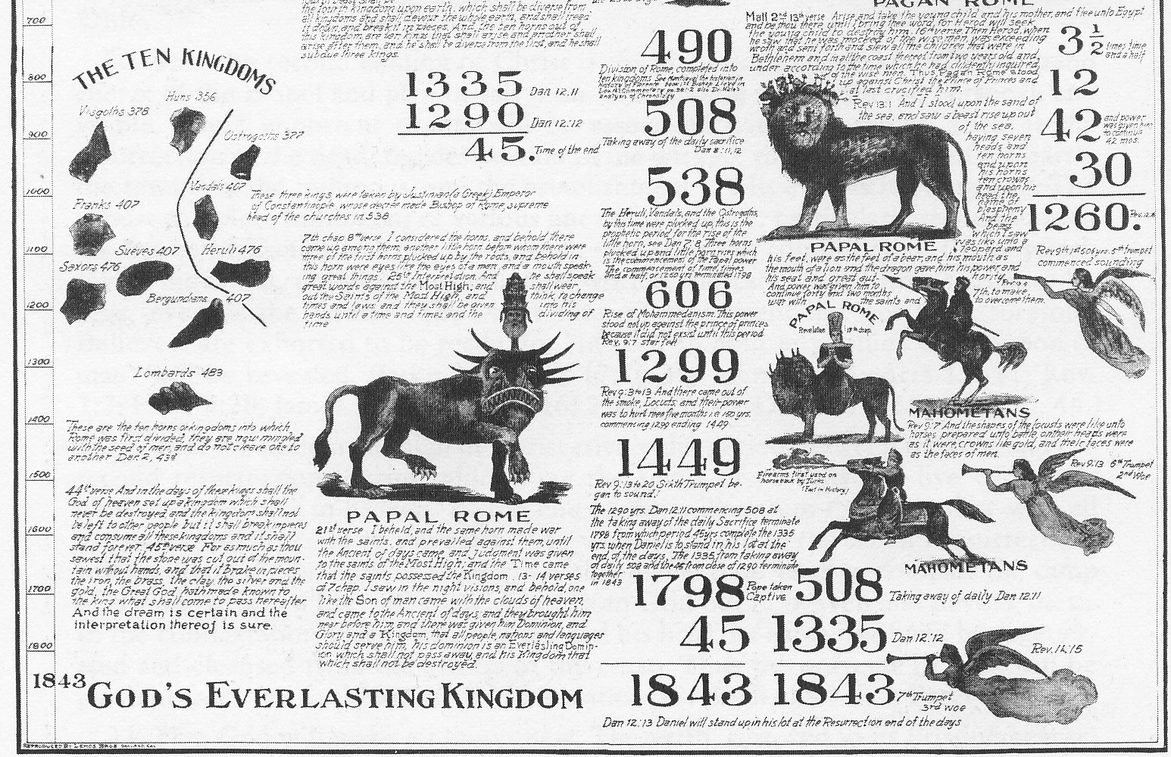
7 Reasons to Study Prophecy
Christian Hjortland

Slide 2


Slide 3


1. To understand God's plan and that He is in control
”Surely the Lord God does nothing, unless He reveals His secret to His servants the prophets.”
Amos 3:7

Slide 4

2. It will increase our faith
”And now I have told you before it come to pass, that, when it is come to pass, ye might believe.”
John 14:29
Luke 24:27,32
1/3 of the BIble

Slide 5

3. So that God can save us and make us prosper
Jonah 1-2, 3:3-5,10
(Jer 18:8-10)
Matthew 24
2 Timothy 3:15
2 Chron 20:20

Slide 6
3. So that God can save us and make us prosper
"When the books of Daniel and Revelation are better understood, believers will have an entirely different religious experience. They will be given such glimpses of the open gates of heaven that heart and mind will be impressed with the character that all must develop in order to realize the blessedness which is to be the reward of the pure in heart."
- Testimonies to Ministers, p. 114.

Slide 7
4. Jesus encourages us to study it
”When ye therefore shall see the abomination of desolation, spoken of by Daniel the prophet, stand in the holy place, (whoso readeth, let him understand)
Matthew 24:15
”Behold, I come quickly: blessed is he that keepeth the sayings of the prophecy of this book.”
Revelation 22:7

Slide 8
5. To be able to finish our mission
“…We have a special work to do to prepare the people for the greatest event the world has ever seen. The books of Daniel and Revelation are of great consequence to us, and should be studied with great earnestness.”
- Review and Herald, June 21, 1898

Slide 9
6. To get to know Jesus
Jesus appears in Prophecy.
2 Peter 1:19
Luke 24:27
“Ministers should present the sure word of prophecy as the foundation of the faith of Seventh-day Adventists. The prophecies of Daniel and the Revelation should be carefully studied, and in connection with them the words, “Behold the Lamb of God, which taketh away the sin of the world.” [John 1:29.]” {GW 148.1}

Slide 10

7. Believe that Jesus is coming soon
Ellen White's first vision.
2 Peter 3:3-4
Photo: Joiseyshowa

Slide 11
7 Reasons Why we Need to Study Prophecy
1. To understand God's plan and that He is in control
2. It will increase our faith
3. So that God can save us and make us prosper
4. Jesus encourages us to study it
5. To be able to finish our mission
6. To get to know Jesus
7. Believe that Jesus is coming soon

